Slide 1
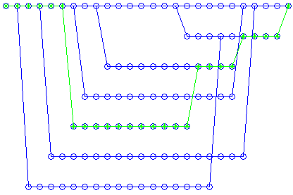
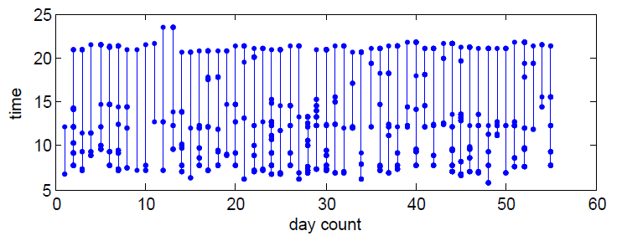
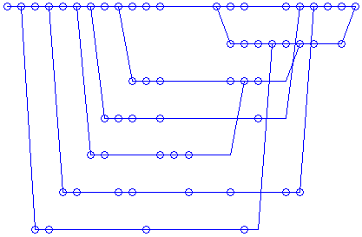
Hidden Markov Model and Split-Merge Algorithm for Project ATTEND
AdapTive scenario recogniTion for Emergency and Need Detection
Abstract:
Within the scope of the project ATTEND a system will be developed that increases the time frame of independent living of elderly persons in their used living environment. The system comprises an intelligent, adaptive network of sensors, which are to be installed in the living environment of the user in order to thoroughly observe his behavior. An important aspect is that the sensors shall work independent and in a preferably invisible fashion.
ATTEND learns about normal behavior of the user. In case of unusual behavior an alarm plan can be worked out (e. g. enquiring the user, calling a neighbor, calling an external organization). The system is intended to increase comfort, security and social inclusion of the customer and ideally also help with the early detection of upcoming medical problems. In case of an emergency the system can contact primary and secondary users (family, neighbor, care giver) via external interfaces.
Features:
Intelligent, adaptive network of sensors; No camaras, No microphones, No sensors to be worn on the body; Nothing should be activated by the user; Observation of elderly persons’ daily routine; Situation and scenario recognition; Sending alarm to caregiver in case of emergency; Protection of privacy; Increasing comfort and security
Contents:
Sensor Fusion; Situation and Scenario Recognition; Combine Sensor Fusion and Situation and Scenario Recognition
Research Results :
Data from a door contact sensor at the medicine cabinet. X axis is day count (there are about 440 data points in the data set ). Y axis is the time in each day.
Project ATTEND Contents:
Situation and Scenario Recognition: based on hierarchic symbolic abstraction and detection methods to detect the most important situations of elderly persons’ daily routine in a robust way. Developing a fast and reliable learning algorithm, modeling the “normal” behavior of the elderly person with several typical daily routines.
Sensor Fusion: process the sensor data and use the data to build the behavior model of elderly people. The data should be as complete as possible with a few selected sensors.
Combine Situation and Scenario Recognition and Sensor Fusion : for more robust and completely situation and scenario recognition sensor fusion will be used in a high level. It combines recognition results from different sensors (and these sensors installed in different location) together. So the behavior model of the user in different locations in the living environment will be formed a whole model system.
Same data as above, aggregated in histograms (blue) and the learning result showed in green curve. Most important clusters have been found with mean value, standard deviation and percent value for each cluster.
Motion detector data used to model scenarios of user behavior. The top figure shows a model of the state data of 7 days, while the bottom figure shows the same model after state merging procedures. The goal of the algorithms is to provide a compact model of human daily routines. With the help of HMM algorithms, best matches for actual behaviors and learned prototypes can be found
Project Supported by:
FFG-Austria Research Promotion Agency
www.ffg.at
Dr. Gerda Geyer
Project Implementation:
ICT- Institute of Computer Technology
Vienna University of Technology
https://www.ict.tuwien.ac.at/ict/
Uni. Ass. Dipl. –Ing. Dr. techn Dietmar Bruckner
bruckner@ict.tuwien.ac.at
Dipl. –Ing GuoQing Yin
yin@ict.tuwien.ac.at

