Slide 1
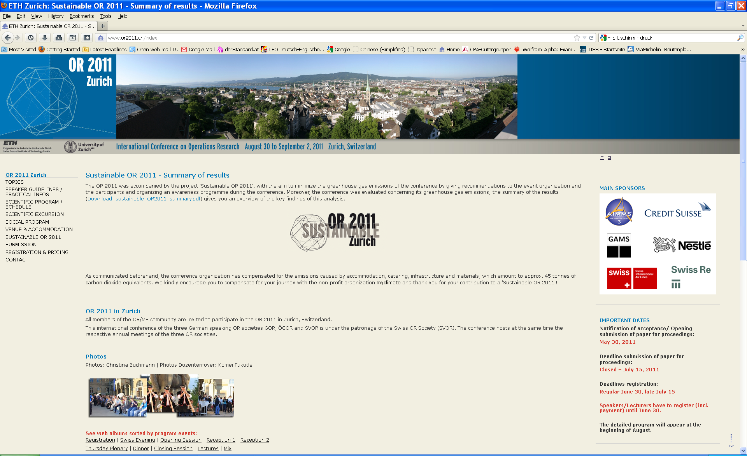

Slide 2
Assessing embedded energy with
Input-Output Analysis
…understanding energy demand from a consumption perspective

Slide 3
Content
Introduction and objectives
Input-Output methodology
Results for Austria
Further steps

Slide 4
Definition
„Embedded energy is the commercial energy that was used in the work to make any product, bring it to the market and dispose of it“

Slide 5
Introduction and Objectives
Consumption based and product oriented view
Total demand for energy can be traced back to the consumption of goods and services
Understanding drivers from a consumption perspective
Identifying reduction potentials for emissions

Slide 6
Introduction and Objectives
What is the energy requirement for the consumption of goods and services?

Slide 7
Introduction and Objectives
Literature:
- Miller Ronald E., Blair Peter D.(2009): Input-Output Analysis – Foundations and Extensions; Cambridge University Press; Cambridge
Manfred Lenzen, University of Sydney
Tukker Arnold et al (2006): Environmental Impact of Products – Analysis of the life cycle environmental impacts related to the final consumption oft he EU-25, Main report; Joint Research Centre; European Commission
Bednar-Friedl Birgit, Munoz Jaramillo Pablo, Schinko Thomas, Steininger Karl (2010): The Carbon Content of Austrian Trade Flows in the European and International Trade Context; FIW Research Reports 2009/2010 N°5

Slide 8
Input Output model
Output
Domestic economy
Input
 | Sector 1 | Sector 2 | Sector 3 | Demand | Total Output
Sector 1 | Zd | Zd | Zd | Yd | X
Sector 2 | Zd | Zd | Zd | Yd | X
Sector 3 | Zd | Zd | Zd | Yd | X
Wage | L | L | L
Profit | N | N | N
Total Output | X | X | X

Slide 9
Input Output model
Output
Domestic economy
Input
 | Sector 1 | Sector 2 | Sector 3 | Demand | Total Output
Sector 1 | Zd | Zd | Zd | Yd | X
Sector 2 | Zd | Zd | Zd | Yd | X
Sector 3 | Zd | Zd | Zd | Yd | X
Wage | L | L | L
Profit | N | N | N
Total Output | X | X | X
Imports from Rest of the World to domestic economy.
 | Sector 1 | Sector 2 | Sector 3 | Demand | Total Imports
Sector 1 | Zi | Zi | Zi | Yi | M
Sector 2 | Zi | Zi | Zi | Yi | M
Sector 3 | Zi | Zi | Zi | Yi | M
ROW - economy
 | Sector 1 | Sector 2 | Sector 3 | Demand | Total Output
Sector 1 | Zf | Zf | Zf | Yf | Xf
Sector 2 | Zf | Zf | Zf | Yf | Xf
Sector 3 | Zf | Zf | Zf | Yf | Xf
Wage | Lf | Lf | Lf
Profit | Nf | Nf | Nf
Total Output | Xf | Xf | Xf

Slide 10
Input Output model
domestic production imported intermediates imported final goods

Slide 11
Results for Austria
Embedded energy in final demand components
Embedded vs. Direct energy use of private consumption
Product groups and composition of Embedded Energy
Change in private consumption spending

Slide 12
Results for Austria

Slide 13
Direct vs. Embedded Energy

Slide 14
Direct vs. Embedded Energy
Notes:
We see that the share of embedded energy was rising in last years, while dircet energy fell by 1.3% from 2000 to 2007, embedded energy in products consumed by household increased by 27.5% percent…… there could be various reasons for this instance that still have to be analysed…. One explanation would be that household appliances became more efficient, it would also be possible that household are more aware of their direct energy consumption….. Another approach to explain the higher share of embedded energy could be a different life style…. if people tend to eat in restaurants more often than in the year 2000 this would lead to lower figures in direct energy consumption of households and higher consumption of embedded energy in the form of hotel and restaurant services. Those effects can usually not be analysed using common energy statistics but they are important to understand the drivers of energy demand

Slide 15
Direct vs. Embedded Energy
Notes:
Looking at total energy consumption of private consumption, which is here simply the sum of embedded and dircet energy we can see that austrians use around 30000 kWh per year…. This number has been pretty constant from 2005 to 2007 and was even going down in 2007. However if we would assume Austrian consumption levels for the world population we would face a final energy demand of 200000TWh a year which is around 40% higher than the primary energy demand in 2008. total primary energy demand would be much higher as conversion losses are not considered and we do not look at all economic activity of Austria because we concentrate on private consumption only which excludes government spending and investments…
So I would say that it is pretty obvious that we are consuming too much…

Slide 16
Results for Austria
Includes intermediate goods:
construction work
sewage and disposal services
water distribution
Notes:
Just taken some sample product groups to illustrate the distribution…. Time is to short to go into detail here…..
Real estate services quite high…. This is the embedded energy of renting and owning appartments…. Includes intermediate goods like construction work, water distribution or sewage and refuse disposal services…
We also see quite high figures for health and social work services…. Those figures would be much higher if we included government spending on this product group…. This is also true for education services…. Including government spending on those two services would add another 1000kWh per year on consumers embedded energy.
a
Most in food and beverages, hotel and restaurant services,
Energy services are excluded, also coke and refined petroleum,

Slide 17
Results
Range from 0.2 to 4.9 kWh/€
Variance in energy intensities decreases – Ratio of 90% and 10% quantil is 11 vs. 18
Some services demand energy intensive intermediate goods
Notes:
Intensities higher… more products invovled, order is not the same – services that demand intensive intermediate goods show higher intensity… real estate – construction work, difference is not that big as in intensity of sectors.

Slide 18
Example: Sector insurance and pension funding
Results for Austria
Intensity form sector data:
0.016 kWh/€
Energy intensity of consumption: 0.32 kWh/€

Slide 19
Results for Austria

Slide 20
Changing consumption patterns and energy demand
10% leeway leads to 6.5% reduction in embedded energy of private consumption
Total output of sectors change less than p
Construction work and related sectors hardly affected

Slide 21
Further research steps
Process analysis for relevant products
Assessing reduction potentials along the process chain and related costs
Translate major changes in process chains into new input coefficients to assess economic effects of measures to reduce energy demand
Hybrid model for embedded energy

Slide 22
Thanks for your attention!!!
Contact: hartner@eeg.tuwien.ac.at

