Slide 1
Linked Open Data for Business Oriented Applications
A Min Tjoa
Institute of Software Technology and Interactive Systems
Vienna University of Technology – Austria
http://www.ifs.tuwien.ac.at
November 2013

Slide 2
What is Linked Data?
The term Linked Data refers to a set of best practices for publishing and connecting structured data on the Web.
Rules for publishing data on the web
  Use URIs to identify things.
  Use HTTP URIs so that these things can be referred to and looked up ("dereferenced") by people and user agents.
  Provide useful information about the thing when its URI is dereferenced, using standard formats such as RDF/XML.
  Include links to other, related URIs in the exposed data to improve discovery of other related information on the Web.
Bizer, Christian; Heath, Tom; Berners-Lee, Tim (2009). "Linked Data—The Story So Far". International Journal on Semantic Web and Information Systems 5 (3): 1-22. DOI:10.4018/jswis.2009081901. ISSN 15526283. Retrieved 2010-12-18.

Slide 3
Why Linked Data?
Information integration from different sources, (mashing data) is often too time-consuming and too costly
  databases are still seen as „silos”, and people often do not want others to touch the database for which they are responsible
  data is still locked up in certain applications
Notes:
This way of thinking is based on some assumptions from the 1970s: that only a handful of experts are able to deal with databases and that only the IT department’s inner circle is able to understand the schema and the meaning of the data. This is obsolete. In today’s internet age, millions of developers are able to build valuable applications whenever they get interesting data.

Slide 4
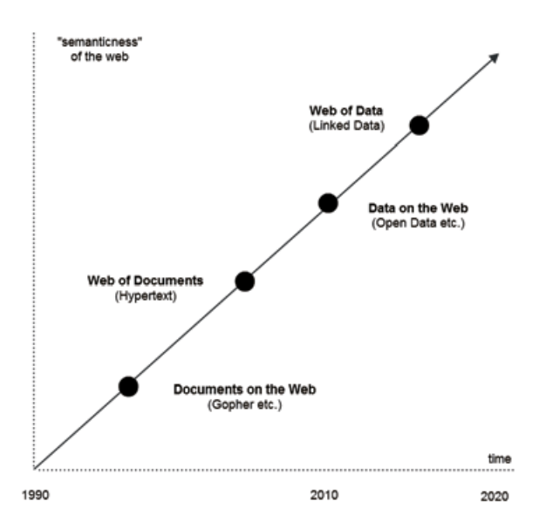
Evolution of Web to Web of Data

Slide 5
Tim Berners Lee‘s Data star scheme
Quality Level | Description | Format / example
★ | Available on the web but with an open licence, to be Open Data | whatever format
 | Available as machine-readable structured data | Excel instead of image scan of a table
 | as (2) plus non-proprietary format | CSV or JSON instead of Excel
 | All the above plus, Use open standards from to identify things | RDF, SPARQL
 | All the above, plus: Link your data to other people’s data to provide context | Linked RDF

Slide 6
Semantic Web vs. Linked Data
 | Semantic Web | Linked Data
Big Data | Not neccesarily | Often presented as big datasets
Open Data | Not necessarily | To get the first  should be Open
Data structuring approach | Top-down: sterts with ontologies, a conceptual and logical foundation to how information is modeled and interrelated | Bottom-up : starts simply by primitive data
Complexity | Some aspects are complex and too theoretical | Simple and effective
Evolution | After a decade, there is a handful of standards and languages, the heavy AI emphasis of the initial semantic Web advocacy now feels dated | Very fast: in less than five years there is a huge amount of data, the community is now shifting the emphasis to linked data
Notes:
http://www.mkbergman.com/category/linked-data/

Slide 7
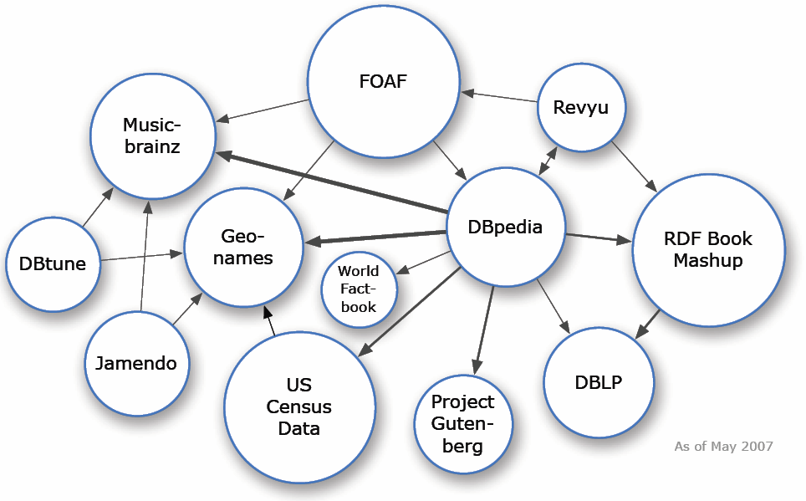
LOD Datasets on the Web: May 2007
Over 500 million RDF triples
Around 120,000 RDF links between data sources
Notes:
Use this section to talk about developments in the project over the last year

Slide 8
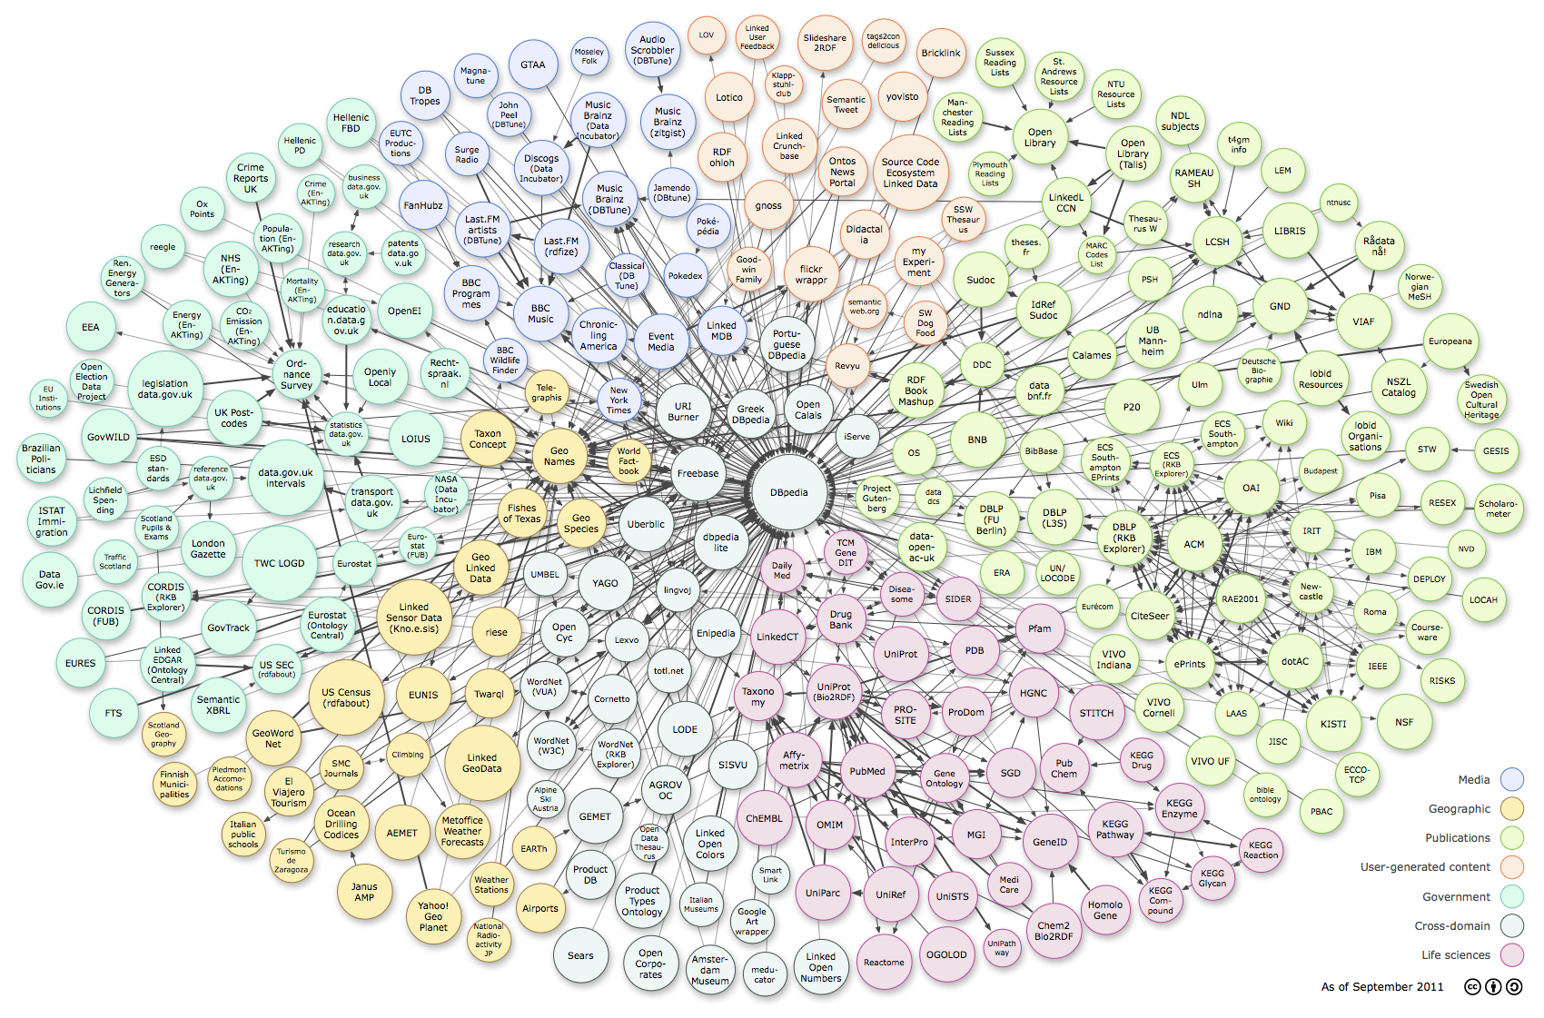
Linked Open Data 2011 : 26 Billion Triples
Notes:
The following diagram visualizes the data sets in the LOD cloud as well as their interlinkage relationships. Each node in this cloud diagram represents a distinct data set published as Linked Data. The arcs indicate that RDF links exist between items in the two connected data sets. Heavier arcs roughly correspond to a greater number of links between two data sets, while bidirectional arcs indicate the outward links to the other exist in each data set.

Slide 9
Number of data sets, amount of triples, and amount of RDF links per topical domain
Domain | Data Sets | Triples | Percent | RDF Links | Percent
Cross-domain | 20 | 1,999,085,950 | 7.42 | 29,105,638 | 7.36
Geographic | 16 | 5,904,980,833 | 21.93 | 16,589,086 | 4.19
Government | 25 | 11,613,525,437 | 43.12 | 17,658,869 | 4.46
Media | 26 | 2,453,898,811 | 9.11 | 50,374,304 | 12.74
Libraries | 67 | 2,237,435,732 | 8.31 | 77,951,898 | 19.71
Life sciences | 42 | 2,664,119,184 | 9.89 | 200,417,873 | 50.67
User Content | 7 | 57,463,756 | 0.21 | 3,402,228 | 0.86
 | 203 | 26,930,509,703 |  | 395,499,896

Slide 10
Open Governmental Data (OGD) 1/2
OGD was initiated by “The Memorandum on Transparency and Open Government” (The Transparency Directive)
  a memorandum signed by US President Barack Obama in January2009.
The basic idea of Open Government is
  to establish a modern cooperation among politicians, public administration, industry and private citizens
  by enabling more transparency, democracy, participation and collaboration.
In European countries, Open Government is often viewed as a natural companion to e-government
In September 2011, there were 46 national government commitments to Open Government worldwide
http://www.semantic-web.at/LOD-TheEssentials.pdf

Slide 11
Open Governmental Data (OGD) 2/2
Open Government Data (OGD) is emerging as a major movement in knowledge sharing
basic premises are
  to open up publicly-owned data and information from governmental institutions
  Make it available in machine-readable formats for easy re-use and cross-combination by citizens, industry, media, and academia – as well as by government itself.
OGD movement has also the power to fuel greater transparency, to enable collaboration between stakeholders, and last but not least to spur new economic activity

Slide 12
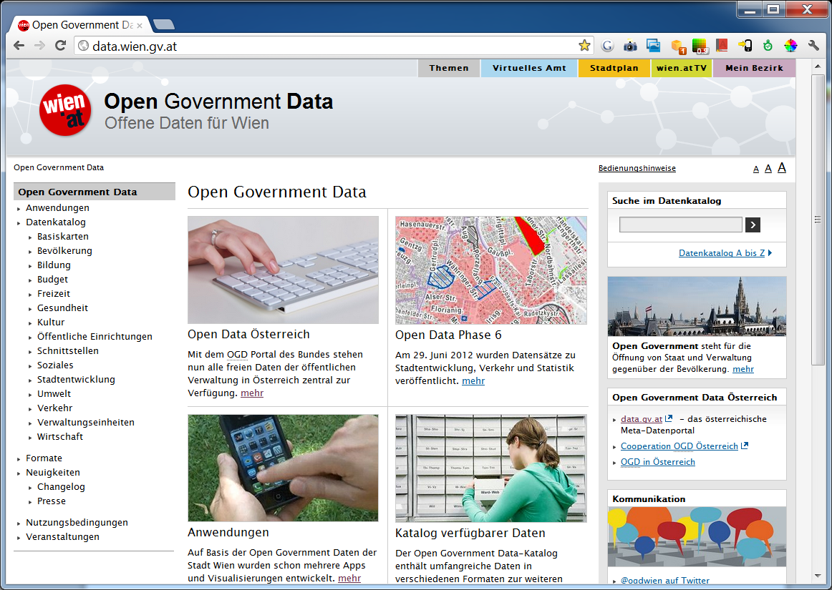
Vienna Open Government Data

Slide 13
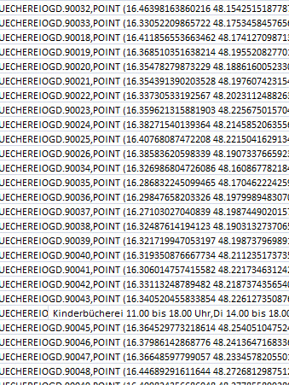
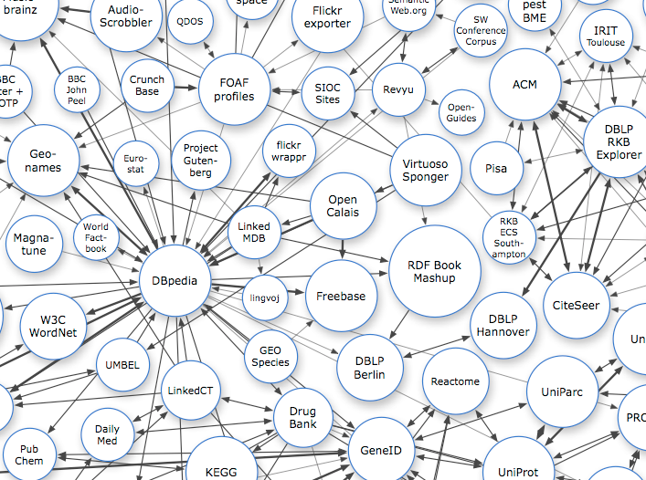
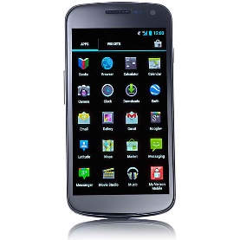
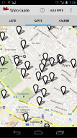



Vienna Linked Open Government Data - System Architecture
Ontologies
DC/VCARD/WGS84/VOGD
Linked
Open Data
Raw Data Files
DATA.WIEN.GV.AT
APP STORE
SPARQL
MAPS API
JENA
VIRTUOSO
Android Framework
Model Output
Triplestore
ogdconfig.xml
OWL/RDF
SPARQL
RDF Conversion
RDF Postprocessing
Source Data Extractor
Schema Matching
Data Enhancement Processor
Internal Link Discovery
External Link Discovery
querycache
Structured Data
Enhanced Structured Data
Internally Linked Data
Linked Data

Slide 14
OGD Data Quality
Open Government Linked Data represents 43% of the total volume of statements it contains less than 4% out-links.
Compared to other domains such as Life Sciences and Publications with over 27% and 38% out-links, respectively, government data is not highly linked with other data.
Published Open Government Linked Data is usually “3-star Linked Data" in most cases.
Many published government data sets, including the comma-separated-value (CSV) format, are not immediately useful because column headings or schema are not defined.
Chris Bizer (Freie Universität Berlin), Anja Jentzsch (Freie Universität Berlin), Richard Cyganiak (DERI, NUI Galway) State of the LOD Cloud
http://www.w3.org/2011/gld/wiki/Linked_Data_Cookbook

Slide 15
Challenge : Schema heterogeneity and lack of schema-level links
LOD is open and distributed so datasets
  do not need to follow a uniform conceptual schema
  may define their own concepts locally.
So a single real-world concept might have multiple representations in different LOD datasets
  in most of cases these representations are not connected via appropriate schema-level links
  datasets are more sparsely connected than expected
Solution providers need to explore the precise details of the target LOD datasets and enrich the datasets through nontrivial cross-links in order to create their unique data integration solutions.
Unfortunately, The creation of user-generated solutions demands considerable effort in familiarizing oneself with the target datasets,
More unfortunately and the implemented data integration solutions cannot be efficiently shared and reused.

Slide 16
Challenge: Lack of custom-tailored LOD tools
The current LOD tools and frameworks typically address the generic requirements of Linked Data solutions
  such as LOD publishing, storage, query, and reconciliation.
Currently, it is believed in some major software domains that the one-size-fits-all era has come and gone
The LOD community is now striving for custom-tailored tools for addressing the long tail of requirements that a large number of novice end users and solution providers need.
Mashup architecture can be a potential candidate for custom-tailored LOD solutions

Slide 17
Challenge: Lack of effective LOD integration with Open APIs
The RESTful APIs are one of the core technologies of Web 2.0
Many service providers incorporate Open APIs to offer their data and core functions
These Open APIs - similar to LOD - provide well-structured data in a scalable and resource-oriented manner
Unfortunately, neither Linked Data nor the Open APIs sufficiently describe the integration of these two useful information resources
The LOD community has tried to overcome this problem by introducing Linked APIs.
However, the data integration environments need to be improved to take the full advantage of both LOD and Open APIs for creating effective data integration solutions.

Slide 18
A Widget-based Framework for
Linked Applications

Slide 19
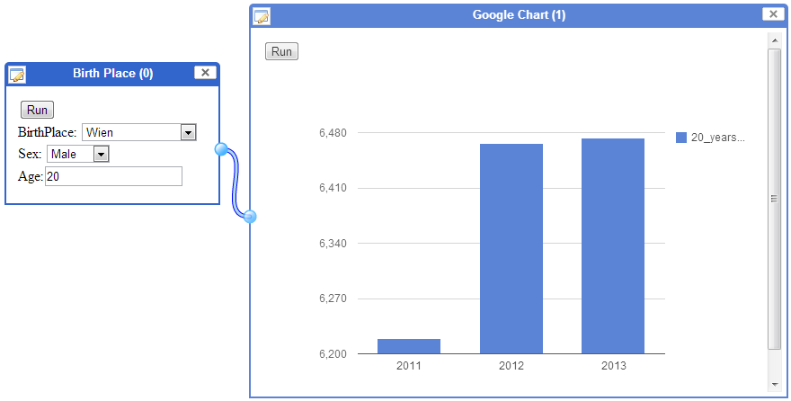
Demographic - 1
Number of 20 years old males born in Wien
Notes:
The first group of use cases I will introduce here is about Demographic. Two most basic widgets here are Birth Place widget and the Google Chart widget. The former returns the number of male/female at a specific age who were born at a particular place. And of course, the later displays the output in a bar chart.
So, the above mash-up shows the number of 20 years old males born in Wien. I don’t know why but we can see the interesting information that in 2011, there was little males were born, just 6200 compared to 6480 of 2012 and 2013

Slide 20
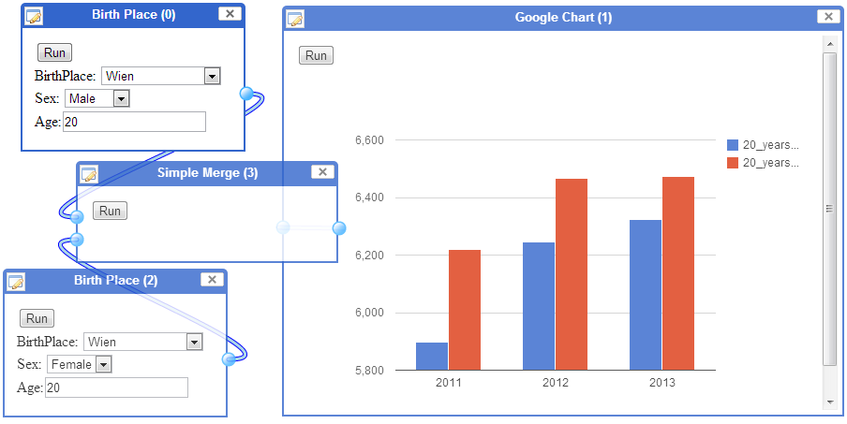
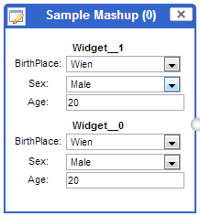
Demographic - 2
Compare the number of males & females at 20 years old born in Wien
Notes:
Now is a more complicated use case. What if I want to compare the number of males and females at 20 years old who were born in Wien?
In this case, I need the Merge widget to create the mash-up as shown in the slide. Thanks to this, I can see that at 20 ages, there are more males than females born in Wien.
Furthermore, we can quickly save this whole mash-up as a new Widget. This new Widget will have all fields contained in its original widgets. In other words, we have six fields here.

Slide 21
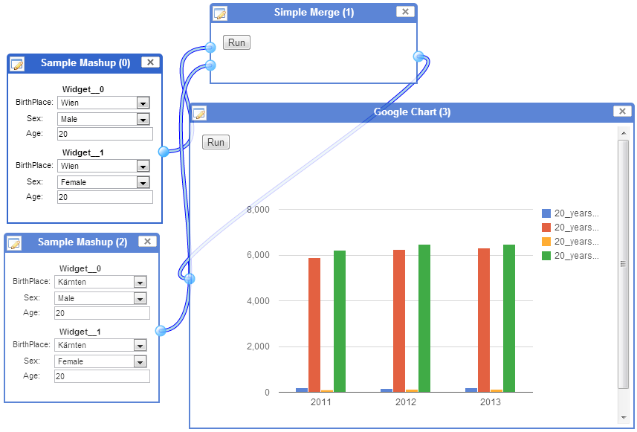
Demographic - 3
Notes:
And later we can use our new widget in a new Mashup.
We can quickly compare & contrast number of 20 years old males and females born in Wien and Karnten. You can see that the number of male and female born in Wien are far greater than that in Karnten

Slide 22
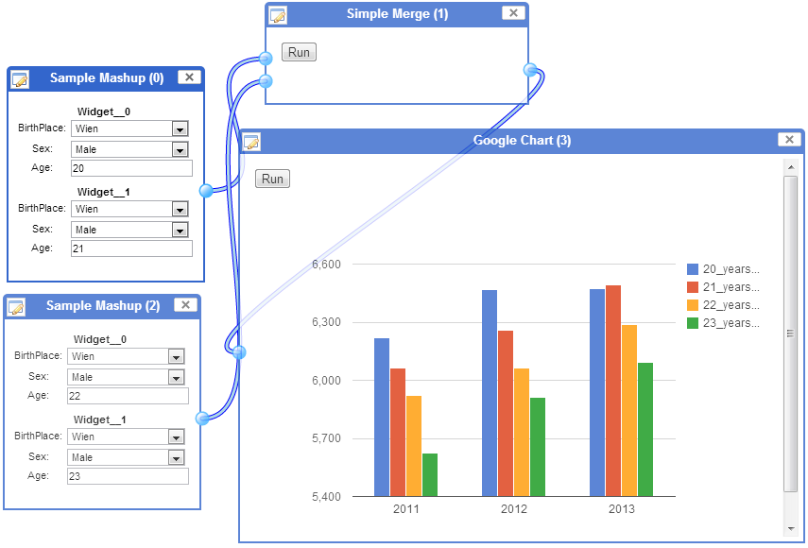
Demographic - 4
Notes:
Or modified the configuration a little bit, we can compare & contrast the number of 20, 21, 22, 23 male born in Wien.
Similarly, we can have hundreds of similar use cases like that based on just 3 original widgets

Slide 23
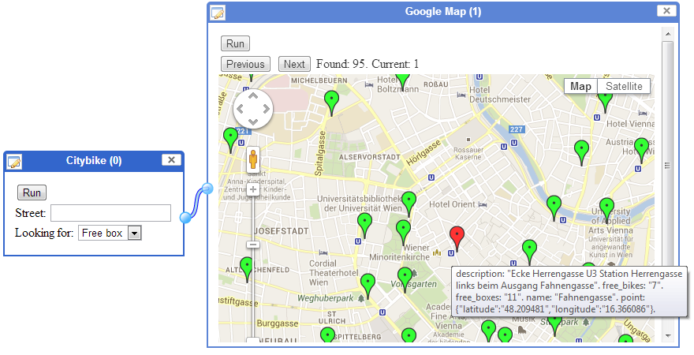
Location - 1
Notes:
Now comes to the different type of use cases related to locations. At any time, we can easily find all citybikes that have free box so that we can leave our bike there, using the City bike widget and Google map widget.

Slide 24
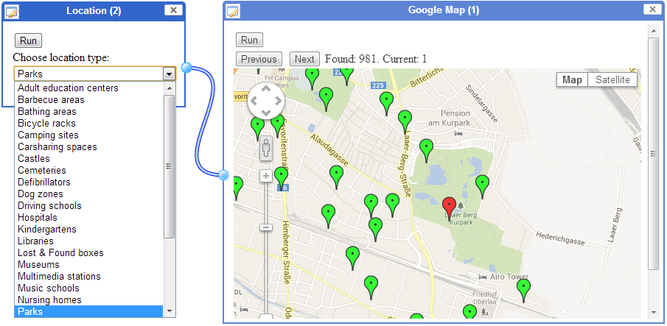
Location - 2
Notes:
Similarly, we can find the location of 981 parks in Wien, using the Location widget and Google map widget

Slide 25
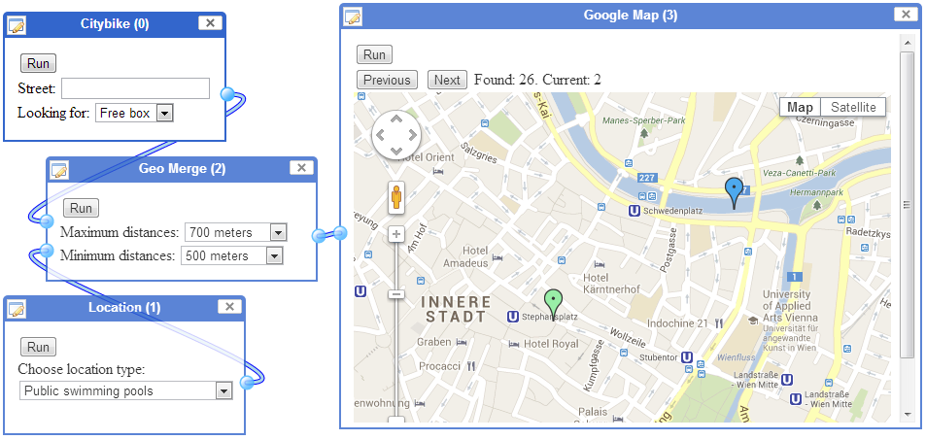
Location - 3
Ride a bike, walk around 700 meter & go swimming?
Notes:
Next is a more interesting use case. If one day, I want to ride a bike, then drop it somewhere and walk around 700 meters before go to swimming, how can a mashup help me?
In this case, besides City bike widget, Location widget , Google Map widget, we need one more: Geo Merge Widget. It will try to combine 2 locations based on the distance between them. So now, I can have 26 options to choose the favourite one.

Slide 26
Open Mashup Solution for Consuming Lined Data

Slide 27
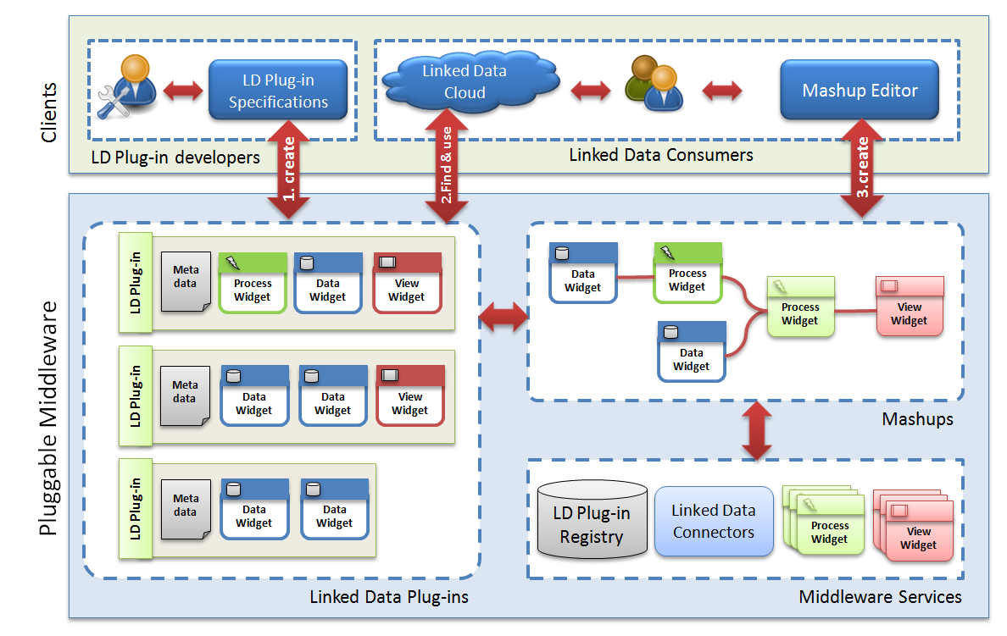
Architecture Overview

Slide 28
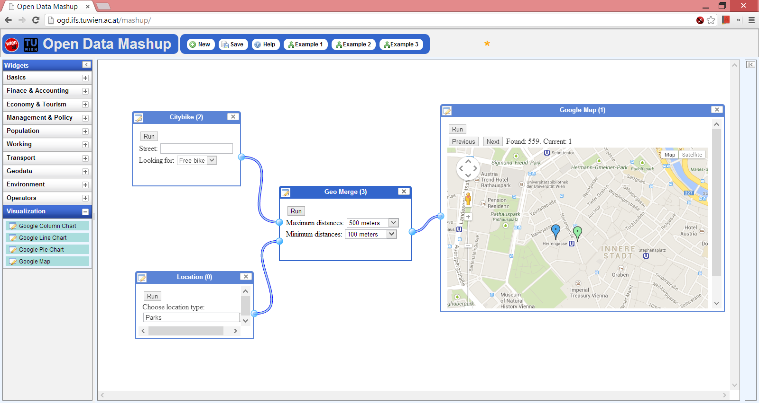
Open Data Mashup Platform

Slide 29
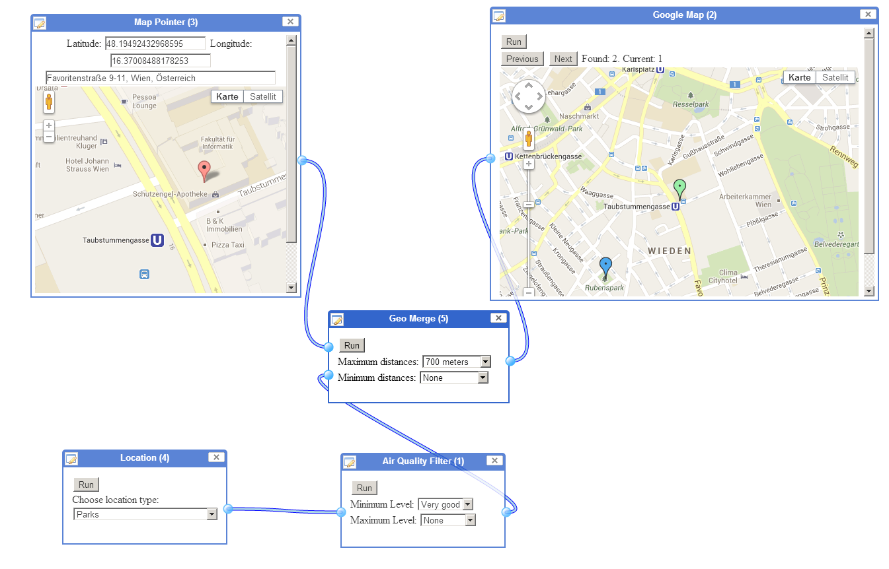
Example 1
Find a park with good air quality 700m near my home/office

Slide 30
Example 2
Find a park with good air quality 700m near my office
Used widgets
  Location + Map Pointer: serves as input
  Air quality: retrieves air quality values
  Geo Merge: combines 2 locations based on distance
  Google Map: for visualization

Slide 31
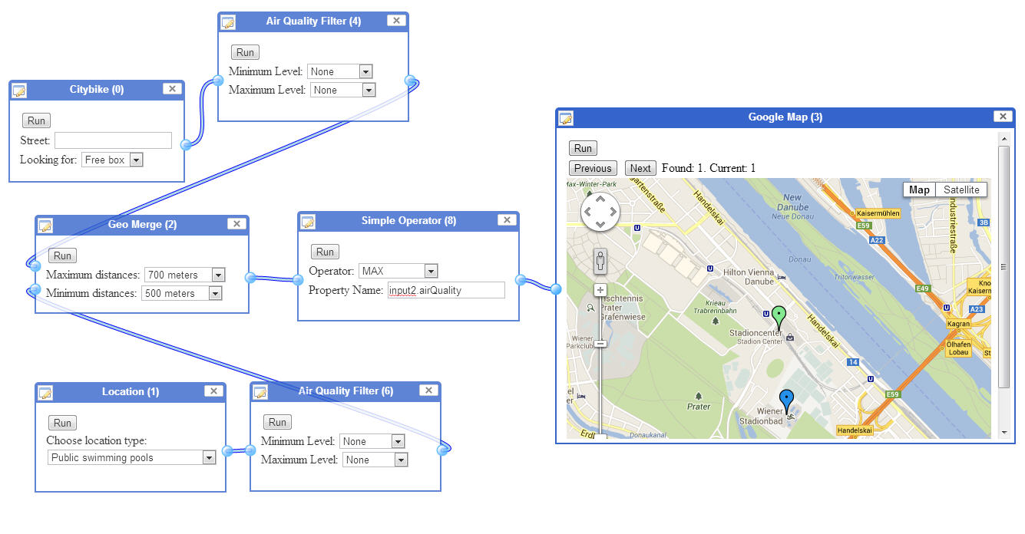
Example 3
Requirement: I want to ride a City Bike and then go swimming. Good air quality should be provided.
Solution: Find a City Bike location, which is near a public swimming pool and provides best air quality.

Slide 32
Work in Progress

Slide 33
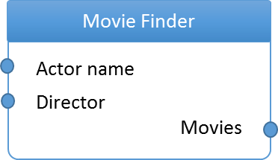
Semantic Description of Widgets
hasAddress
http://linkedwidgets.org/12345-A4567-65BD0
Lw:Widget
movieWidget
Movie Widget
hasName
swrl:ClassAtom
atom1
Lw:Output
foaf:Person
foaf:Person
output
director
Lw:Input
swrl:ClassAtom
input
atom2
hasAttribute
dbpedia:Actor
hasAttribute
Lw:Model
swrl:ClassAtom
dbpedia:Actor
model
atom3
actor
hasAttribute
dbpedia:Film
swrl:PropertyAtom
atom4
dbpedia:Film
film
dbpedia-owl:director
swrl:PropertyAtom
atom5
dbpedia-owl:starring

Slide 34
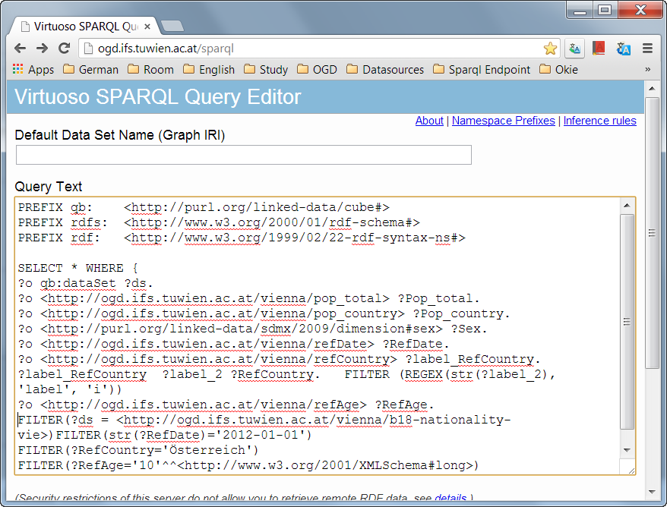
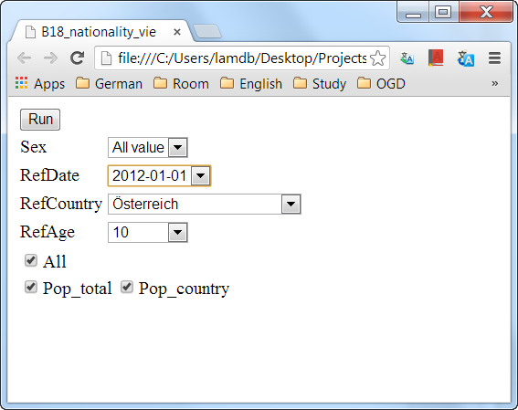
Facilitating the Linked Data Consumption
Sparql query interface
User friendly Widget
Notes:
We need to change. Almost user don't know Sparql language => it is too difficult for user.
We can create widgets with menu for user. It is more interesting than traditional method.

Slide 35
Automatic Generation of Widgets
The widgets are automatically generated by negotiating with SPARQL endpoints that are using W3C Data Cube Vocabulary

Slide 36

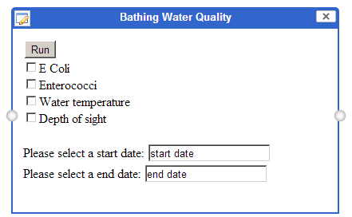
Converting the Environmental Data 1/2
Data Conversion
Raw Measurement Data ➔ W3C RDF Data Cube Vocabulary
Pre-Semantic
Semantic
Post-Semantic
Data Acquisition
Data Mapping
Data Structure Definition
RDF Generation
Data Storage
Data Access
Data Integration
Data Exploitation
CSV / XLS / …
RDF Data Cube
Semantic Widget
layerP_AT3340003700020010;47.062999;10.641699;Badesee Überwasser in Ladis;1;15;21,8;1,5;2013-08-08;2013-08-30 15:42:40
# Example Observation
ifs-env:obs1 a cube:Observation ;
cube:dataSet ifs-env:bathingStats;
ifs-envProps:enterococci "10";
ifs-envProps:ecoli "20";
ifs-envProps:temperature "20";
ifs-envProps:depth "1.5";
ifs-envProps:date "2013-07-09";
ifs-envProps:geo ifs-envLoc:layerP_AT1120004400010010.

Slide 37

Converting the Environmental Data 2/2
Big picture
Heterogeneous data
Unified Semantic Data
Semantic Web Platform
External Vocabulary
Linked Widgets
RDF Data Cube Vocabulary
Environmental Ontologies (GeoSPARQL, SWEET, etc.)
Mashup Design & Execution
Environmental Data
Linked Widgets Environmental Vocabulary
Widget Discovery
Historic Data
Widget Annotation
Real Time Data
Data enrichment
Data enrichment
Sensor Stream Data
SPARQL Endpoint
Data conversion
Data integration

Slide 38
Conclusions
The efficient management of data and information is critical for the global economy.
data and knowledge sharing can ensure better decision-making
Semantic technologies have done a great job by putting the languages and standards in place
  This makes a solid basis for Linked Data
the community is now shifting the emphasis to Linked Data and raising the awareness of the potential of linked data.
A huge amount of high quality data is now available following the Linked Data trend
However
  applications that consume Linked Data are not yet widespread
  Current approaches lack methods for seamless integration of Linked Data
  We need novel approaches to overcome the Linked Data challenges such as data consistency, dynamic and on-the-fly discovery of available data, information quality assessment, elaborate user interfaces, etc
Notes:
http://km.aifb.kit.edu/ws/cold2012/

Slide 39
Thank you very much for your attention!

Slide 40

Linked Widgets

Slide 41
Open Data Mashup Platform

Slide 42
Linked Widget
Linked Widget is an extension of Standard Web Widget that is customized to consume Linked Data
It has a model that describes the inputs, outputs, and their relationships
The model can be used to
  check the compatibility of widgets
  Select and consume the required data from provided data pool

Slide 43
Linked Data Consumption
Domain Ontology
Merger
SPARQL DBLP
Movie Finder
Actor name
Director
SPARQL MovieDB
Movies

Slide 44
hasAddress
http://linkedwidgets.org/12345-A4567-65BD0
Lw:Widget
movieWidget
Movie Widget
hasName
swrl:ClassAtom
atom1
Lw:Output
foaf:Person
foaf:Person
output
director
Lw:Input
swrl:ClassAtom
input
atom2
hasAttribute
dbpedia:Actor
hasAttribute
Lw:Model
swrl:ClassAtom
dbpedia:Actor
model
atom3
actor
hasAttribute
dbpedia:Film
swrl:PropertyAtom
atom4
dbpedia:Film
film
dbpedia-owl:director
swrl:PropertyAtom
atom5
dbpedia-owl:starring

Slide 45
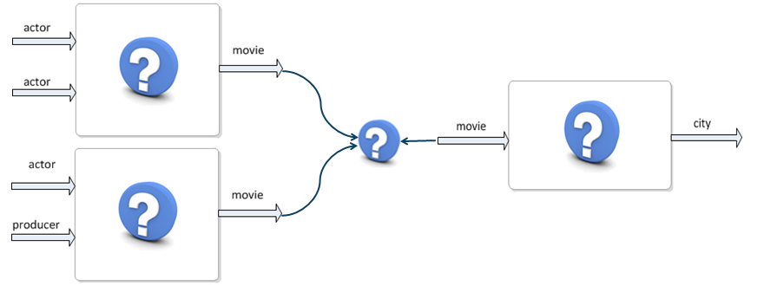
Problem
The Linked Widget like web services, they have also input, output, functional properties etc.
The main problem with existing service description technologies is their focus on technical aspects (input and parameter types, exceptions etc.) and invocation modalities.
The goal of the work was to find out the best technique for semantic description of data behind the widget and the Linked Widgets

Slide 46
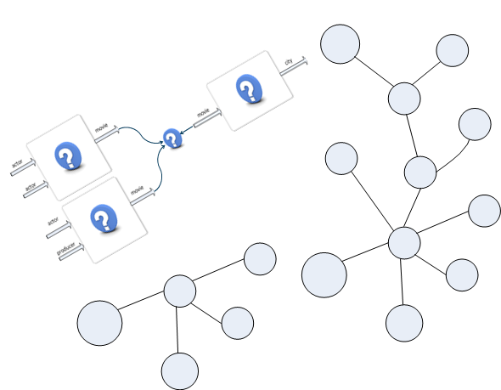
Approach
Therefore the approach focuses on 2 parts:
Semantic widget description;
Semantic description of the data inside the system.

Slide 47
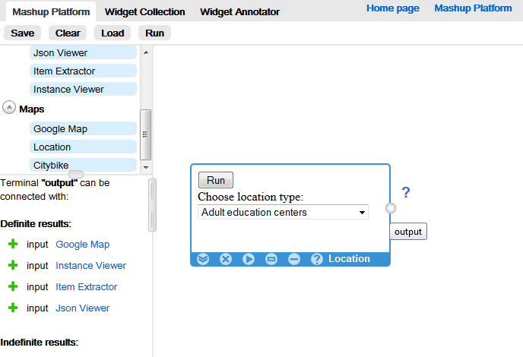
Help on terminal
Use 1 SPARQL query to get which terminal of which widget can connect with querying terminal

Slide 48
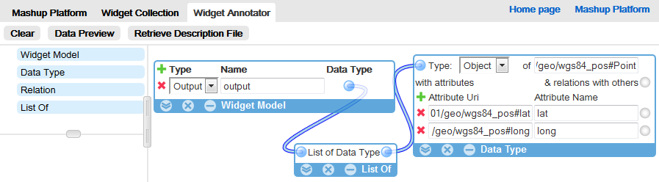
Widget annotator (1/2)
To annotate Location widget

Slide 49
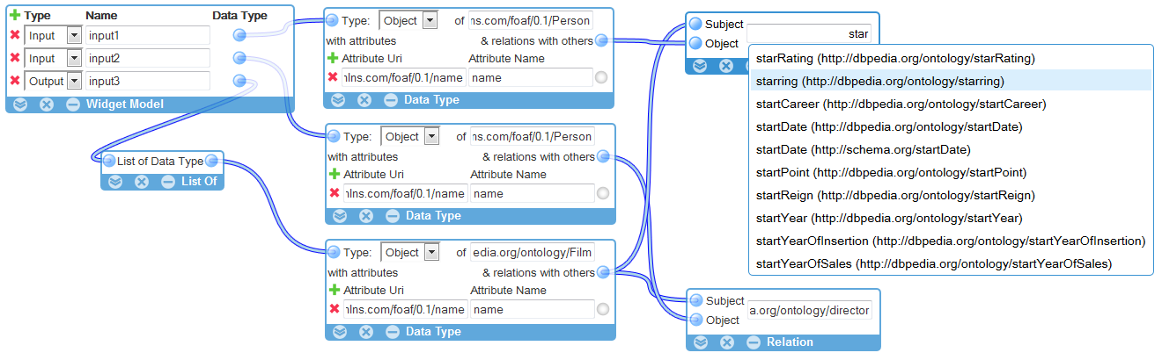
Widget annotator (1/2)
To annotate widget that:
  Input1: a star
  Input2: a director
  Output: List of Films (that …)

Slide 50
Creating automatically widgets from statistical sparql endpoints

Slide 51
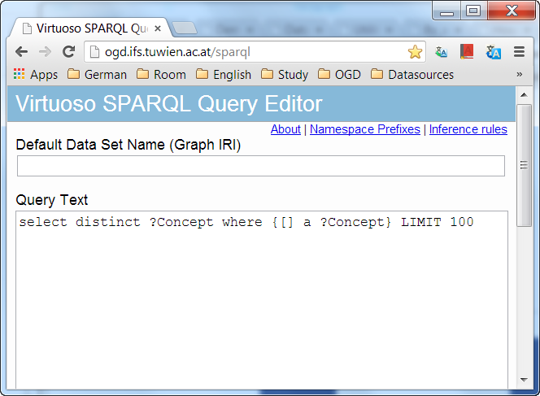
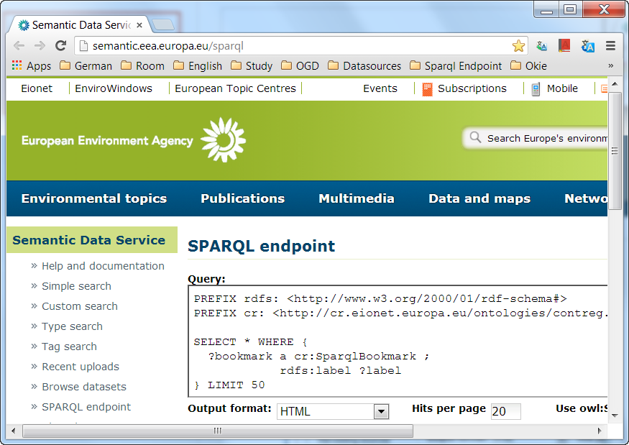
Problem
Sparql endpoints
To view data
=> create Sparql query
Notes:
Many Sparql endpoints provide statistical data
User need know SPARQL language to make query and get result

Slide 52
We need simpler query
Webpage - Sparql query
Widget - menu
Notes:
We need to change. Almost user don't know Sparql language => it is too difficult for user.
We can create widgets with menu for user. It is more interesting than traditional method.

Slide 53
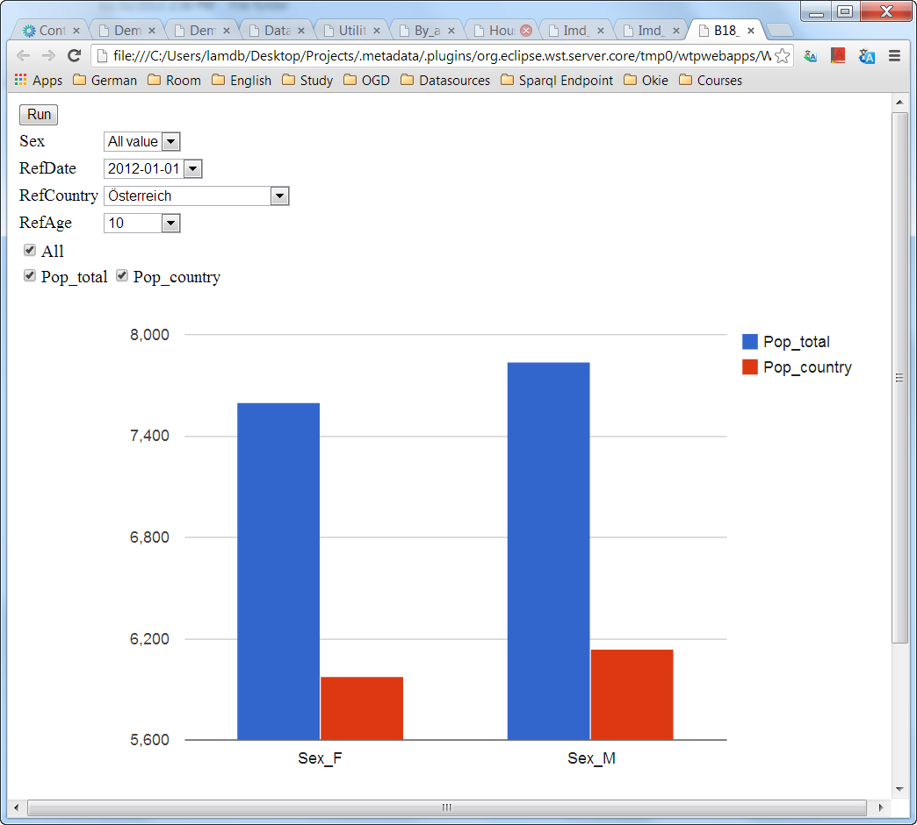
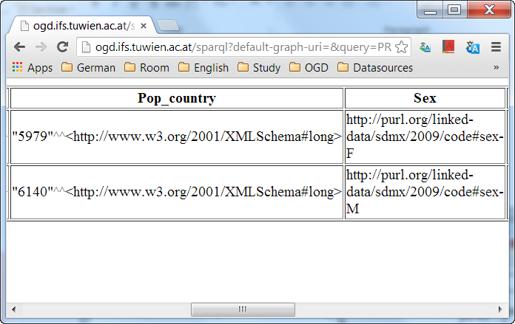
We need better interface
Text – view
Column - view
Notes:
Widget can run itself to show result.
We can use Google Chart library to make visualization

Slide 54
We need to incorporate data from many sources
Input: Widgets come from many Sparql endpoints
Output: Can we merge them together in mashup system?
Salary of Austria, 2012
ifs endpoint
Merger
need describe widgets
Salary of other country, 2012
other endpoint
Notes:
A question: How we can integrate data from many source.
For example can we compare data of salary of the Austria and other country in the same year (2012). Two widget comes from different sources .
We can
Firstly, we can need describe widgets
Secondly, we need to point out they have same year 2012

Slide 55
Sequence diagram to create Widgets

Slide 56
Result
Can parse many sparql endpoints that follow Data Cube Vocabulary (all 16 endpoints that I found)
Widget can show result in browser as well as show result in mashup system
Each widget has description file which describe the dimensions of it
We can merge widgets from the same endpoint (they use same URI to present one dimension)
Can we merge two widgets from two sources that have one dimension is described by two different URIs?

Slide 57

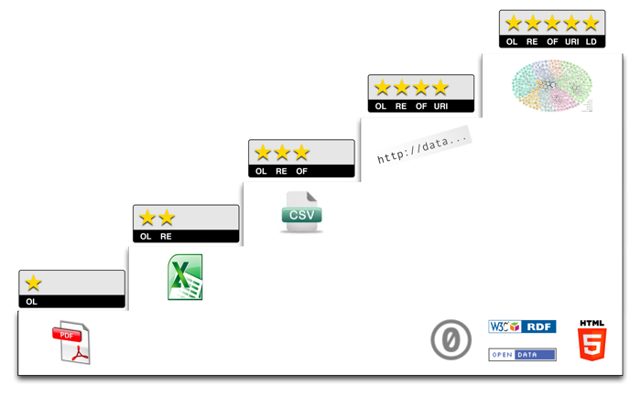
Environmental Data Consumption
Use Linked Widgets system to provide and consume Environmental Data
Data should be
  Open
  Linked
Data spheres can be
  Air
  Water
  Waste
  Energy
  Etc.
Source: http://usgin.org/sites/usgin.org/files/Open_Data.png
Source: http://5stardata.info/5star-steps.png

Slide 58
Basic Environmental Widgets 1
Find a park with good air quality 700m near my office
Used widgets
  Location + Map Pointer: serves as input
  Air quality: retrieves air quality values
  Geo Merge: combines 2 locations based on distance
  Google Map: for visualization

Slide 59
Basic Environmental Widgets 2
Requirement: I want to ride a City Bike and then go swimming. Good air quality should be provided.
Solution: Find a City Bike location, which is near a public swimming pool and provides best air quality.

Slide 60
Current work in progress 1
Towards Enhanced Environmental Widgets
  Semantic annotation of widgets enables intelligent and semi-automatic connection of widgets
  Semantic retrieval of widgets enables smart discovery of desired widgets
  Common Environmental Vocabulary enables unified querying of heterogeneous and scattered data sets
  Integration of Linked Stream Data enables (near) real-time analysis of environmental data

Slide 61
Current work in progress 2
Environmental Data Integration Workflow
… future work
… current work
Pre-Semantic
Semantic
Post-Semanti-fication
Data Acquisition
Data Mapping
Data Structure Definition
RDF Generation
Data Storage
Data Access
Data Integration
Data Exploitation

Slide 62
Current work in progress 3
Data Conversion
Raw Measurement Data ➔ W3C RDF Data Cube Vocabulary
Pre-Semantic
Semantic
Post-Semantic
Data Acquisition
Data Mapping
Data Structure Definition
RDF Generation
Data Storage
Data Access
Data Integration
Data Exploitation
CSV / XLS / …
RDF Data Cube
Semantic Widget
layerP_AT3340003700020010;47.062999;10.641699;Badesee Überwasser in Ladis;1;15;21,8;1,5;2013-08-08;2013-08-30 15:42:40
# Example Observation
ifs-env:obs1 a cube:Observation ;
cube:dataSet ifs-env:bathingStats;
ifs-envProps:enterococci "10";
ifs-envProps:ecoli "20";
ifs-envProps:temperature "20";
ifs-envProps:depth "1.5";
ifs-envProps:date "2013-07-09";
ifs-envProps:geo ifs-envLoc:layerP_AT1120004400010010.

Slide 63
Current work in progress 3
Big picture
Heterogeneous data
Unified Semantic Data
Semantic Web Platform
External Vocabulary
Linked Widgets
RDF Data Cube Vocabulary
Environmental Ontologies (GeoSPARQL, SWEET, etc.)
Mashup Design & Execution
Environmental Data
Linked Widgets Environmental Vocabulary
Widget Discovery
Historic Data
Widget Annotation
Real Time Data
Data enrichment
Data enrichment
Sensor Stream Data
SPARQL Endpoint
Data conversion
Data integration

