Slide 1
4diac in Teaching Lessons from Lab Exercises and Student Projects
Martin Melik Merkumians
7th 4diac Users Workshop

Slide 2
Content
Student background at TU Wiens Electronics Master Programme „Energy and Automation Technology“
Lab course background
Lab exercises
Student project – transportation system
Conclusion

Slide 3
Student background
Beginner level C skills (no object-orientation)
Beginner level Java skills
Basic Boolean algebra
Basic understanding of finite-state machines (Mealy and Moore)
Introduction to IEC 61131 language und execution model
Introduction to IEC 61499 and its execution model

Slide 4
Lab course background
Master level course
Focus on automation systems and IEC 61131 / IEC 61499 languages and concepts
Approximately 120-130 students in one semester
Four parts / 4h for each part + preparations at home
Discrete manufacturing
Batch process
Industrial robot (6 axis articulated arm)
Distributed control with IEC 61499

Slide 5
Lab exercise – Mechanic Press Example
4diac sample project
Tasks
Implement control with standard library function blocks only
Implement a basic function block to control the mechanic press
Add communication function block for control-to-simulation and control-to-GUI communication
Pros
Easy to set up
Provided via 4diac systems
Distributed scenario (although running on one PC)
Easy to debug for students
Suitable for large lab classes (30+ students at once)
Cons
Simulation only / no hardware specific problems (e.g. Timings, real signal behavior)
As nothing really happens/moves, students percieve the lab as rather boring

Slide 6
Lab exercise – Measure and Sort NTC‘s
Gantry robot
Shaker
Sorting station
Measurement
station

Slide 7
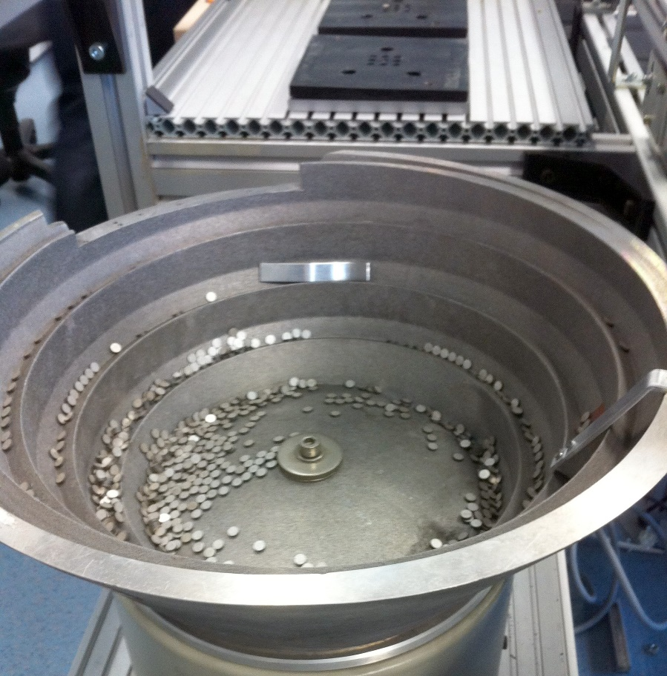
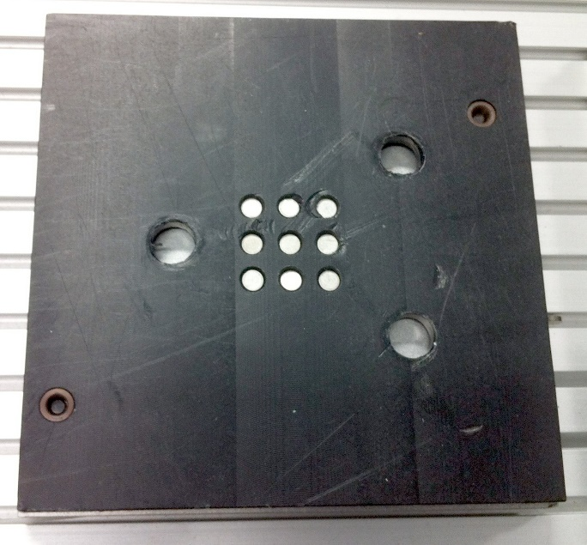
Lab exercise – Measure and Sort NTC‘s

Slide 8
Lab exercise – Measure and Sort NTC‘s
Lab lecture notes
Description of the plant
Explanation of IEC 61499 and 4diac
30 minute live demonstration of 4diac (Flip-Flop tutorial)
Basic FB creation and export
Compile FORTE with new FB
Test FB with monitoring
Consultation with the lab lecture supervisor (me) and the responsible Student Assistant

Slide 9
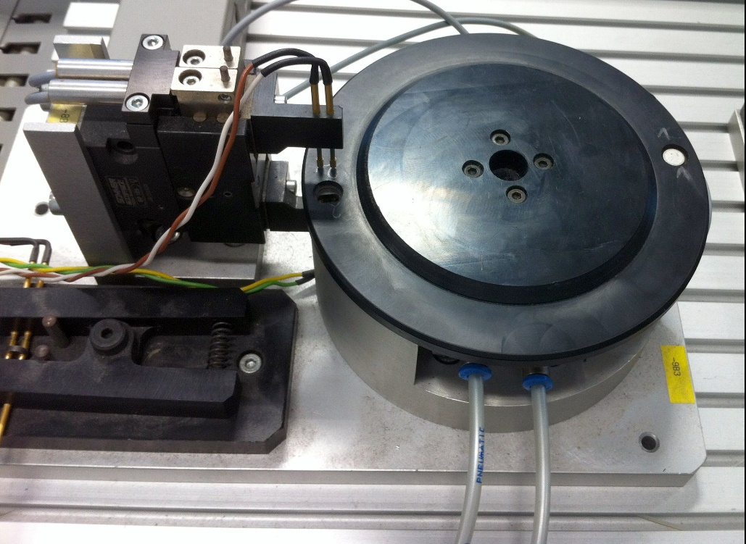
Lab exercise – Measurement Station Control
Turn table in measurement position
Close measurement clamps
Start measurement and readout
Open measurement clamps
Turn table back
Provide measurement to system

Slide 10
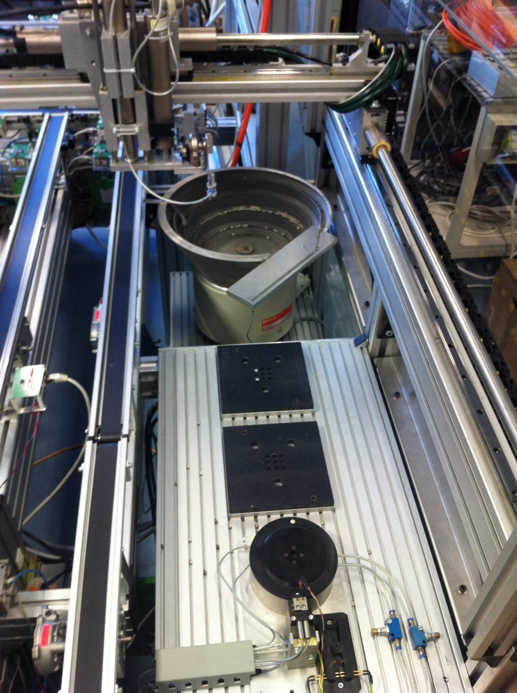
Lab exercise – Overall control
Shake NTC to takeout position
Grab NTC with gantry robot
Put NTC into measurement station
Sort NTC depending on the measurement value

Slide 11
Lessons learned from first year
Short introduction (30 min) to 4diac IDE/FORTE is not enough for most students to independently create 4diac solutions
Textual explanations of the desired processes are to inaccurate for preparations, even though we tried to be very accurate
The event driven approach of IEC 61499 is hard to grasp for students at first
Basic function block development with ECC and Algorithms is also not always clear to students
FORTE compilation and FB creation should be all done in the same tool

Slide 12
How to make things better
Four tutorial videos how to install and use 4diac
Available at (German only) https://www.youtube.com/channel/UCt0MlNo6Y7dXCZSDACXFi1g
Test function blocks, which simulates the plant and gives advice if there are any errors in the desired behavior
Mandatory preparation of the control program
No solution for combining FORTE compilation/FB creation steps

Slide 13
How 4diac got better through the use in lectures
A lot of bug reports (120 testers per year ☺)
ADS interface FBs for communication with Beckhoff hardware
Added serial interface communication for Windows
Added RawDataLayer for communication
Tutorial videos
Input on how to enhance the ECC and Algorithms views in 4diac-IDE

Slide 14
Experiences of the second year
Tutorial videos helped a lot!
Setup steps for 4diac IDE and FORTE are a bit to complicated for approximately 30% of students
Visual Studio changed
Too much tools (CMake, VS or Cygwin, and 4diac IDE)
Test FBs were very helpful, although they cannot cover all wrong behaviors
4diac IDE has become much more stable

Slide 15
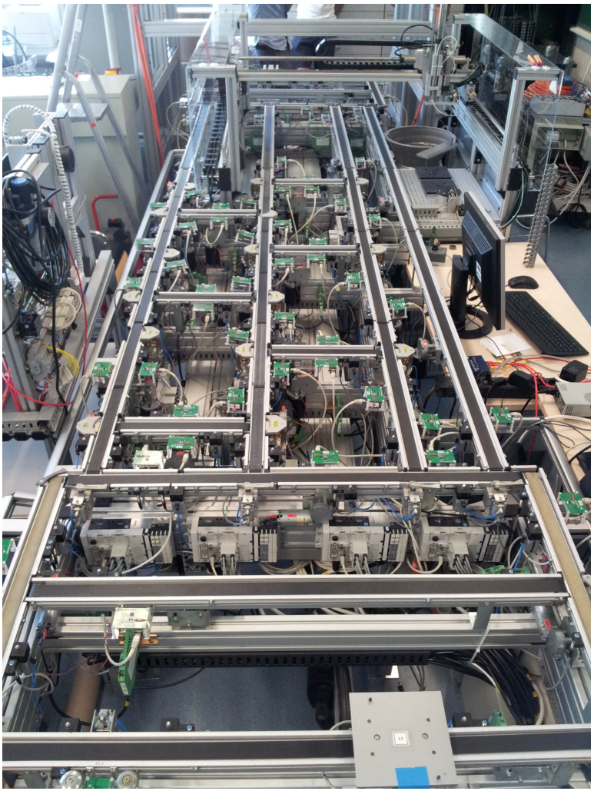
Transportation system
Platform Festo CPX-CEC
Three different kinds of station types
2-way junction
3-way junction
Handling station
One program for each station
Find shortest path between two stations
Activate path in plant
Communication via MQTT

Slide 16
Testbed manager

Slide 17
Feedback to 4diac
Again bug reports
Most important - MQTT communication layer
Able to run FORTE on Festo CPX-CEC (again)
Can control I/Os and valve ports
Unfortunately not open source

Slide 18
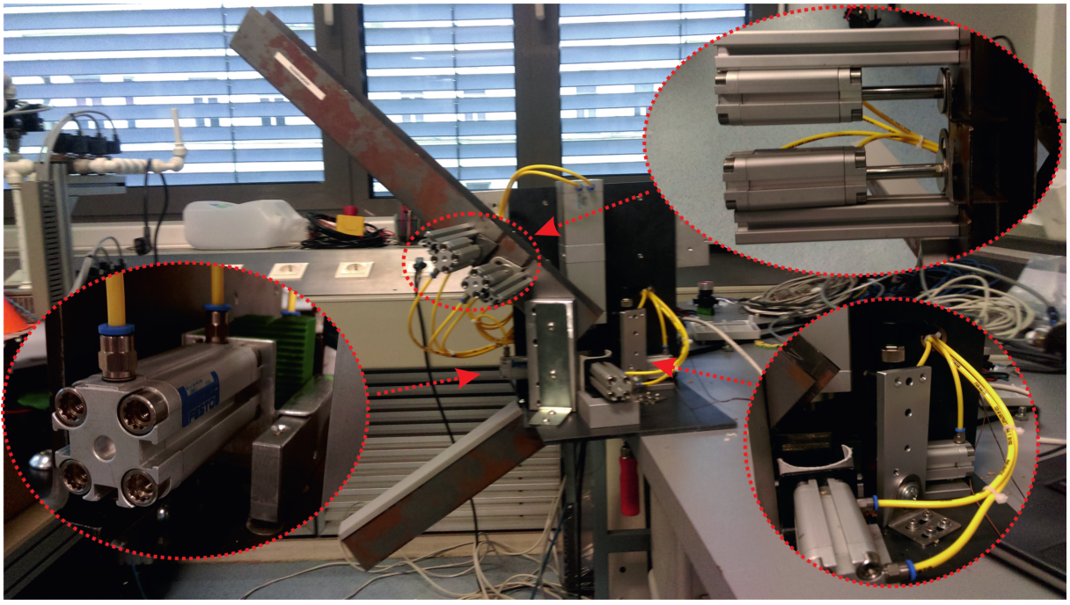
Other systems controlled by 4diac
Nutcracker
Platform: Festo CPX-CEC

Slide 19
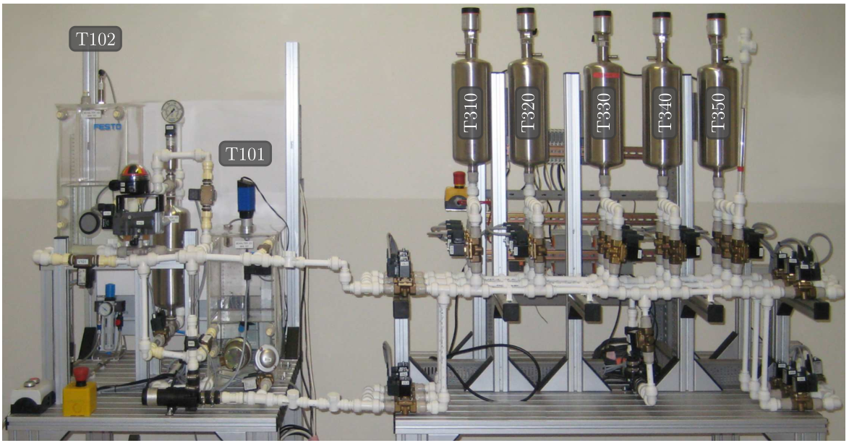
Other systems controlled by 4diac
Process plant
Platform: Beckhoff CX5010

Slide 20
Conclusion
4diac sample projects make it easy to ramp up a course or lab exercise to introduce IEC 61499, but lack reality
Demonstration plants for exercises
show the complexity and problems of real plants
are more valued by students
are a LOT more work to prepare and to use in exercises
Helps to improve 4diac
Are incubators to create new 4diac features

