Slide 1
Retreat May 15-17, 2019 High Wall
My last 5 years at TU Wien
Daniel Landskron

Slide 2
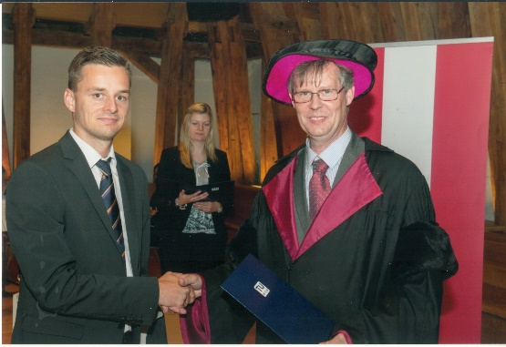
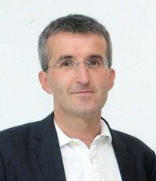
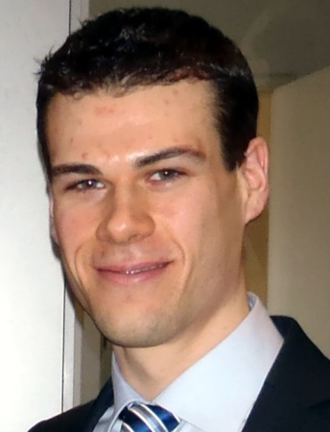
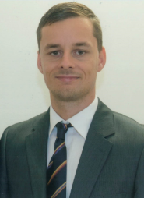
Projects
2014/06: graduation ceremony
2014/06-2017/05: Radiate VLBI
2017/06-2019/08: RADIATE ORD

Slide 3
Overview
Research:
Mapping Functions
Azimuthal Asymmetry
Publications:
7 peer-reviewed papers as first author
15 talks at international conferences
4 posters at international conferences
PhD defense
Launch of VMF Server
Teaching activities
GEO Green Team

Slide 4
1.) Research

Slide 5
Troposphere Delay Modeling
Mapping Functions
Vienna Mapping Functions 3 (VMF3)
Update of VMF1 (Böhm et al., 2006)
Discrete mapping function + zenith delays
Global Pressure and Temperature 3 (GPT3)
Update of GPT2w (Böhm et al., 2015)
Empirical mapping function + troposphere model (1°×1° and 5°×5°)
Site-Augmented GPT2w (SA-GPT2w)
Site-augmentation using in situ meteorological data
Horizontal Gradients
Horizontal tropospheric gradients (GRAD)
Discrete north and east gradients
Global Pressure and Temperature 3 (GPT3)
Empirical horizontal gradients model (1°×1° and 5°×5°)

Slide 6
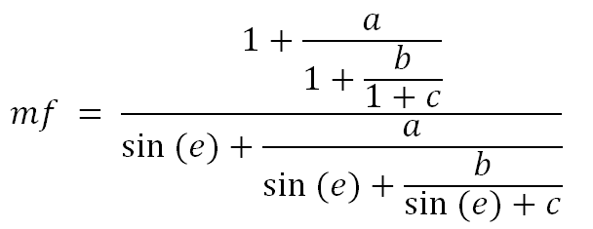
Troposphere Delay Modeling
ΔL(a,e): total delay dependent on azimuth and elevation (m)
ΔL^{z}: delay in zenith direction (m)
mf(e): mapping function (hydrostatic, wet and gradient)
G_{n}: north gradient (m)
G_{e}: east gradient (m)

Slide 7
Results
Mapping factors from VMF3/GPT3 yield better results than VMF1/GPT2w
particularly at low elevations
however fairly small
discrete zenith delays from RADIATE more precise
SA-GPT2w approximates VMF1 better than GPT2w
Discrete and empirical modeling close to peak of technical means

Slide 8
2.) Publications

Slide 9
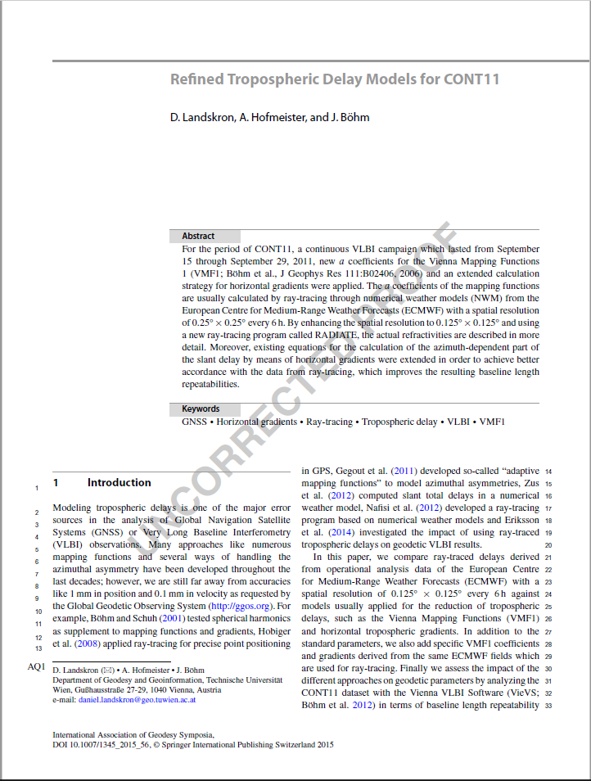
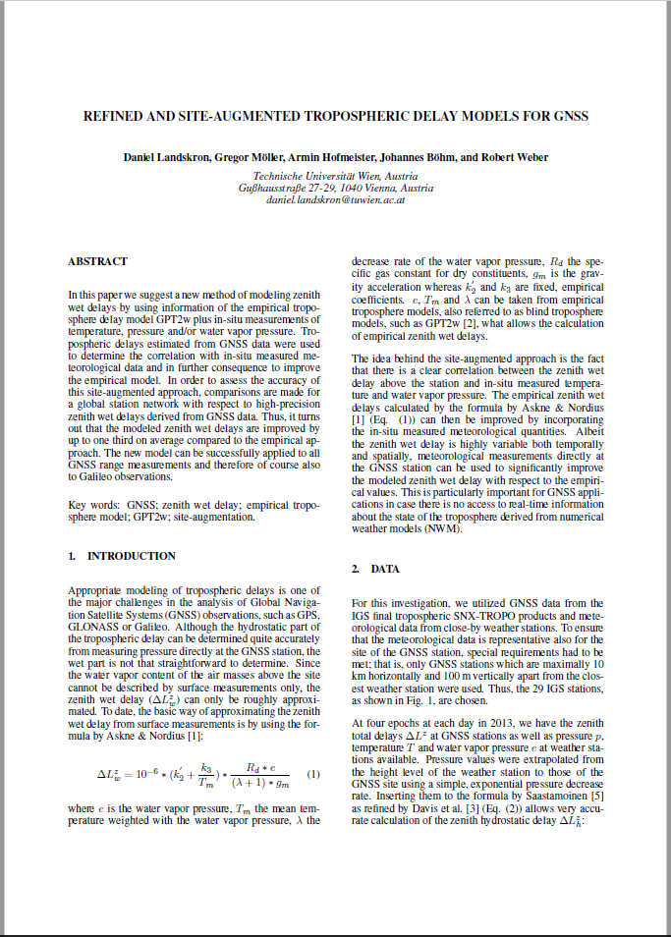
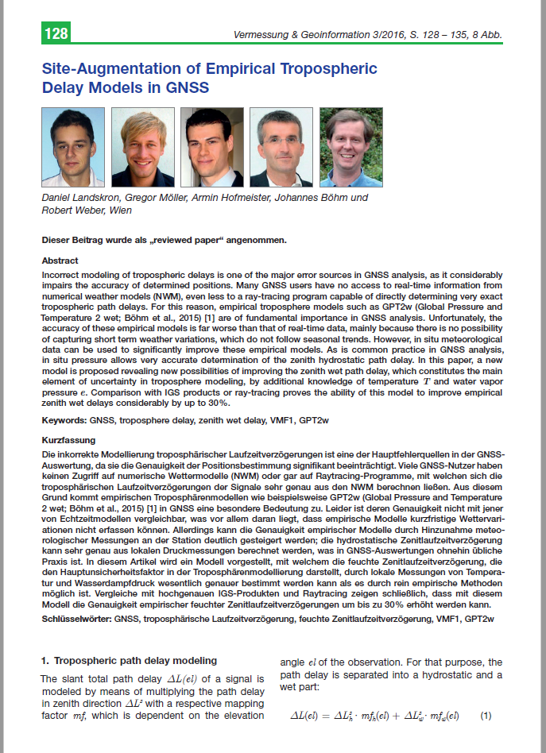
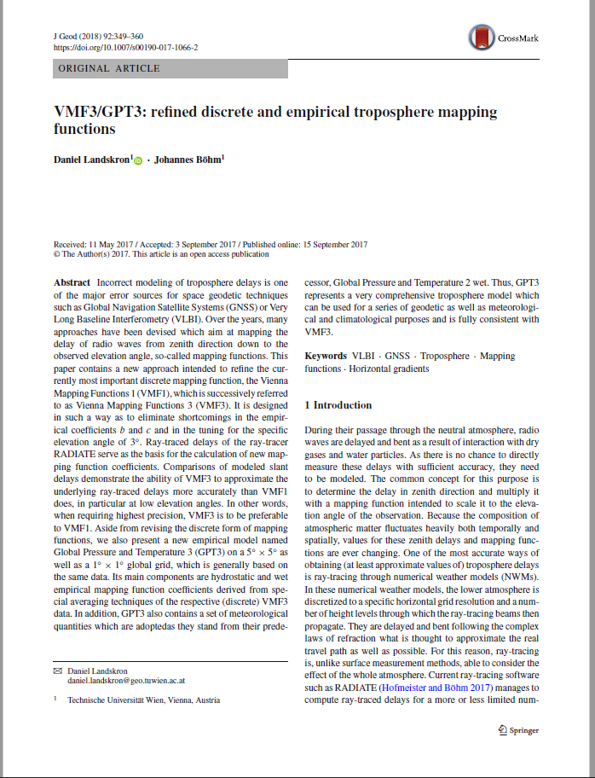
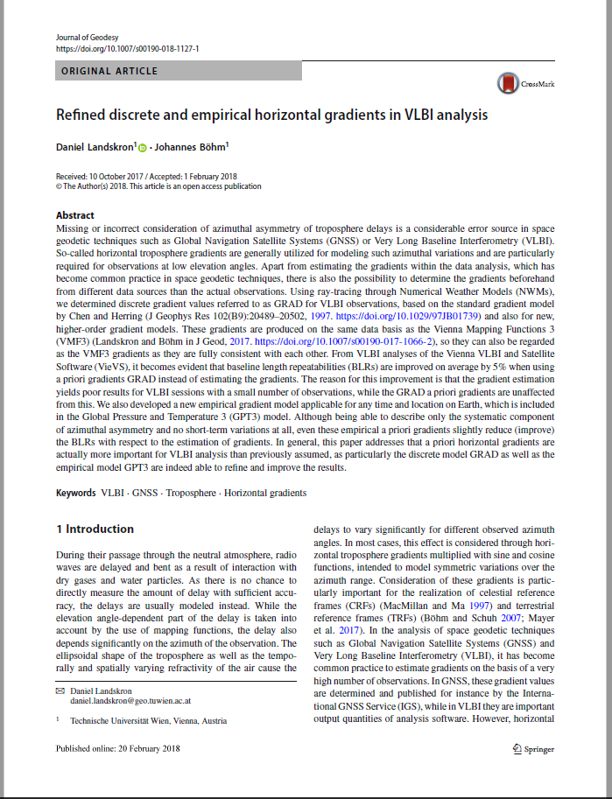
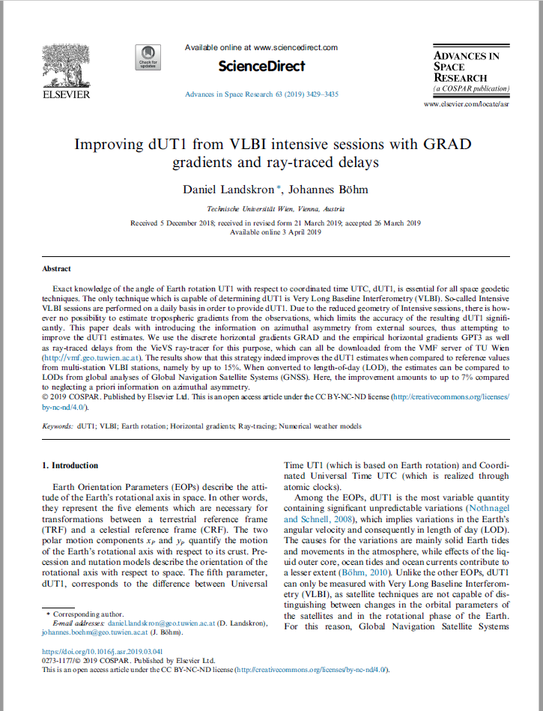
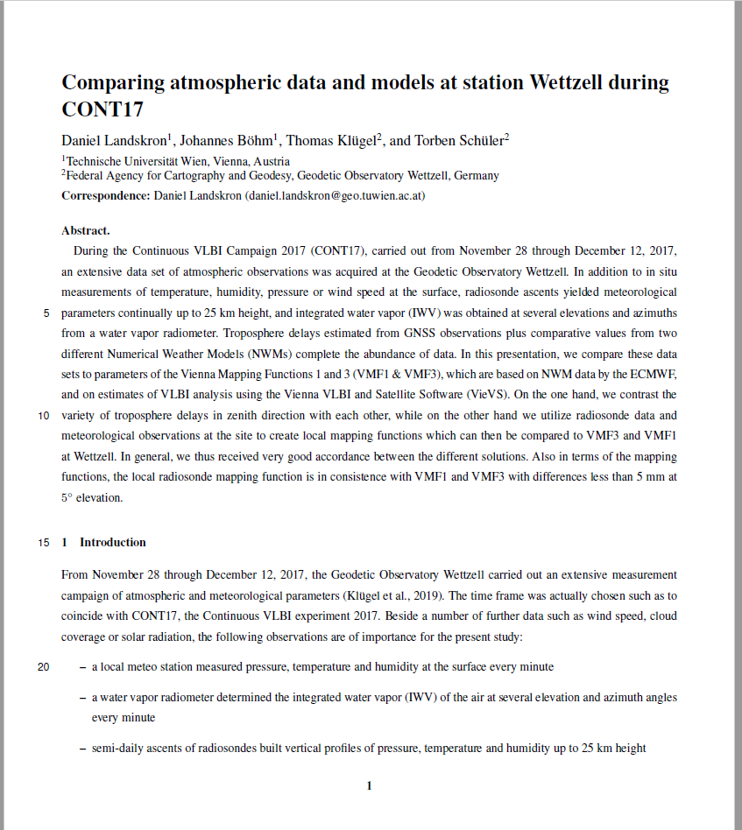
Publications

Slide 10
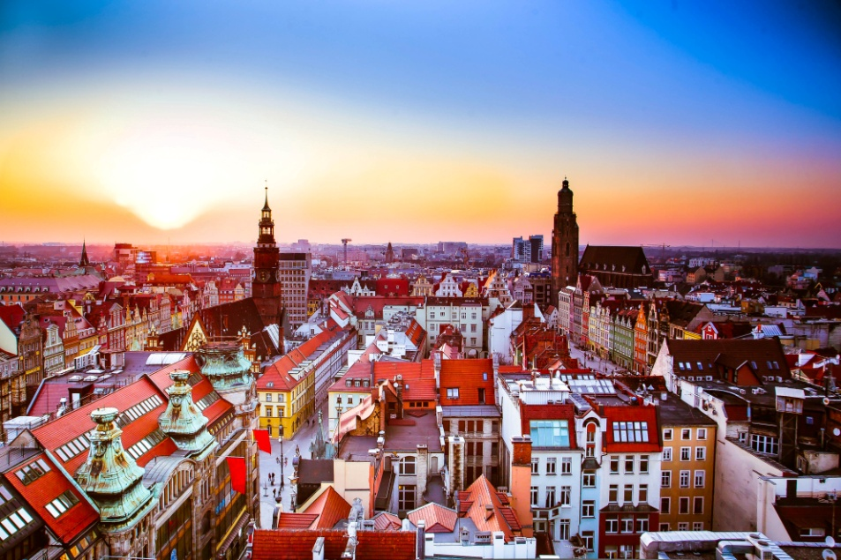
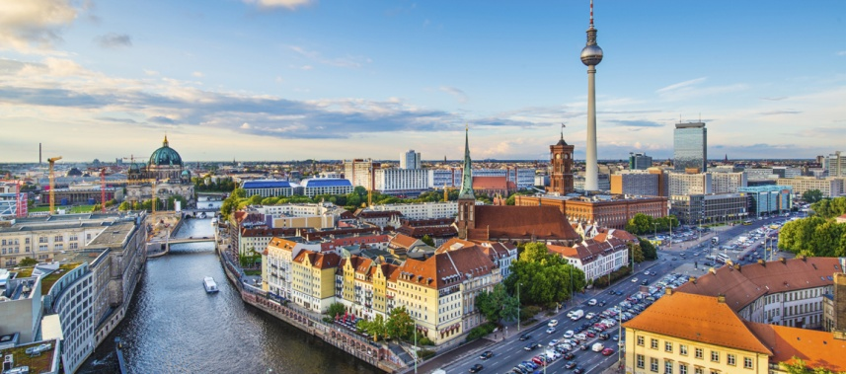
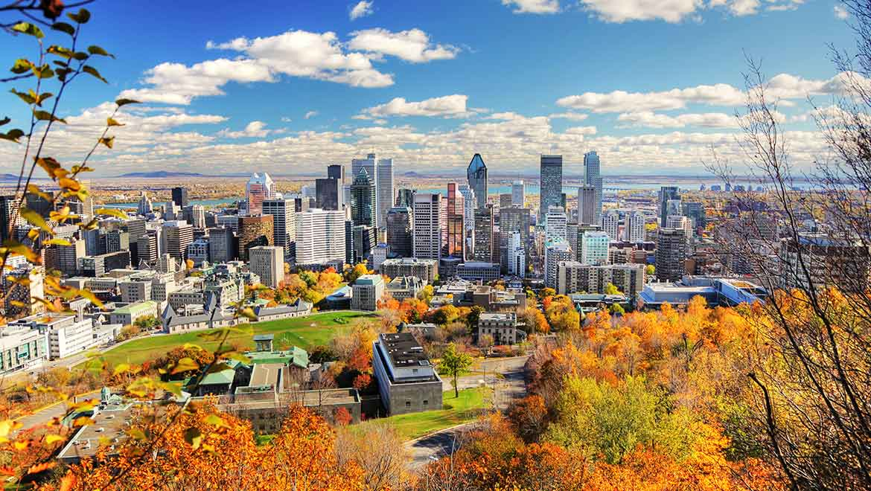
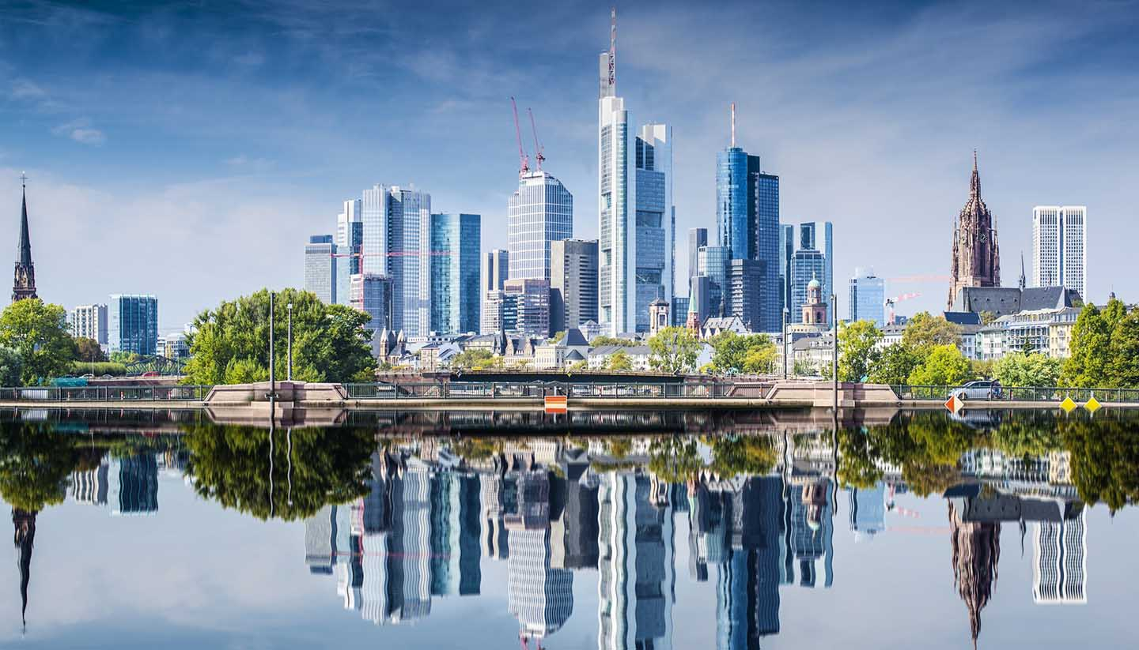
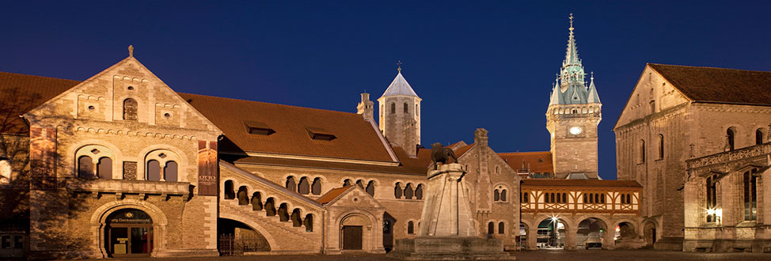
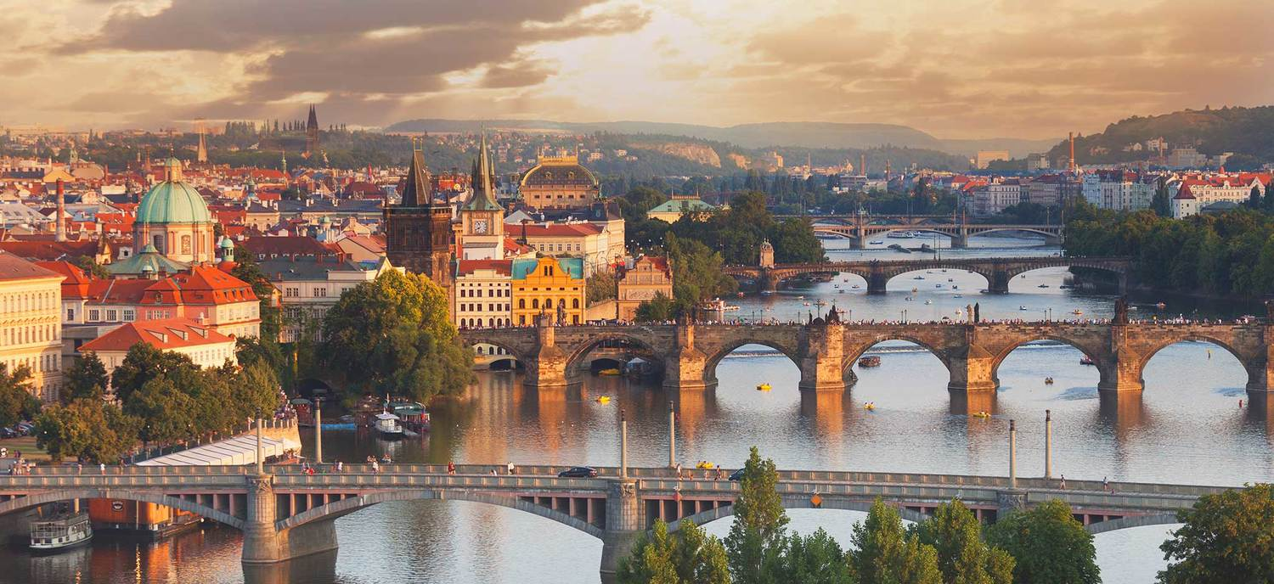
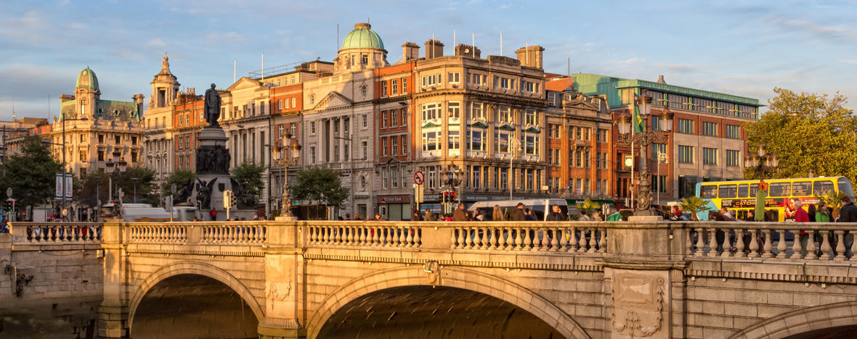
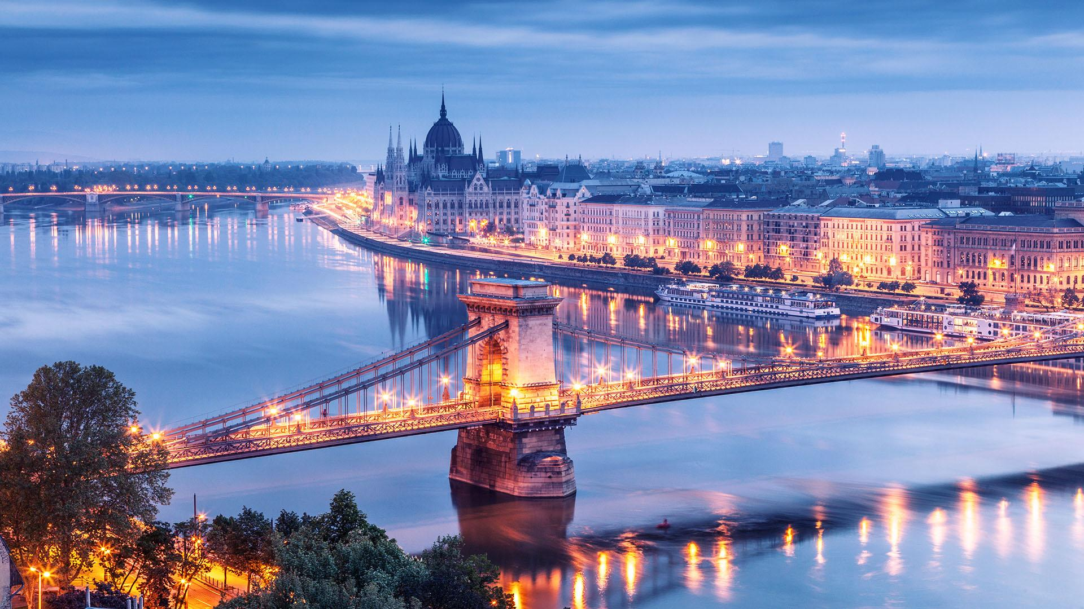
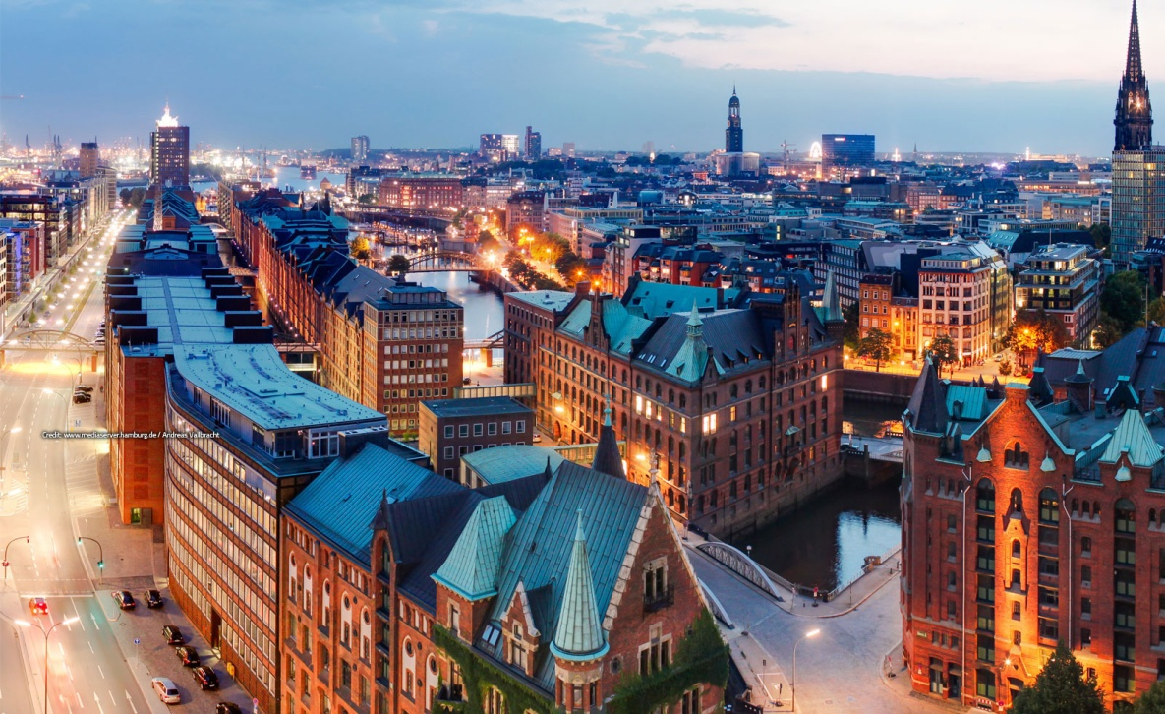
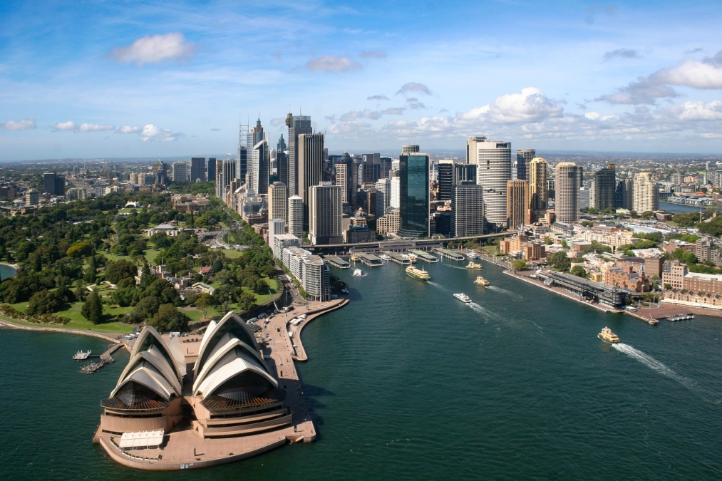
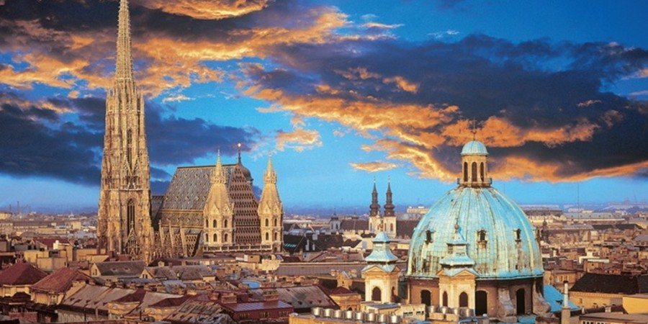
Presentations at international conferences

Slide 11
3.) PhD Defense

Slide 12
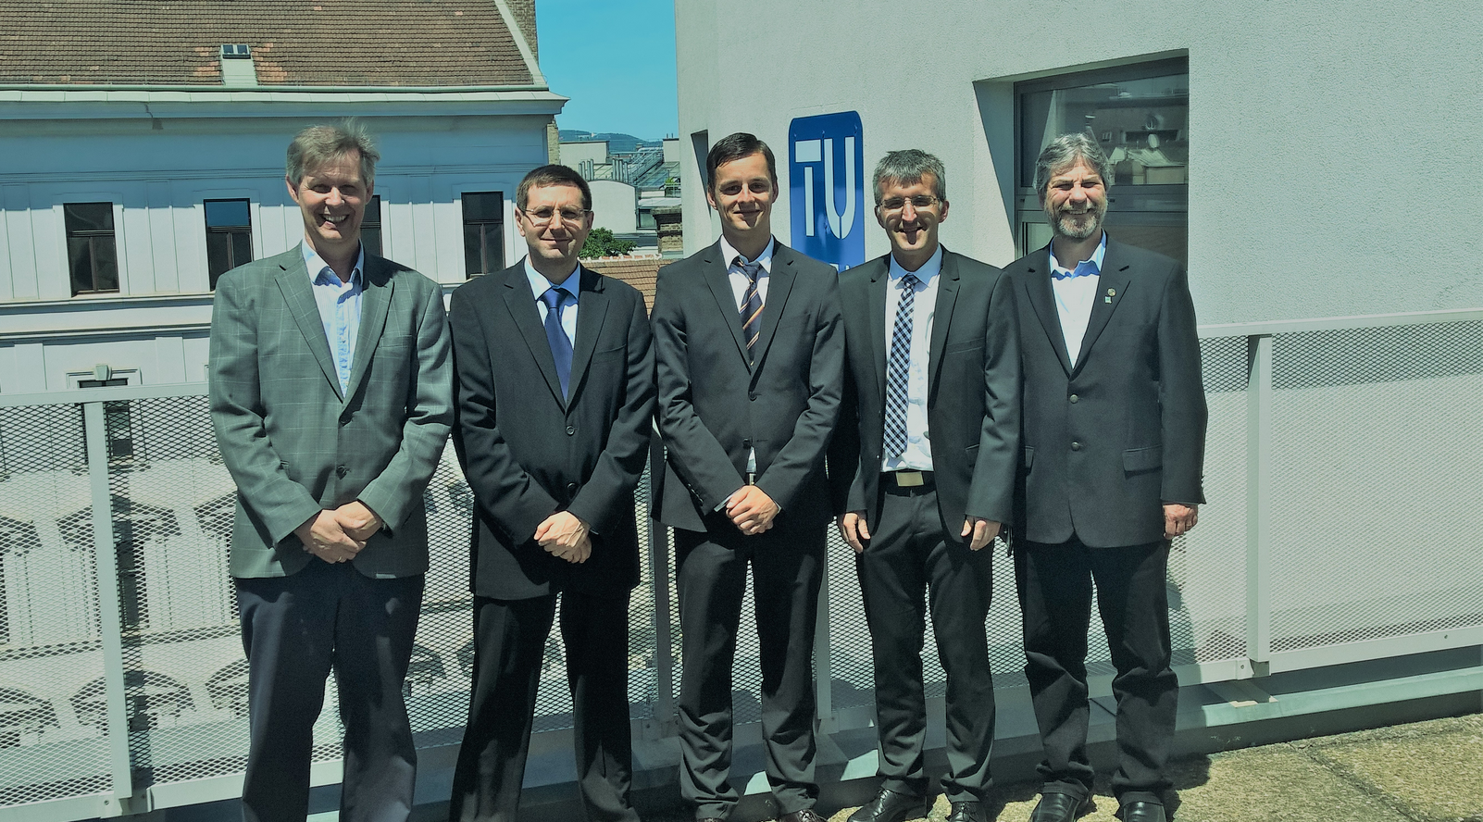
PhD Defense

Slide 13
4.) Launch of VMF server

Slide 14
vmf.geo.tuwien.ac.at

Slide 15
5.) Teaching Activities

Slide 16
Teaching Activities
120.018, UE Atmospheric Effects in Space Geodesy
124.026, UE Moderne geodätische Weltraumverfahren UE
120.020, SE Seminar der Geowissenschaften
120.071 Satellitengeodäsie UE
Supervision of a diploma thesis (Patrick Greimeister)

Slide 17
6.) GEO Green Team

Slide 18
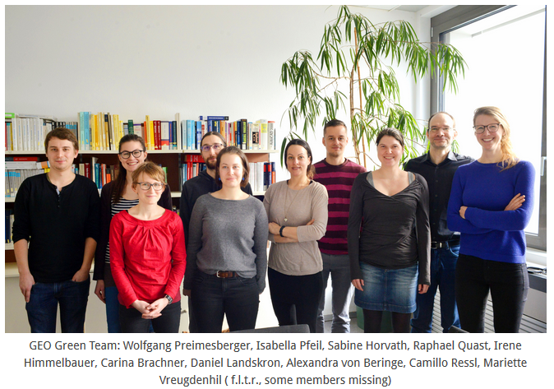
GEO Green Team

Slide 19
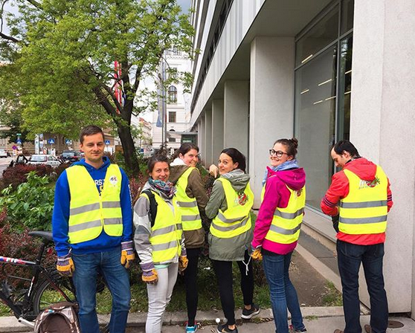
GEO Green Team
Make the department „greener“
Regular activities and events to raise awareness
Post monthly fact sheets
Frühjahrsputz
Movie nights
Other events such as bee hive visit, „Radelt zur Arbeit“, GGT Blutspendetag, …
Publish guidelines on the webpage, e.g.:
Flying emits 5 times more CO₂, 7 times more nitrogen oxide, 7 times more sulphur dioxide and 30 times more particulate matter than going by train
Computers which are on over night cause costs of more than 100 €/yr

Slide 20
GEO Green Team
Introduce direct-trade organic coffee at the whole department (currently: HG, RS, PH, GP => 12 kg/month)
Implement more sustainable standards at the department
Introduce waste separation
Spread the possibility of CO₂ compensations for flights
Order recycled paper for printers
www.geo.tuwien.ac.at/geogreenteam

Slide 21
Coffee Consumption at HG
New coffee machine
New coffee machine

Slide 22
Outlook

Slide 23
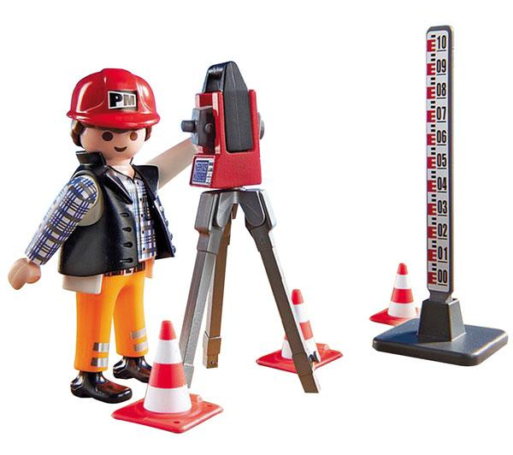
Outlook
New employment at Land Niederösterreich
Work as group leader in surveying activities
Less computer work – more field work
Less flexibility
Fewer business trips
Refresh surveying knowledge…
New colleagues, bosses…….

