Slide 1
GNSS-based Regional Ionosphere Modeling
Dzana Halilovic^{1*}, Robert Weber¹
* dzana.halilovic@geo.tuwien.ac.at
¹ Technical University Vienna, Department of Geodesy and Geoinformation, Vienna, Austria
SGI 2019 Workshop, Berlin, Germany, 26 – 27 September 2019

Slide 2
Overview
Motivation
Methodology
Model overview (main characteristics)
Mapping function and Linear combination
Processing steps
Analysis
Validation sites, Output files, Models
Results and statistics
Conclusions and further work

Slide 3
Motivation
Partnership in the GRC (Galileo Reference Centre) MS Consortium established by the GSA (European GNSS Agency)
Aim of the WP:
To study and analyze the performance of the NeQuick G ionospheric model in different latitudinal regions
Comparison to the GPS Klobuchar model
Evaluation based on data from stations in three latitude regions
WP Technical coordination
Norvegian Mapping Authority | NMA | NO
WP Participants
TU Wien (Technical University of Vienna) | TUV | AT
University of Porto | FCUP | PT
Space Research Centre, Polish Academy of Sciences | SRC/CBK | PL

Slide 4
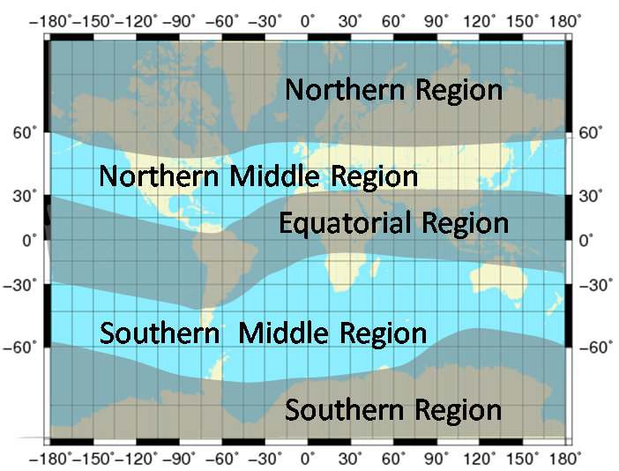
Motivation
High latitudes (above 55° north)
Central European latitudes (TUW region)
Azores and equatorial region

Slide 5
Methodology: Model overview
Network: 35 permanent ground stations
Start DoY: 274 (2018)
Grid size: 0.5°x 0.5°
Coverage: +30° to +65° lat -15° to +45° lon
Temporal resolution: 1h (25 maps in file)
Observation type: geometry-free zero-difference code and carrier phase
Sat.system: GPS+Galileo
Integrated electron density: Described by spherical harmonics (up to degree 6)
Software: Bernese v.5.2
(Post-processing mode)
Starting DoY with more Galileo data: 182 (2019)
(Galileo contribution increased from 5 to 19 stations) → Quarter 3 to be analyzed after Sept 2019

Slide 6
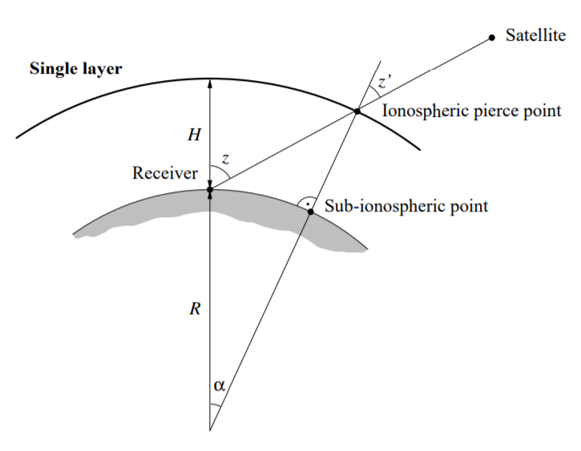
Methodology: Mapping function
MSLM (Modified Single-Layer Model)
All free electrons are concentrated in a shell of infinitesimal thickness at an effective height H (height of maximum electron density at the F2 peak and ranges from 350 km to 450 km.
$$F_{I}\left(z\right)= \frac{E}{E_{V}}= \frac{1}{\cos{z′}}$$
$$\sin{z′}= \frac{R}{R+H}\sin\left(αz\right) where$$
$z, z^{′}…zenith distances at the heights$ $of$
$the station$ $and of the single$ $layer$
$$R……mean Radius of the Earth$$ $H……height of the single layer$ $above$
$$the Earth^{′}s surface (450 km) \\ α……correction factor$$
Single-layer model

Slide 7
Methodology: Linear combination
Geometry-free linear combination (L4)
$$L_{4}=−a\left(\frac{1}{f_{1}^{2}}−\frac{1}{f_{2}^{2}}\right)F_{I}\left(z\right)E\left(β,s\right)+B_{4}$$
$$P_{4}=+a\left(\frac{1}{f_{1}^{2}}−\frac{1}{f_{2}^{2}}\right)F_{I}\left(z\right)E\left(β,s\right)+b_{4} where$$
$$L_{4}, P_{4}……………….geometry−free phase and code observables$$
$$(in meters)$$
$$f_{1},f_{2}……………….frequencies associated with the carriers L_{1} and L_{2}$$
$$a……………………constant (=4.03∗{10}^{17}{ms}^{−2}{TECU}^{−1})$$
$$F_{I}\left(z\right)……………….mapping function for zenith distance z′$$
$$E\left(β,s\right)…………….vertical TEC \left(in TECU\right)as a function of geographic or$$
$$geomagnetic latitude β and sun−fixed longitude s$$
$$B_{4}=λ_{1}B_{1}−λ_{2}B_{2}..constant bias \left(in meters\right)due to the initial phase$$
$$ambiguities B_{1} and B_{2} with the corresponding$$
$$wavelengths λ_{1} and λ_{2}$$

Slide 8
Methodology: Processing steps
1. Preparation
2. Preprocessing
3. Processing
Extraction of:
clock (*.clk)
pole (*.erp) and
precise orbit (*.sp3)
information
Site coordinate extrapolation to current epoch
Code observations screening and smoothing
Rinex files conversion → Bernese formatted file
First SPP solution:
receiver clock synchronization
Phase observations preprocessing
cycle slip detection and correction
outlier detection
Data residual screening (L3)
Outlier identification
Marking identified outliers in observation files
PPP solution
final site coordinate estimation
Generate ionosphere model (L4)
station DCB estimation

Slide 9
Analysis
Sites for validation:
NICO ……………. 30°- 40° lat
AJAC
GRAS ……….. 40°- 50° lat
LEOP
JOZ2 .....……….. 50°- 55° lat
used for DoY 274 (2018) – 90 (2019)
Sites for validation:
NICO ……………. 30°- 40° lat
AJAC
GRAS ……….. 40°- 50° lat
LEOP
WROC .....…….. 50°- 55° lat
used for DoY 91 (2019) -
Output files
Daily VTEC maps for Central Europe
Daily VTEC difference maps for Central Europe w.r.t CODE
Daily site specific range difference plots
Daily site specific residual IONO Slant Error plots
Compared models
TUW regional
NeQuick Gal
GPS Klobuchar
Reference: CODE

Slide 10
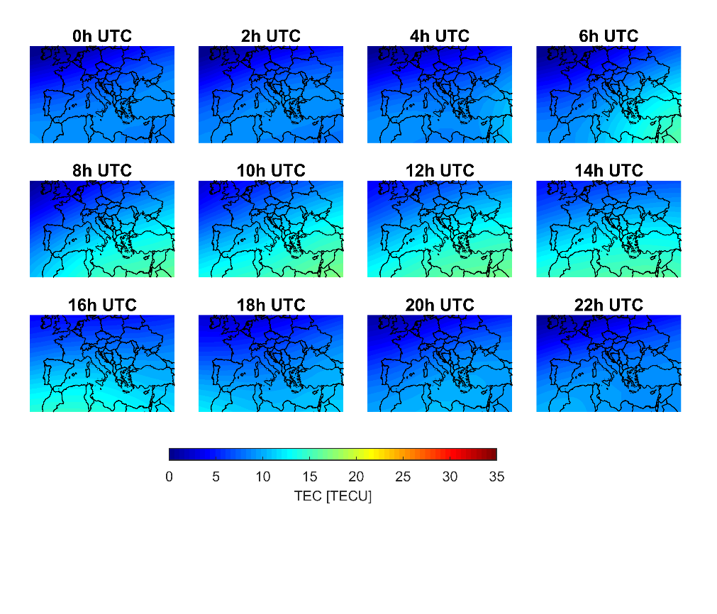
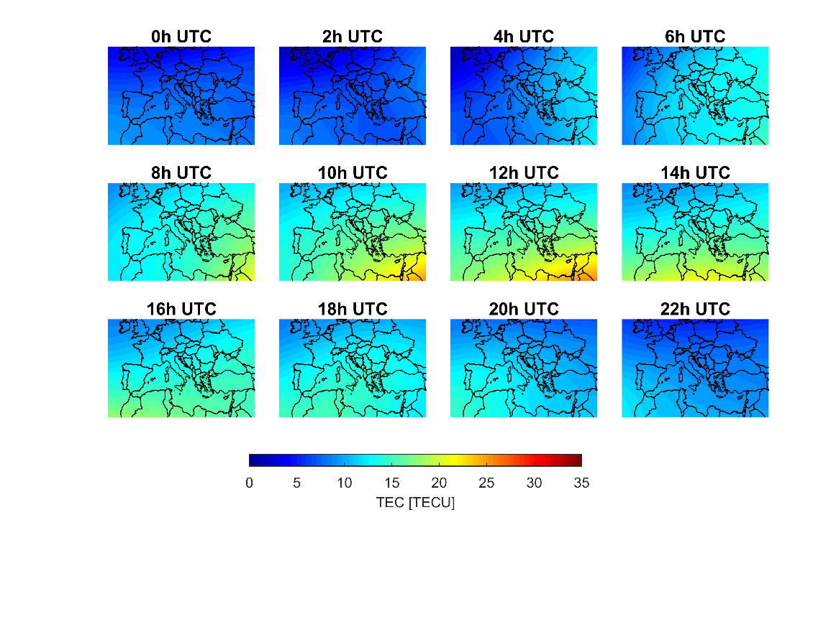
Analysis: Results
VTEC maps (TUW regional model)
DoY 046 (Q1/2019)
Jan - Mar
DoY 135 (Q2/2019)
Apr - Jun

Slide 11
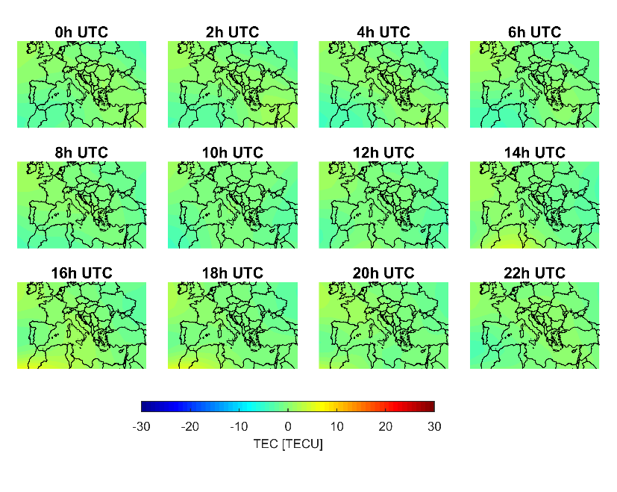
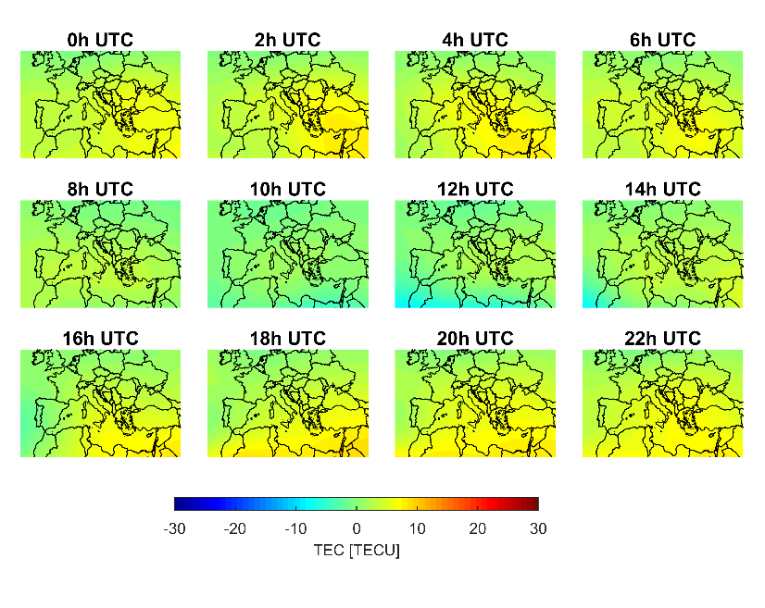
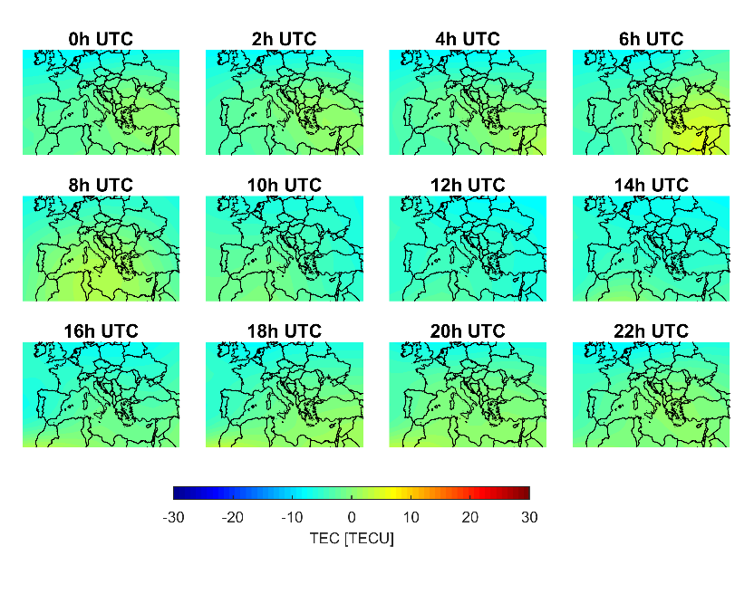
Analysis: Results
VTEC difference maps for Central Europe w.r.t CODE
TUW regional w.r.t. CODE
Differences up to ~ 4 TECU for this day
DoY 046 (Q1/2019)
DoY 046 (Q1/2019)
GPS Klobuchar w.r.t. CODE
Differences up to ~ 8 TECU for this day
NeQuick Gal w.r.t. CODE
Differences up to ~ 8 TECU for this day
DoY 046 (Q1/2019)

Slide 12
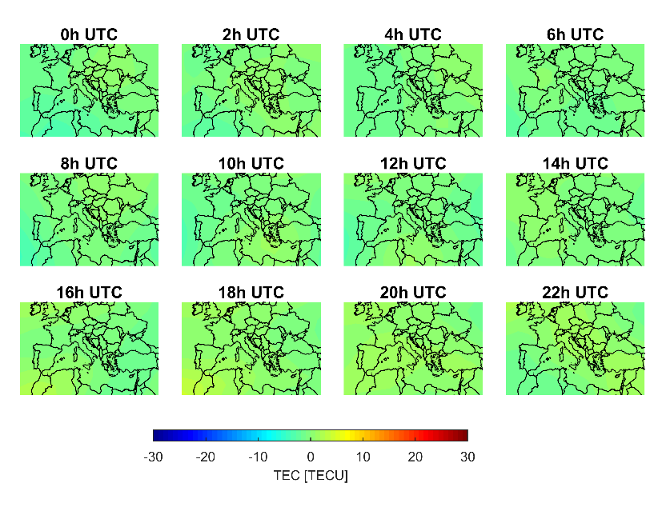
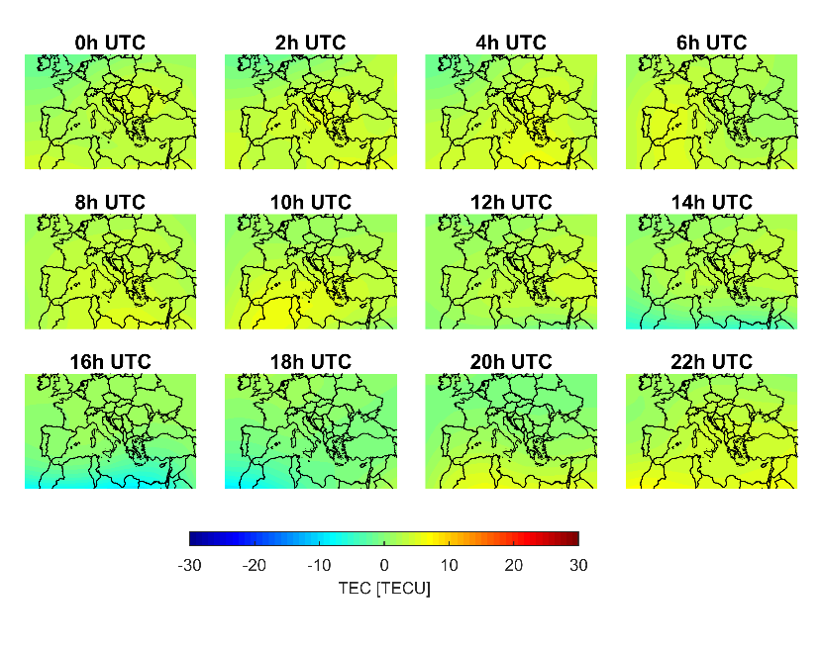
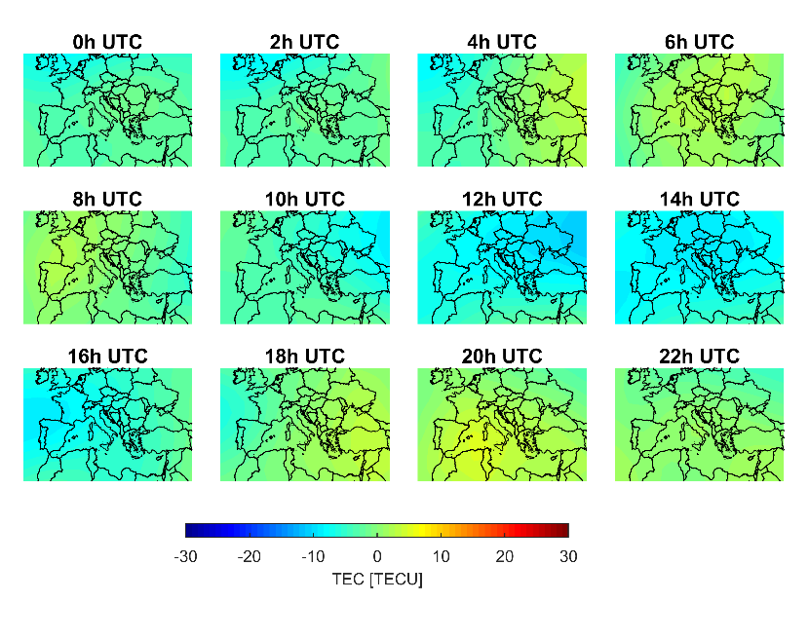
Analysis: Results
VTEC difference maps for Central Europe w.r.t CODE
TUW regional w.r.t. CODE
Differences up to ~ 3 TECU for this day
DoY 135 (Q2/2019)
DoY 135 (Q2/2019)
GPS Klobuchar w.r.t. CODE
Differences up to ~ 10 TECU for this day
NeQuick Gal w.r.t. CODE
Differences up to ~ 7 TECU for this day
DoY 135 (Q2/2019)

Slide 13
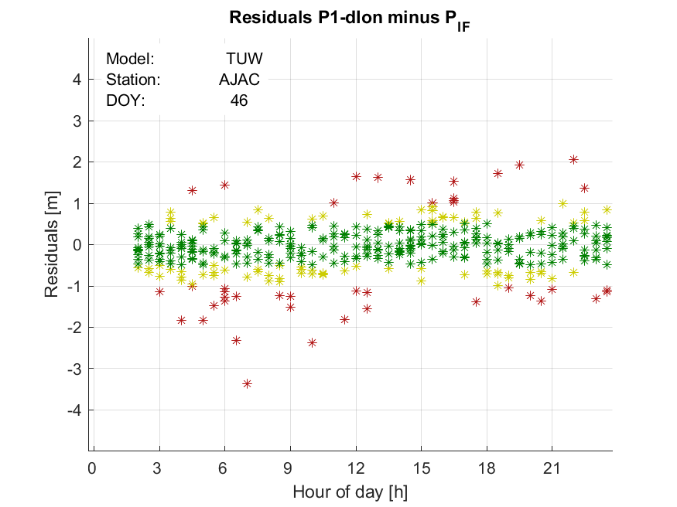
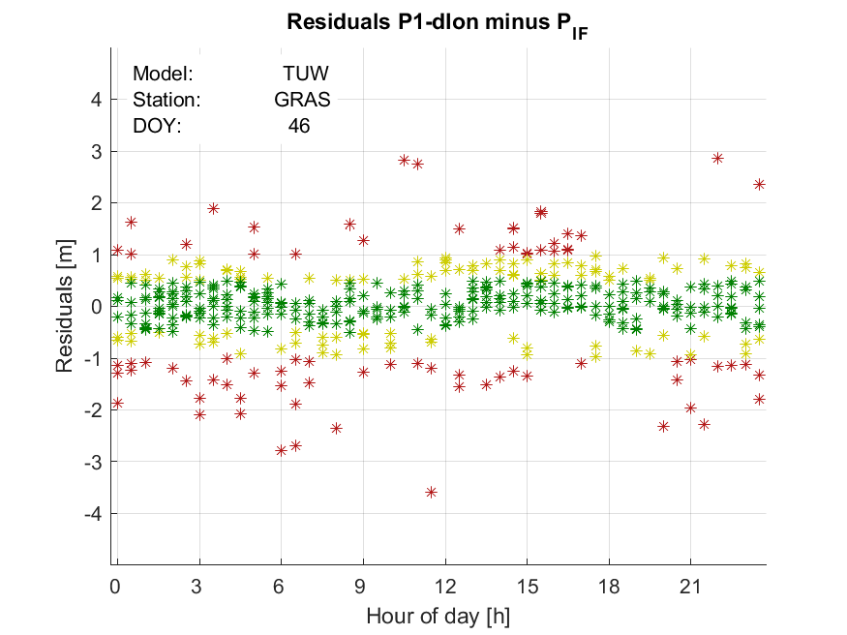
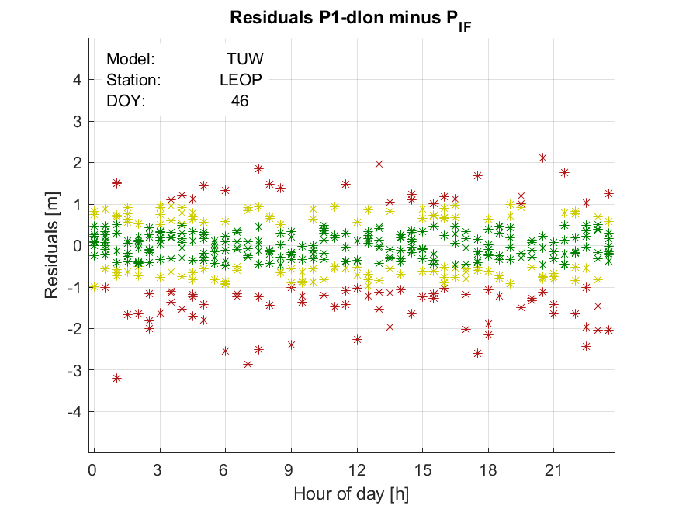
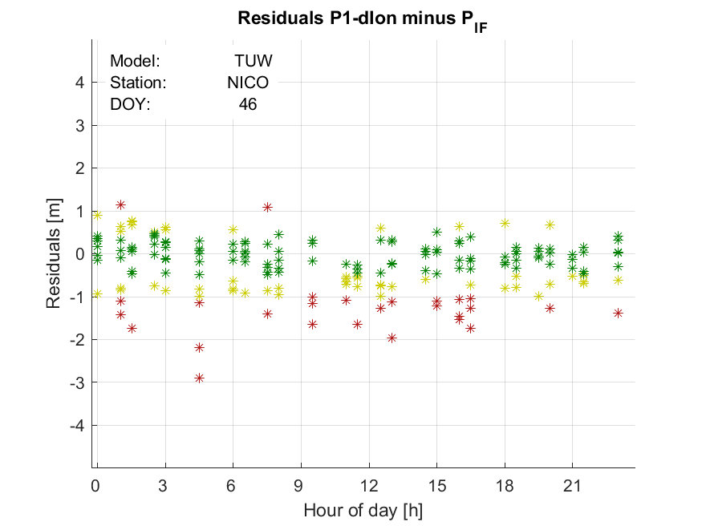
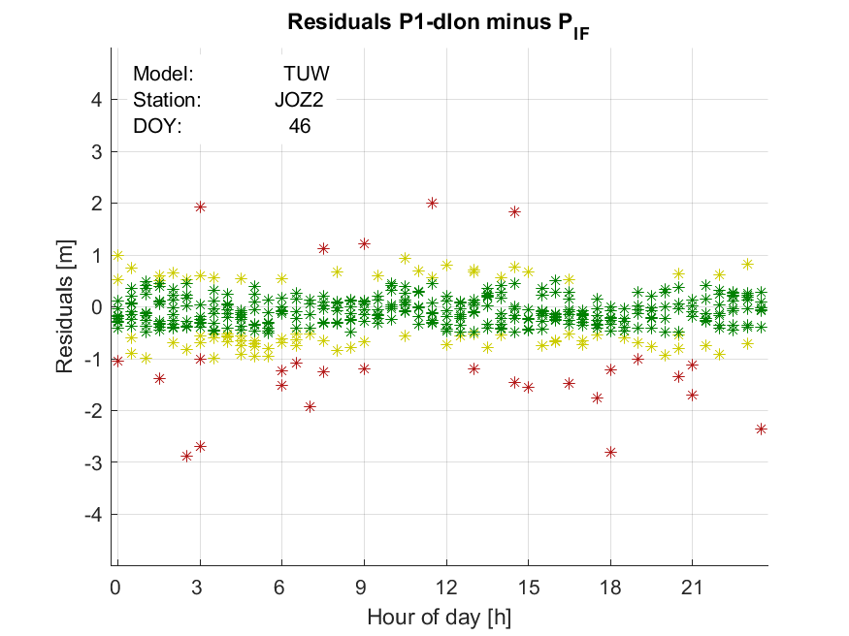
Analysis: Results
Daily site specific range difference plots (I)
L1+model w.r.t ionosphere-free linear combination (L3)
Mean range difference statistics (%)
Model (%) | <0.5m | <1m | <1.5m
CODE | 66,59 | 88,35 | 95,43
TUW reg. | 62,99 | 86,43 | 94,31
NeQuick G | 35,74 | 62,69 | 83,12
Klobuchar | 38,16 | 64,39 | 80,30
DoY 046 (2019)

Slide 14
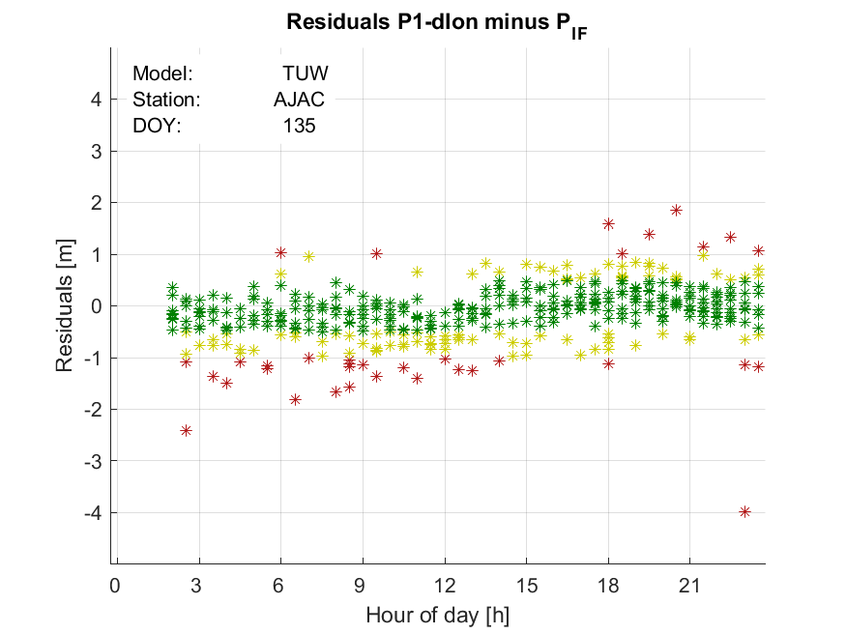
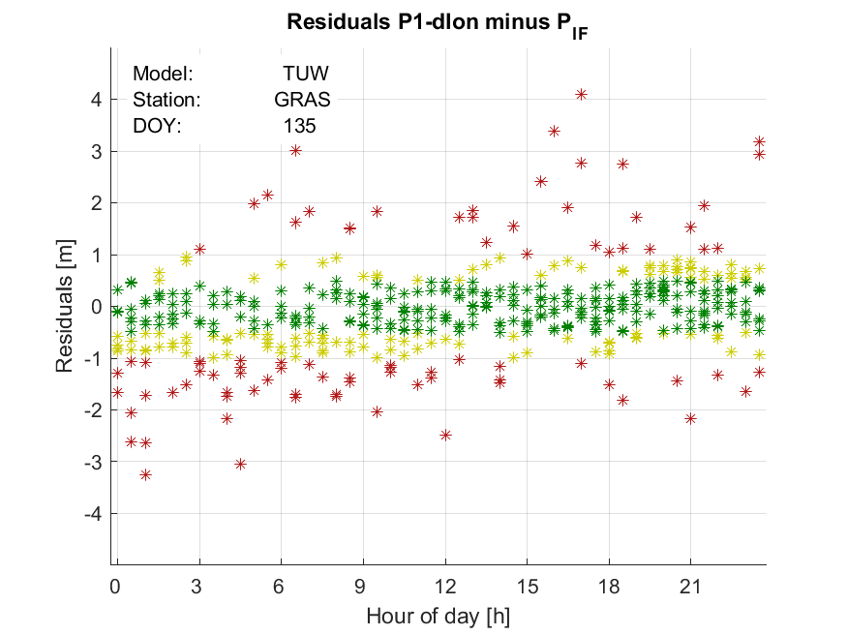
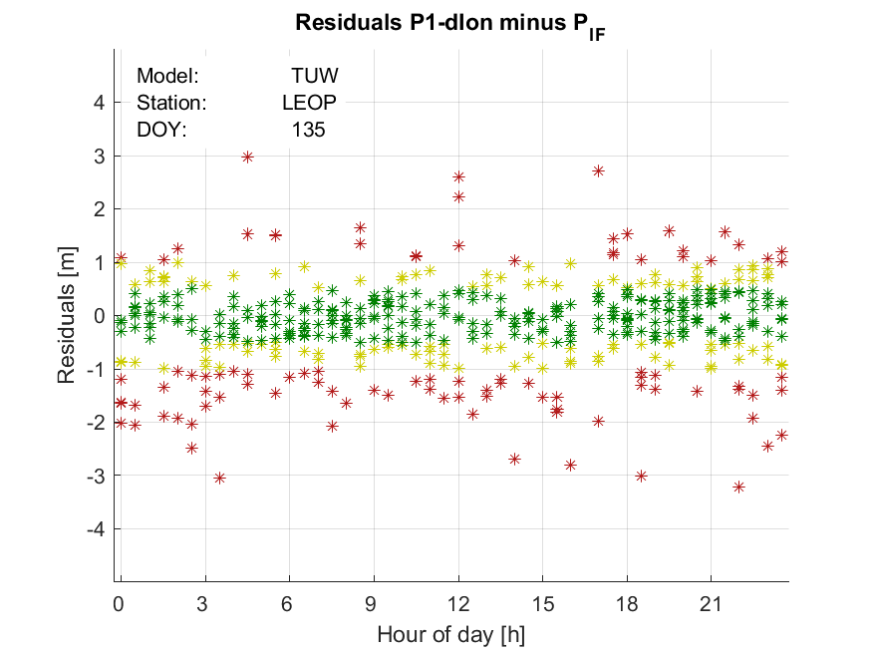
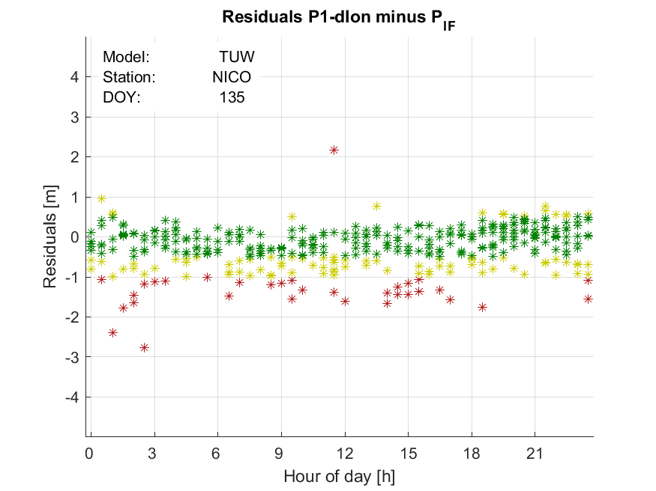
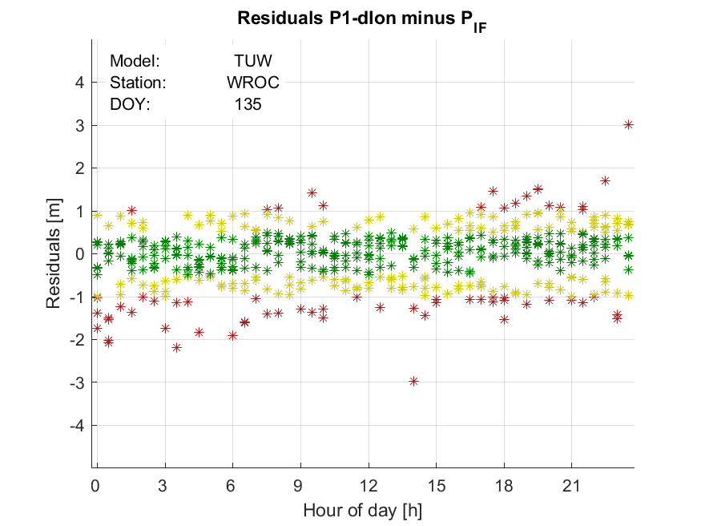
Analysis: Results
Daily site specific range difference plots (II)
L1+model w.r.t ionosphere-free linear combination (L3)
Mean range difference statistics (%)
Model (%) | <0.5m | <1m | <1.5m
CODE | 62,66 | 87,26 | 95,78
TUW reg. | 60,47 | 86,77 | 95,59
NeQuick G | 42,12 | 75,75 | 91,65
Klobuchar | 32,09 | 54,22 | 69,08
DoY 135 (2019)

Slide 15
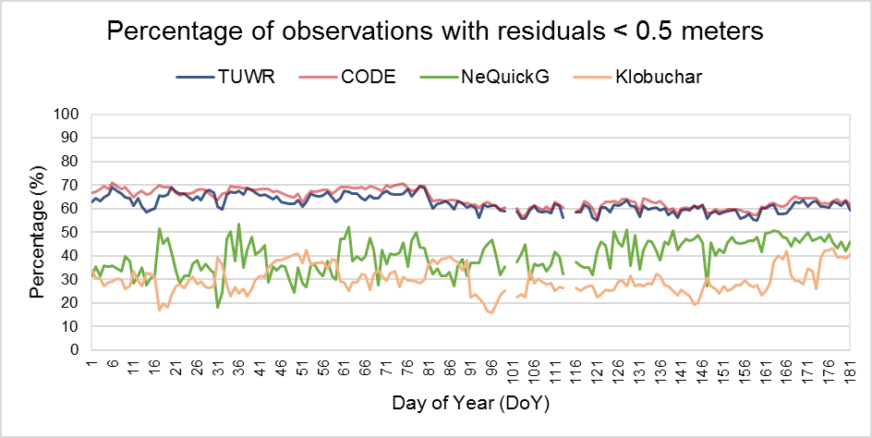
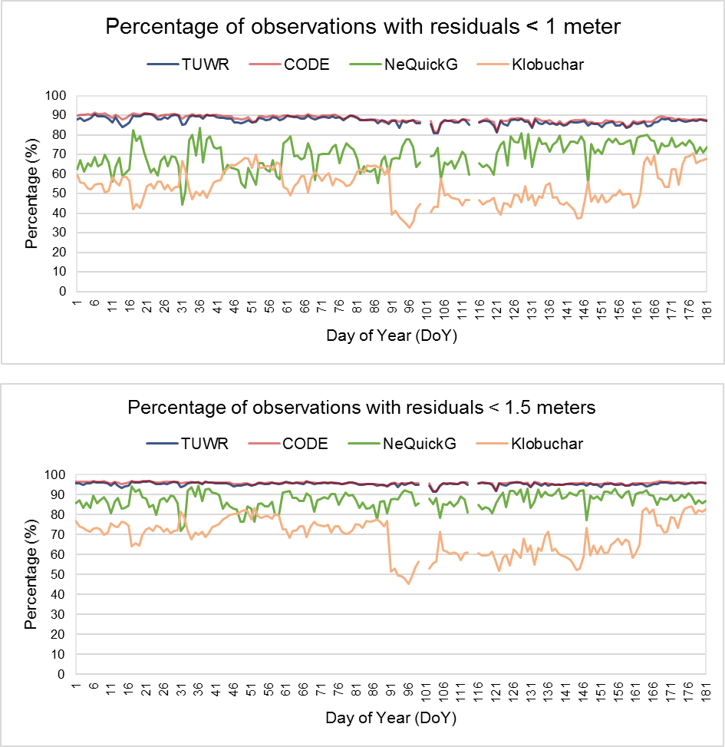
Analysis: Results
Daily site specific range difference plots - Statistics
Mean range difference statistics (%)
Model | <0.5m | STD | <1m | STD | <1.5m | STD
CODE | 64,32 | 3,71 | 88,29 | 1,74 | 95,86 | 0,70
TUW reg. | 62,30 | 3,48 | 87,30 | 1,81 | 95,43 | 0,80
NeQuick G | 39,78 | 6,98 | 69,55 | 7,18 | 87,28 | 4,05
Klobuchar | 29,86 | 5,88 | 53,57 | 8,46 | 69,28 | 9,00
DoY 001-181 (2019)

Slide 16
Analysis: Results
Daily site specific residual IONO Slant Error plots (I)
STEC_{REF} - STEC_{MOD}
observation
reference value
model
tested value
2-freq. derived STEC
Model derived STEC
to all visible satellites in all elevation angles
Project defined specification

Slide 17
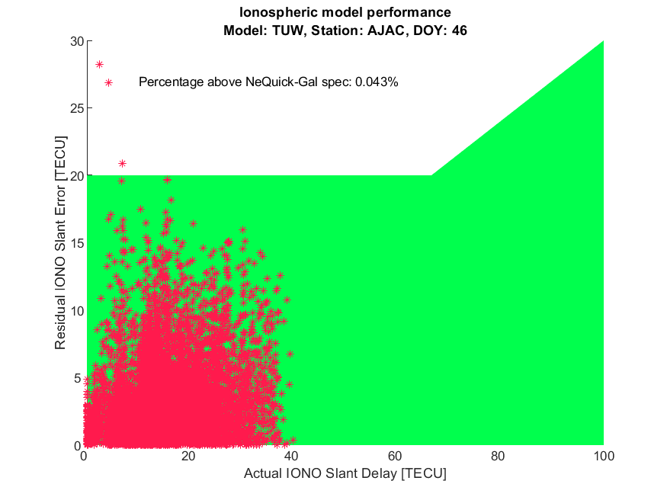
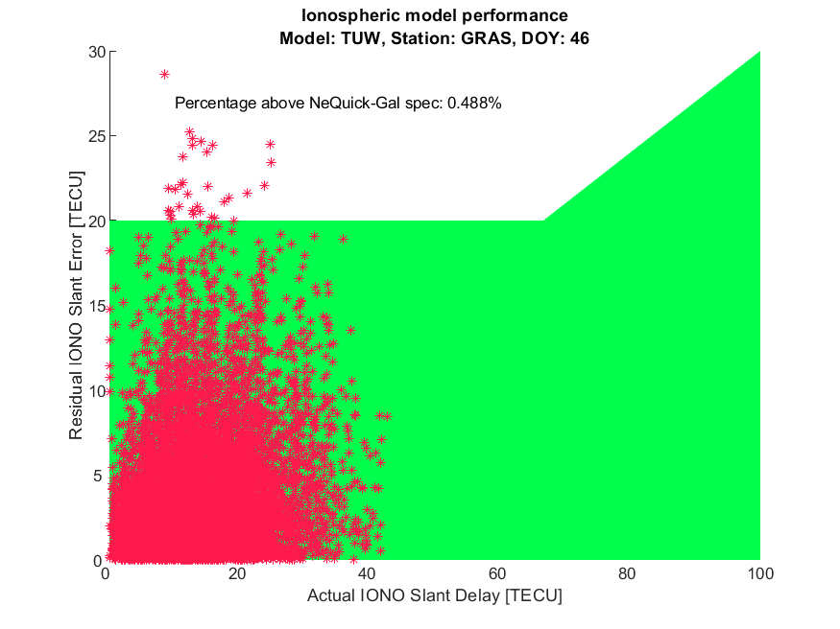
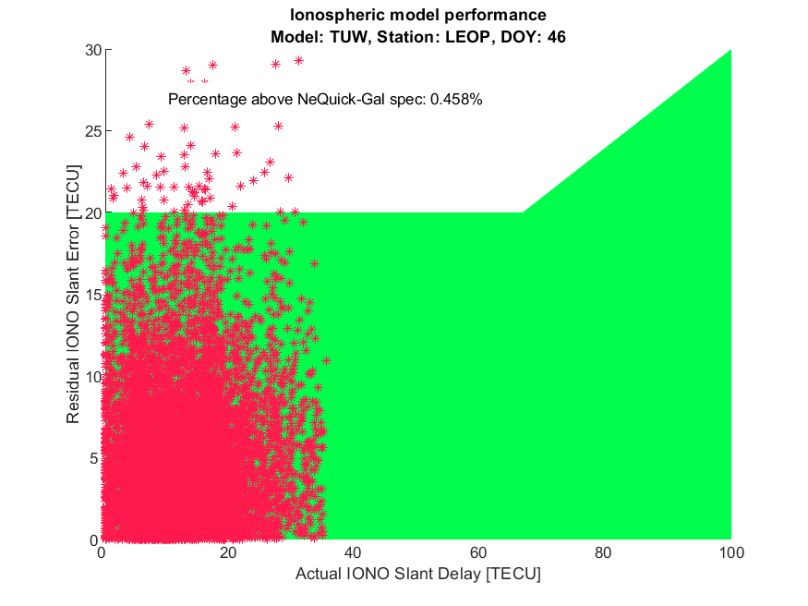
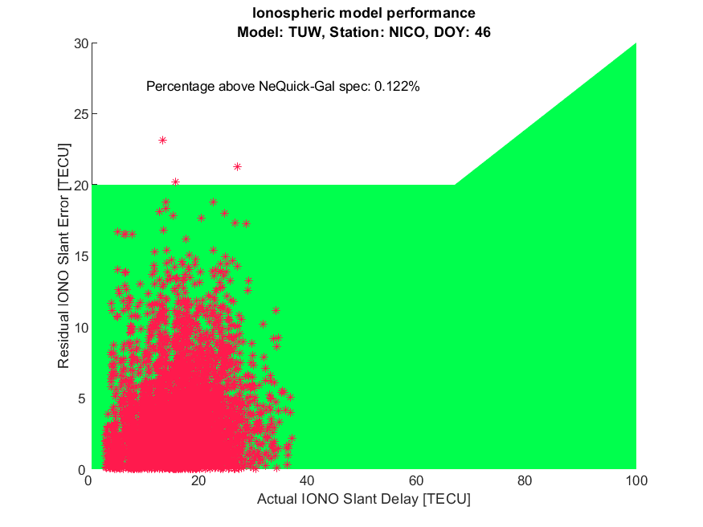
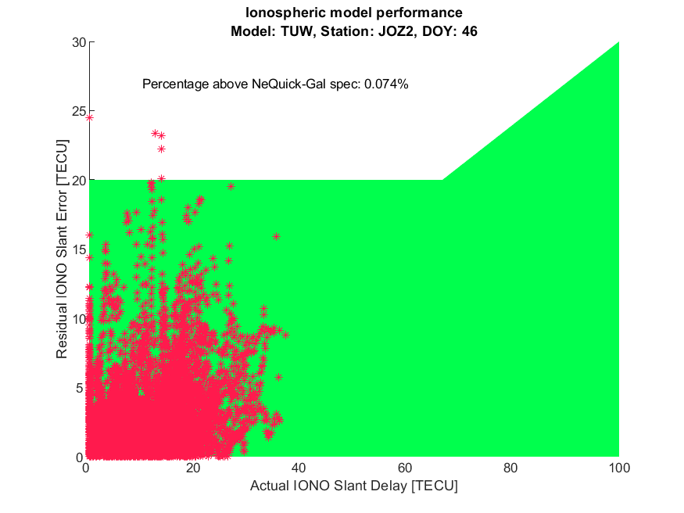
Analysis: Results
Daily site specific residual IONO Slant Error plots (II)
STEC_{REF} - STEC_{MOD}
Model | Points outside NeQuickG spec. (%)
CODE | 0,20
TUW reg. | 0,26
NeQuick G | 0,54
DoY 046 (2019)

Slide 18
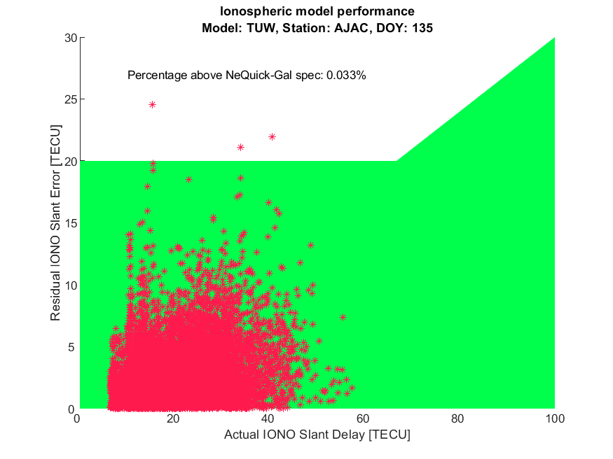
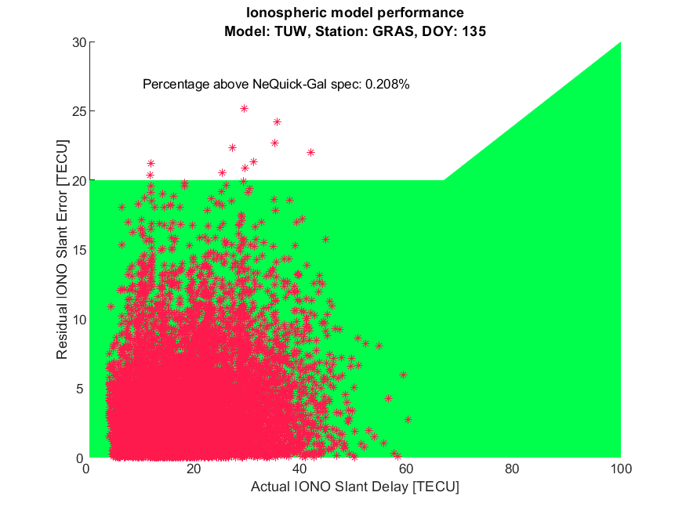
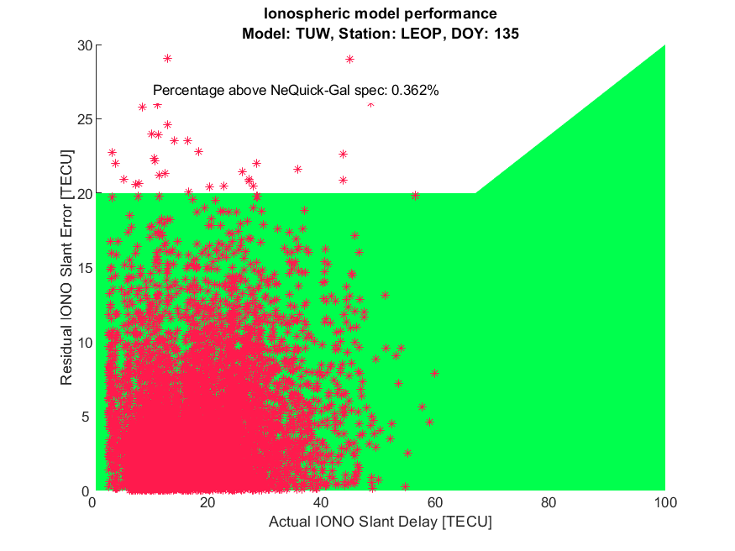
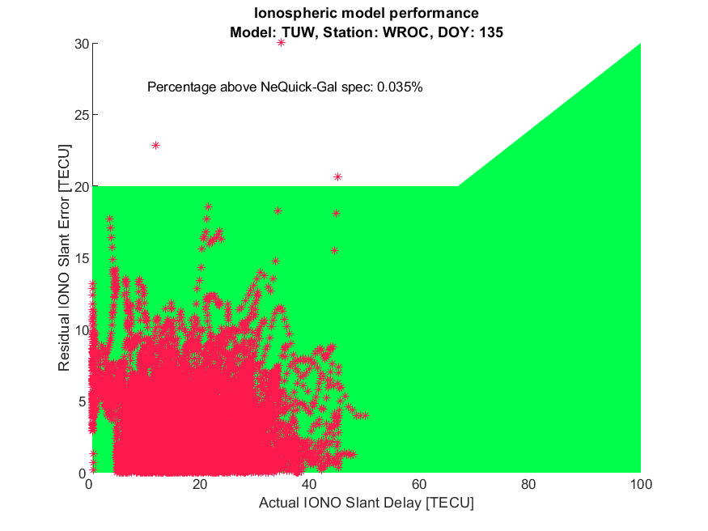
Analysis: Results
Daily site specific residual IONO Slant Error plots (III)
STEC_{REF} - STEC_{MOD}
Model | Points outside NeQuickG spec. (%)
CODE | 0,16
TUW reg. | 0,14
NeQuick G | 0,36
DoY 135 (2019)

Slide 19
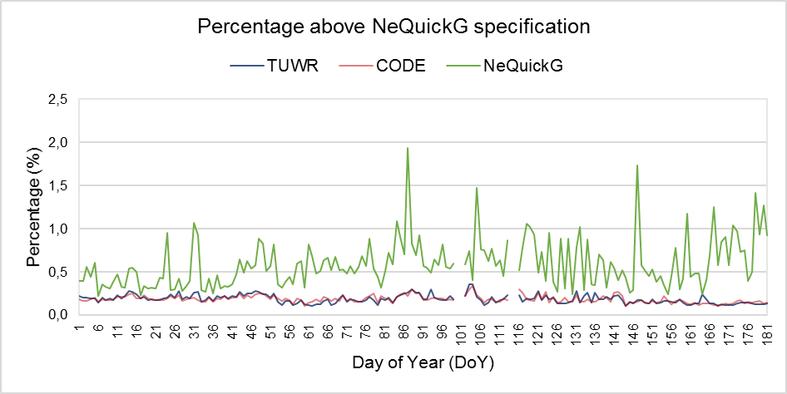
Analysis: Results
Daily site specific residual IONO Slant Error plots - Statistics
Mean IONO slant error statistics
Model | Points outside NeQuickG spec. (%)
CODE | 0,19
TUW reg. | 0,19
NeQuick G | 0,59
DoY 001-181 (2019)
Daily mean percentage of epochs outside the NeQuick G specification

Slide 20
Conclusions
A notable agreement between the TUW regional model and the CODE model, used as a reference (differences up to 5 TECU)
A useful model to provide ionospheric information for single-frequency GNSS users in the European mid-latitude region
Further work
Increased amount of multiGNSS observations in the existing processing included
→ First results after September 2019 (for Q3)
Analyze model performance including other satellite systems
Check for stations from other networks (eg. EUREF) to improve model performance on map boundaries
Looking for the next year’s Consortium contract with GSA
Check if our results still match GSA KPIs for this work package

Slide 21
Thank you for your attention!

