Slide 1
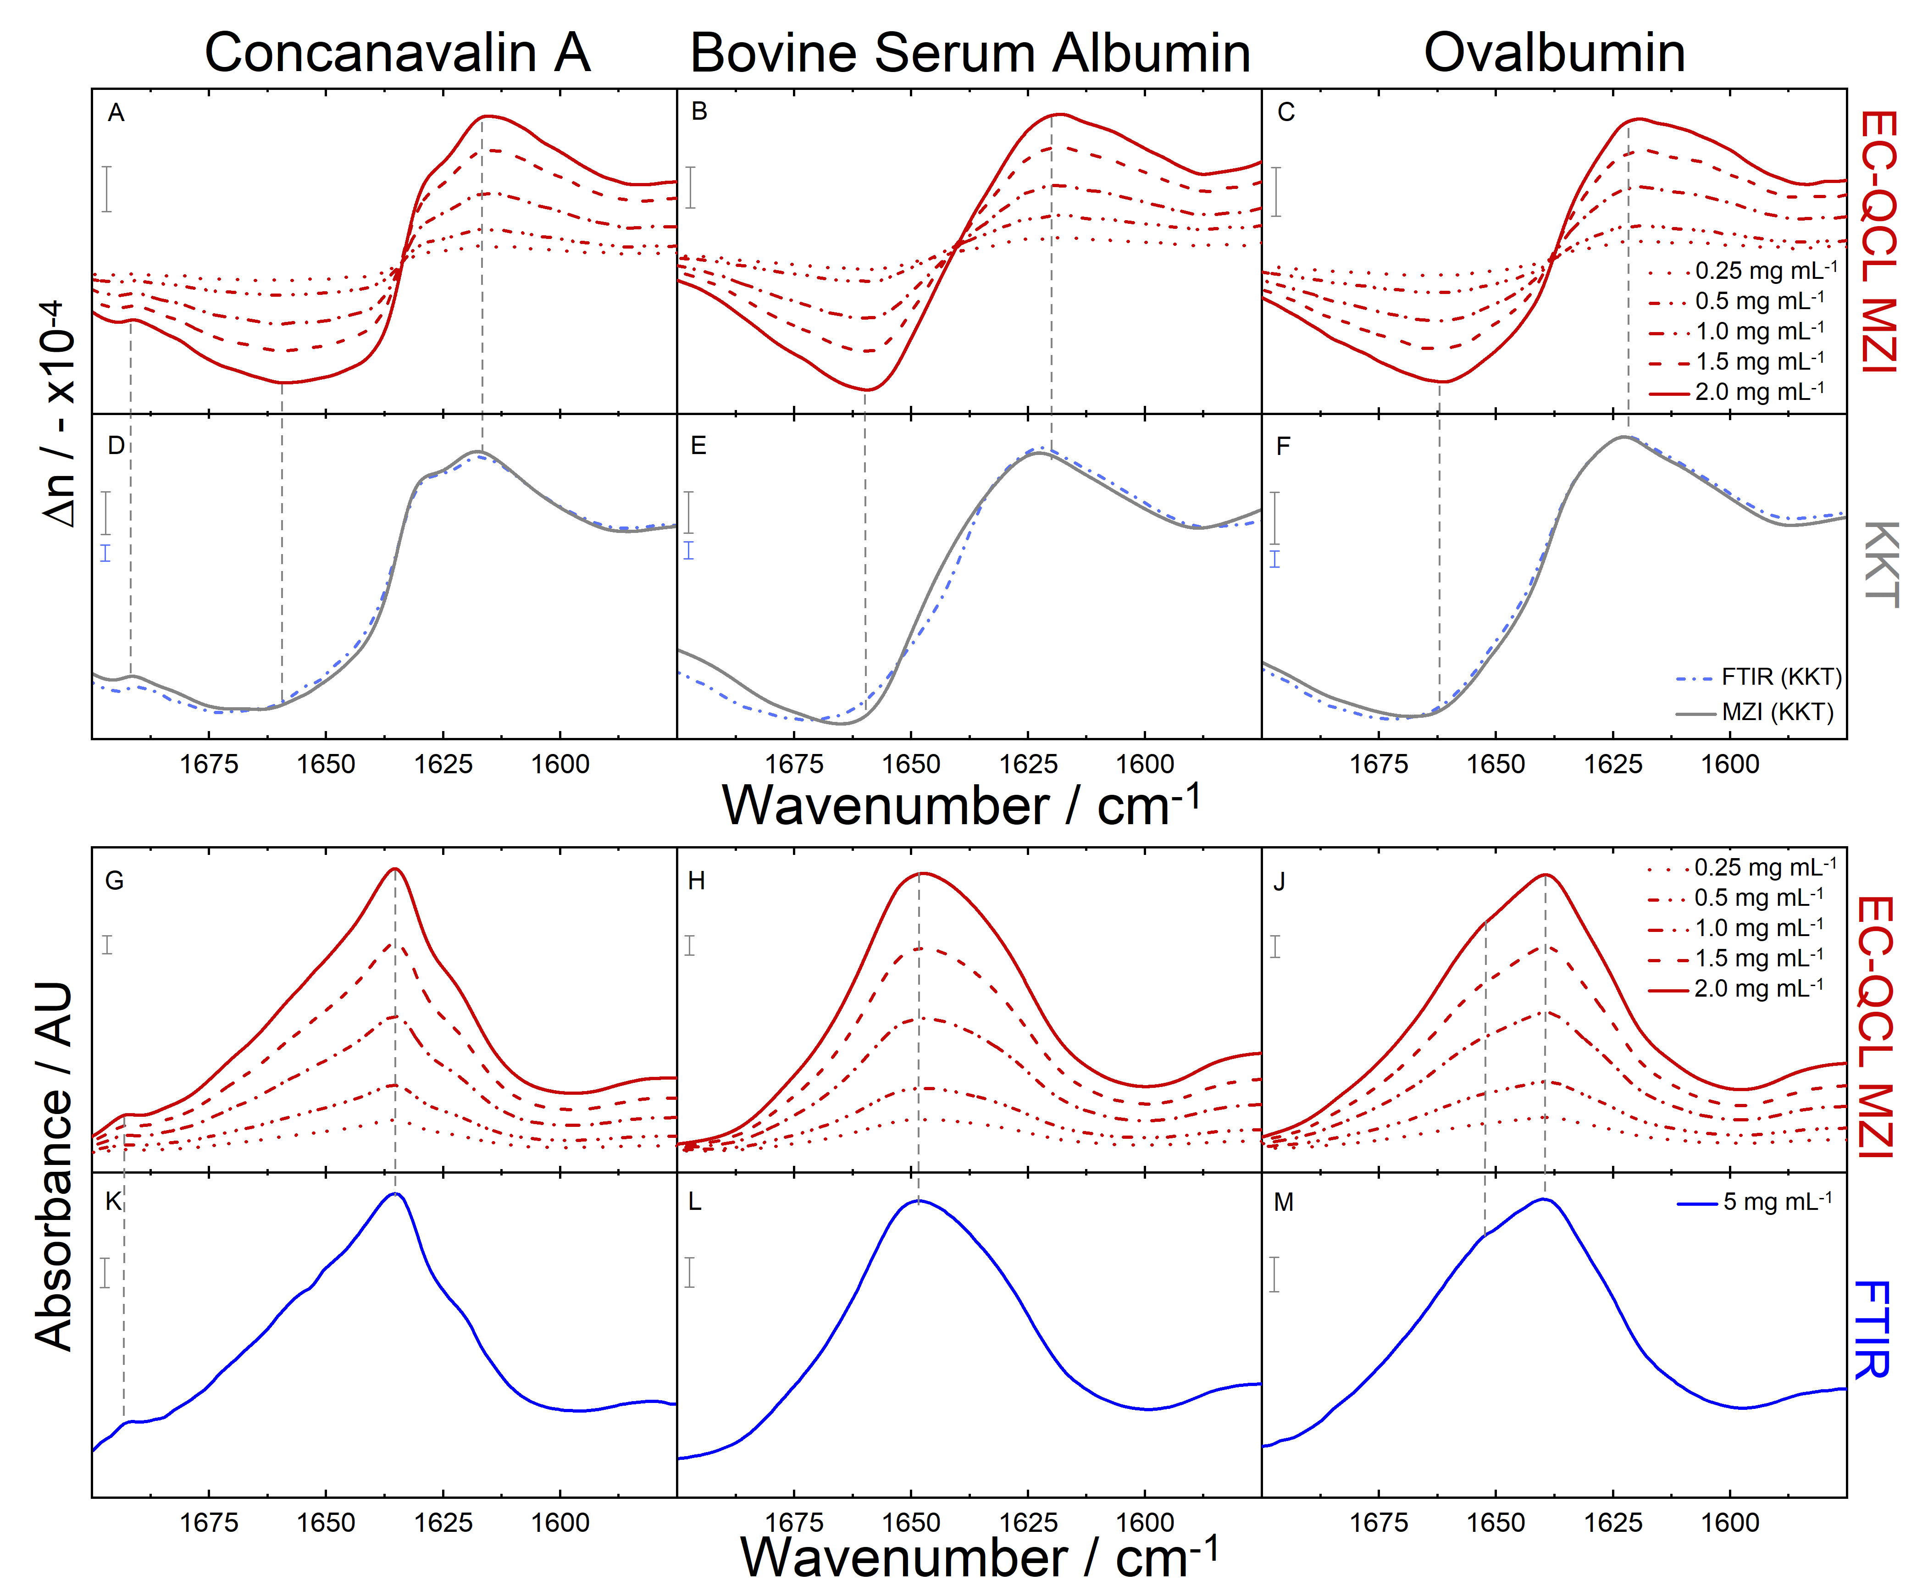
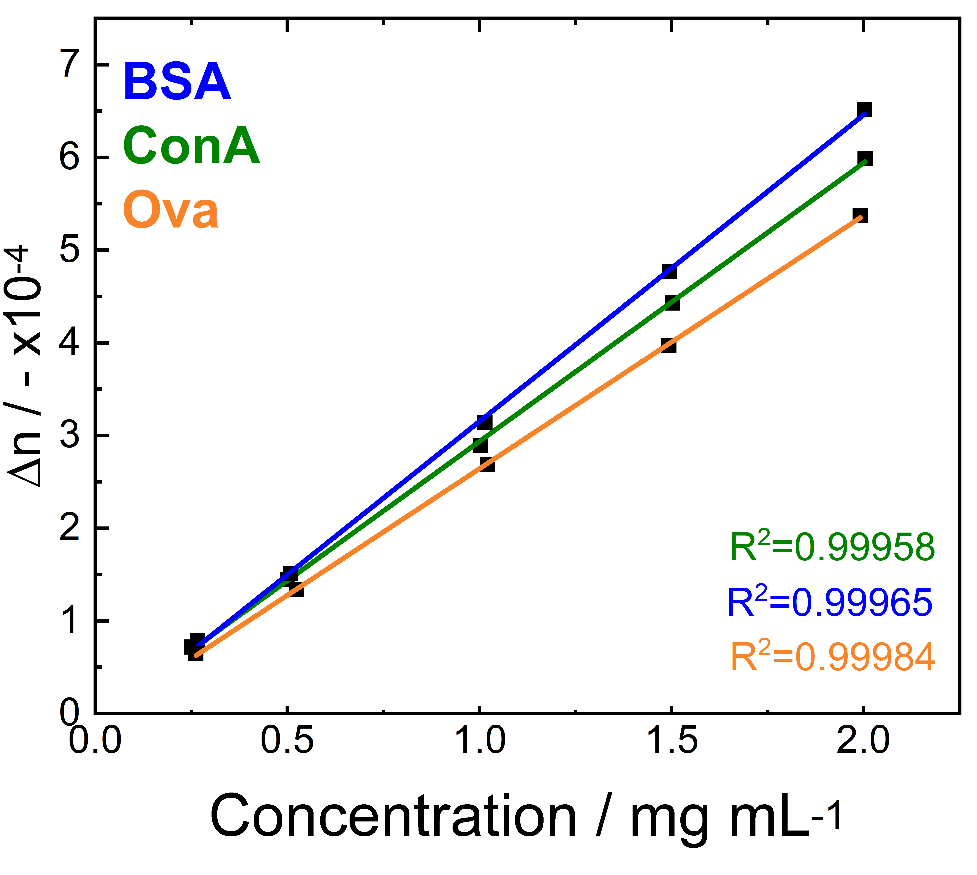
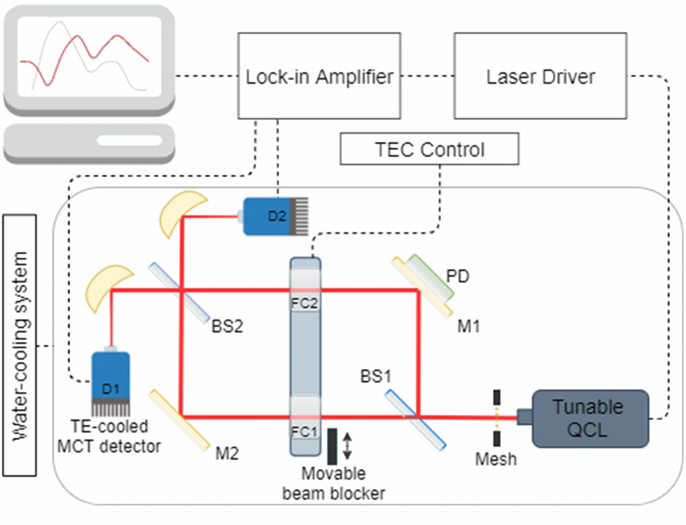
Mid-IR Laser-based Dispersion Spectroscopy in Liquids
Alicja Dabrowska, Andreas Schwaighofer, Stefan Lindner, Bernhard Lendl
alicja.dabrowska@tuwien.ac.at
Institute of Chemical Technologies and Analytics, Technische Universität Wien, Getreidemarkt 9, A-1060 Vienna, Austria
www.cta.tuwien.ac.at/cavs
Introduction
Dispersion Spectra of Proteins
Quantitative Results
In this work, we report an external-cavity quantum cascade laser (EC-QCL)-based Mach Zehnder Interferometer (MZI) setup for dispersion spectroscopy of liquid-phase samples. This novel sensing concept, exploiting the coherent nature of EC-QCLs, was applied for qualitative and quantitative analysis of proteins in heavy water [1]. The developed setup allows for fast acquisition of high resolution dispersion (refractive index, RI) spectra in transmission configuration.
Quantitative analysis of the dispersion spectra was performed by assessing the amplitude of the Δn function in the anomalous dispersion region occuring in the vicinity of an absorbance band.
The calibration method confirmed the expected high linearity (R²>0.999) of the refractive index function with concentration.
Dispersion vs. Absorption Spectroscopy
Dispersion spectroscopy measures changes in refractive index (or phase shift), whereas absorption spectroscopy measures the attenuation of light intensity.
Detection based on interferometric approach
and coherent laser sources (QC lasers)
Method established for gas-phase samples
Novel approach for liquid-phase samples
$$\overline{n}\left(\tilde{v}\right)=n\left(\tilde{v}\right)+iκ\left(\tilde{v}\right)$$
For the investigated proteins, the limit of detection achieved for dispersion measurement (0.007 mg mL⁻¹) was in the same order of magnitude as compared to conventional FTIR spectroscopy.
$$∆φ=\frac{2π}{λ}\left(n−n_{0}\right)L$$
Regions of the rapid change in the refractive index (anomalous dispersion) coincide very well the respective absorbance bands.
The recorded dispersion spectra were referenced to the KK transformed FTIR absorbance spectra. The shape and positions of the measured spectra agree very well with the calculated spectra, proving the ability of dispersion spectroscopy and the built setup to discriminate between proteins with different secondary structures.
Sample
(gas/liquid/solid)
Advantages of dispersion spectroscopy:
Immune to power fluctuations
Linear output with concentration
Baseline-free
L
Experimental Setup
Conclusions & Outlook
References
EC-QCL (Daylight Solutions) with a tuning range of 1730–1470 cm^{–1}.
A Mach-Zehnder interferometer generates the interference signal that allows to retrieve the information about the relative phase shifts Δφ, caused by the refractive index $n$ of the absorbing sample introduced in one arm of the MZI.
MCT detectors (Vigo Systems S.A.)
Refractive index sensing can be successfully used to derive qualitative and quantitative information about liquid-phase sample.
Dispersion spectroscopy achieves similar figures of merit as established high-end FTIR spectroscopy at similar acquisition times.
Measurements of RI fluctuations with accuracy down to 10⁻⁷.
Future outlook: (i) miniaturization of the sensor, (ii) implementation of fast, hysteresis-free phase locked interferometric detection, (iii) implementation of an evanescent-wave MZI setup.
[1] A. Dabrowska, A. Schwaighofer, S. Lindner, and B. Lendl, „Mid-IR Refractive Index Sensor for Detection of Proteins employing an External Cavity Quantum Cascade Laser-based Mach-Zehnder Interferometer“, Optics Express (submitted)
[2] S. Lindner, J. Hayden, A. Schwaighofer, T. Wolflehner, C. Kristament, M. González-Cabrera, Stefan Zlabinger, and B.Lendl, “External Cavity Quantum Cascade Laser based Mid-Infrared Dispersion Spectroscopy for Qualitative and Quantitative Analysis of Liquid-Phase Samples,” Applied Spectroscopy, DOI: 10.1177/0003702819892646
Financial support was provided by European Union’s Horizon 2020 research and innovation programme within the research project “Mid-Infrared integrated Chemical Sensors (REDFINCH) under the grant agreement no.: 780240.

