Slide 1






Factors to Consider for Observing Bitumen Microstructure with Microscopy
Johannes Mirwald, Christina Niszl, Lukas Eberhardsteiner, Bernhard Hofko
Christian Doppler Laboratory for Bituminous Materials
Institute of Transportation
TU Wien

Slide 2

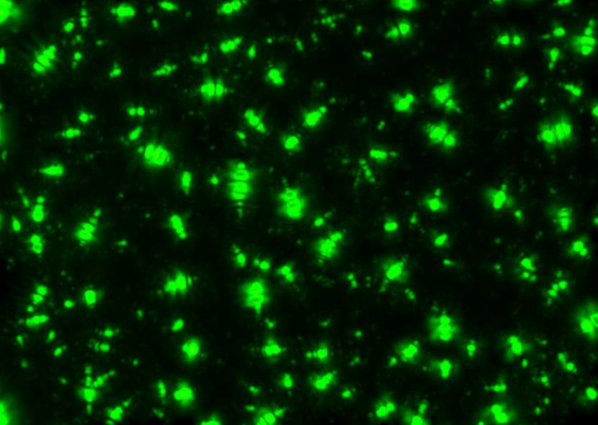
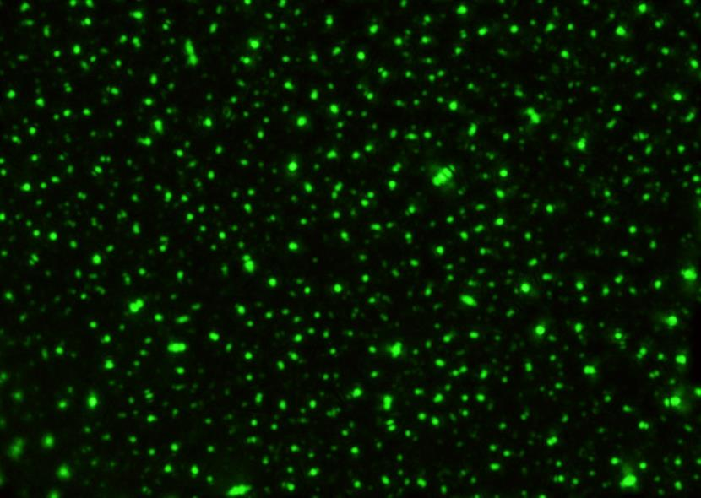

Challenges while Observing Bitumen Microstructure
THE SAME BITUMEN

Slide 3
Factors to Consider
Sample Preparation
  Homogeneity
  Heating Temperature and Time
  Impact of the Microscope
When is the best time to capturing the microstructure
  Different resting periods
  Comparing surface (brightfield) to subsurface (darkfield)

Slide 4
Using Microscopy to Characterize Bitumen
“Nice images” versus quantification
  How can we quantify bitumen microstructure?
  Which microscopic mode is most suitable?
Differentiation between:
  Crude oil source and refinery procedure
  Ageing state
  Specification class

Slide 5
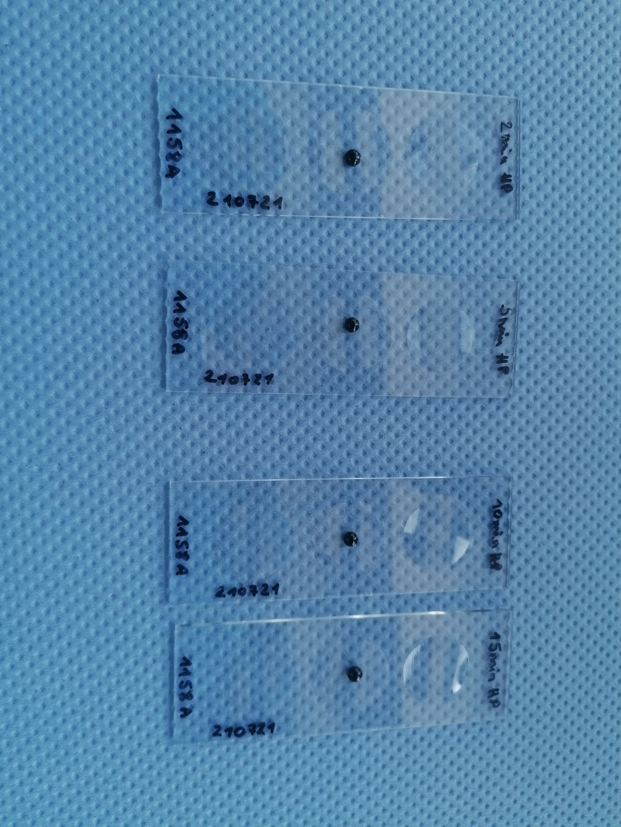
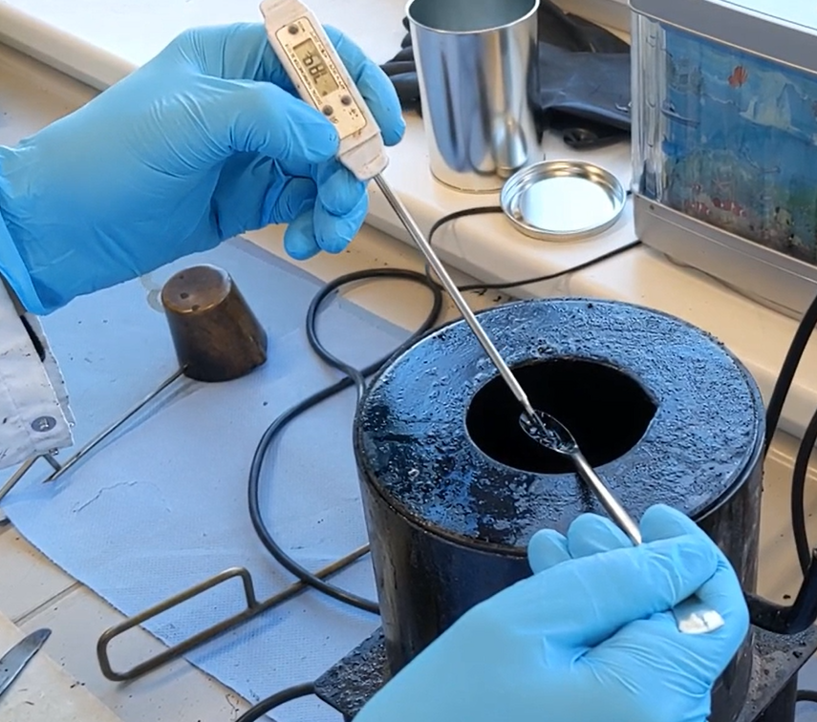
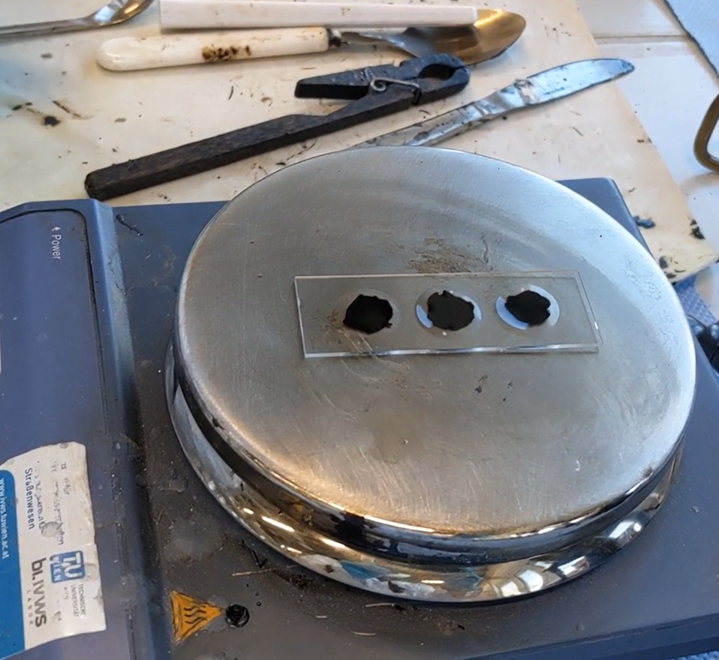
Sample Preparation
Homogeneity and thermal history of the sample
  Stirring with a thermometer
Selection of heating temperature and time
  Temperature between 100 – 180°C, 15 secs – 10 minutes
A
B
C

Slide 6
Microscopic Setup – Optical Microscopy
Microscope
LED
Inverse optical bright-, darkfield and fluorescence microscope
Lightsource: LED with 15 different LEDs
  500 nm
Brightfield:
  Collects all light
  Short exposure times (5 ms)
Darkfield:
  Collects all scattering light (45°)
  Longer exposure times (500 nm)
100x Nikon Plan Fluor objective
Nikon FI 3 digital camera
Camera
Filter Cube
BF/DF/FL
Nikon
Plan Fluor
100x
LED Controller
Objective
Intensity
LED 365: 100%
Sample
365
365
365
365
365
460
525
635
385
470
550
660
405
490
580
710
435
500
595
770
Motorized Stage

Slide 7
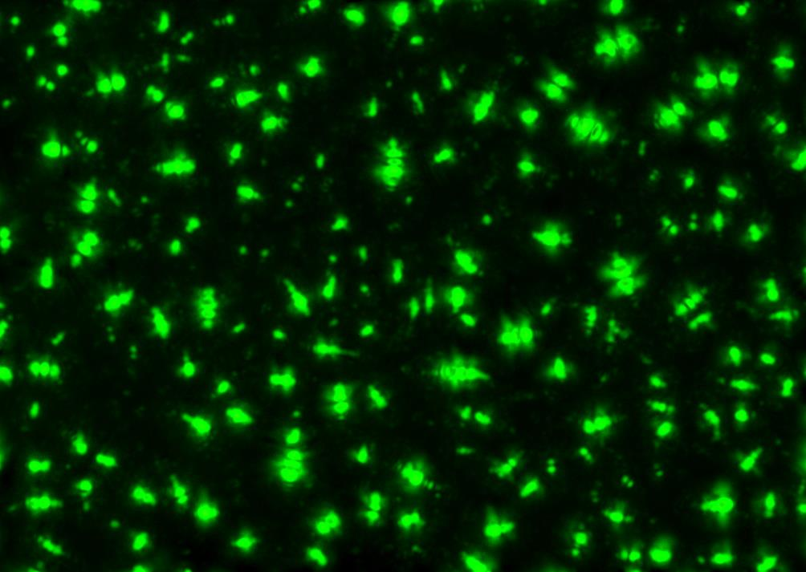
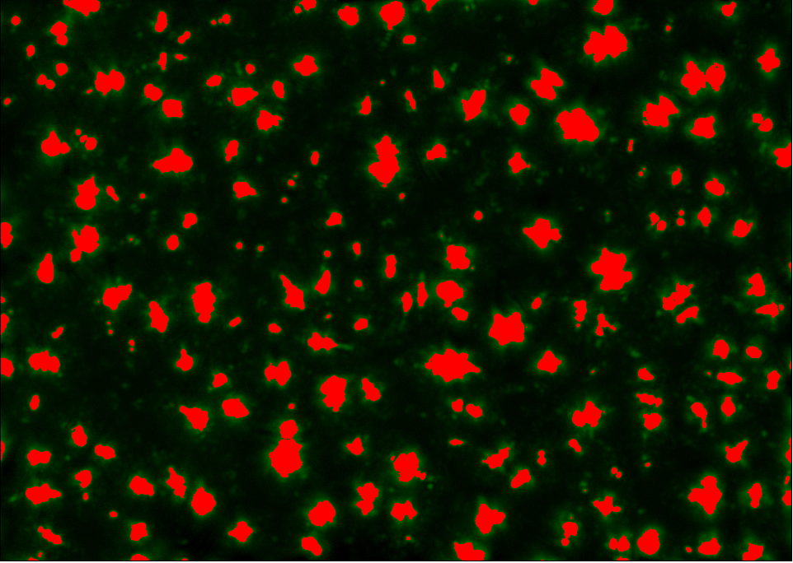
Quantification of Microstructure
Using dark field microscopic images → Best contrast
3 x 3 samples per bitumen
Using a freeware (ImageJ Fiji©)
Image evaluation based on:
Color threshold
Particle number and size

Slide 8
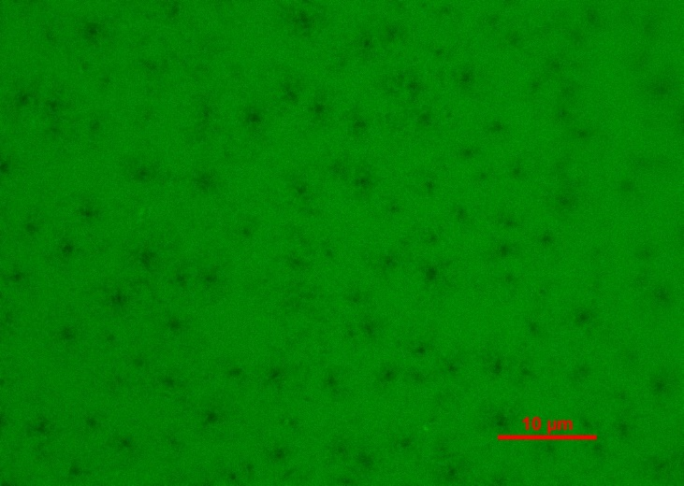
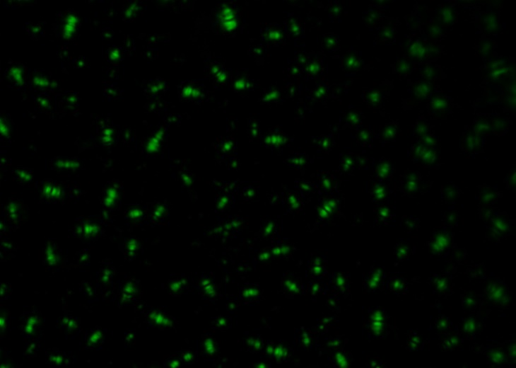
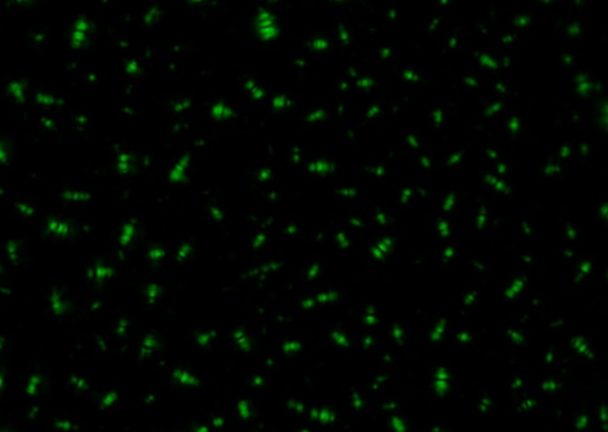


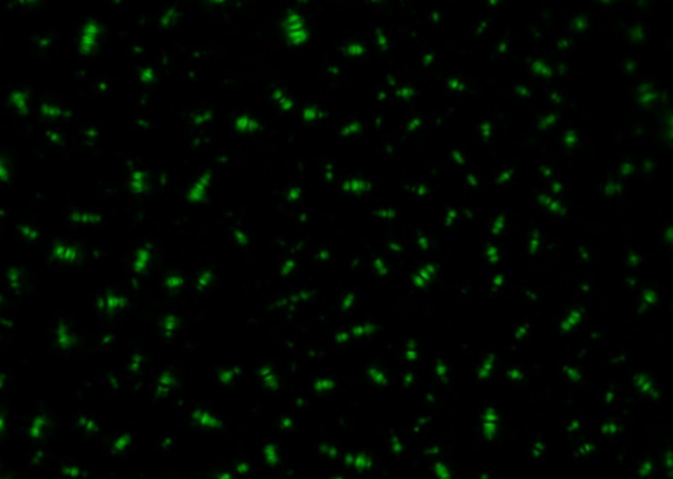

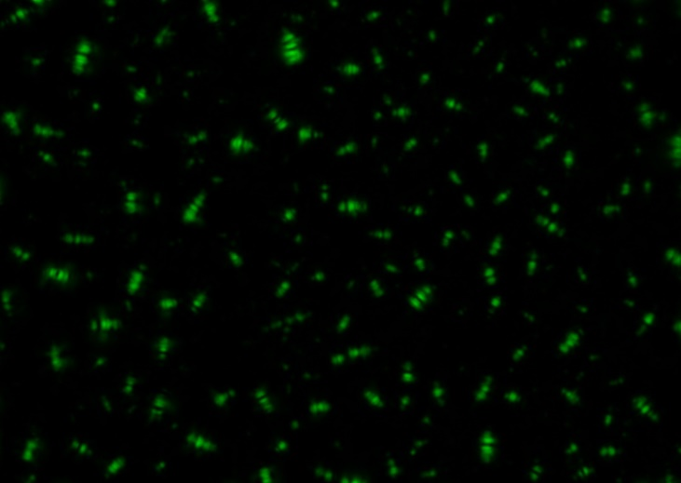
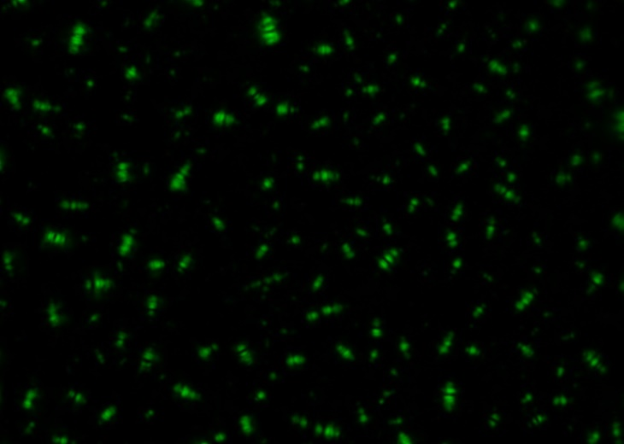


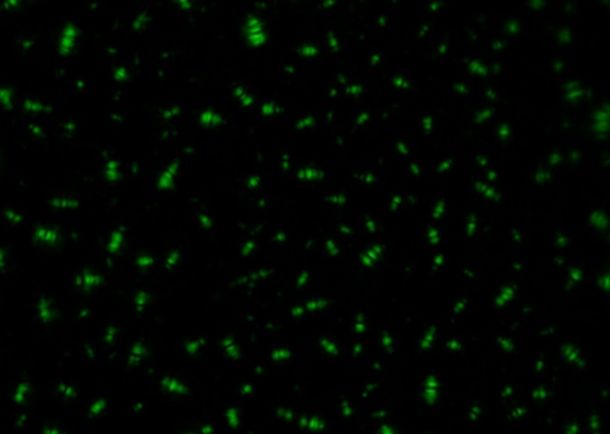
First Step: The Best Moment?
5 min
10 min
30 min
60 min
120 min
360 min

Slide 9
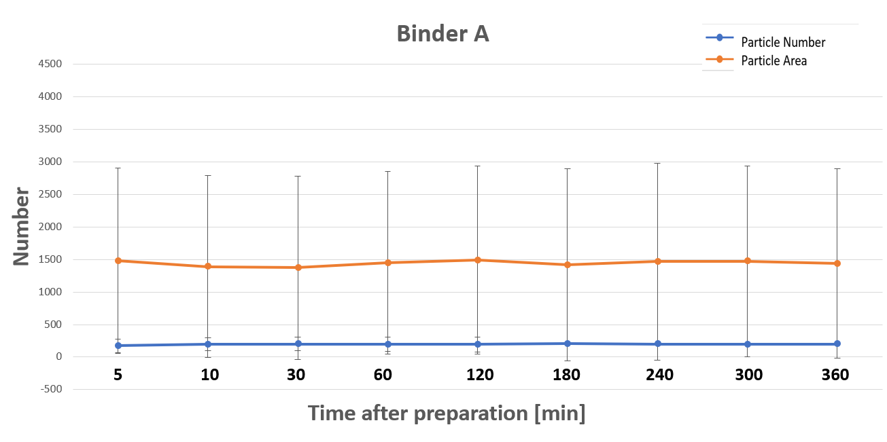
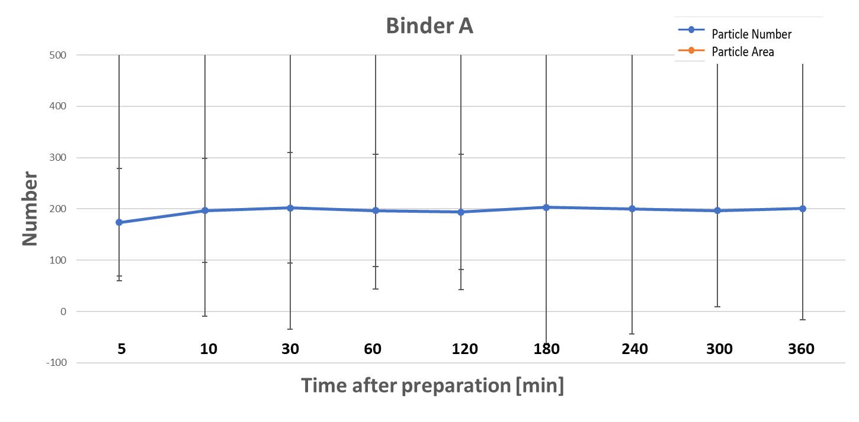
Darkfield Particle Analysis

Slide 10

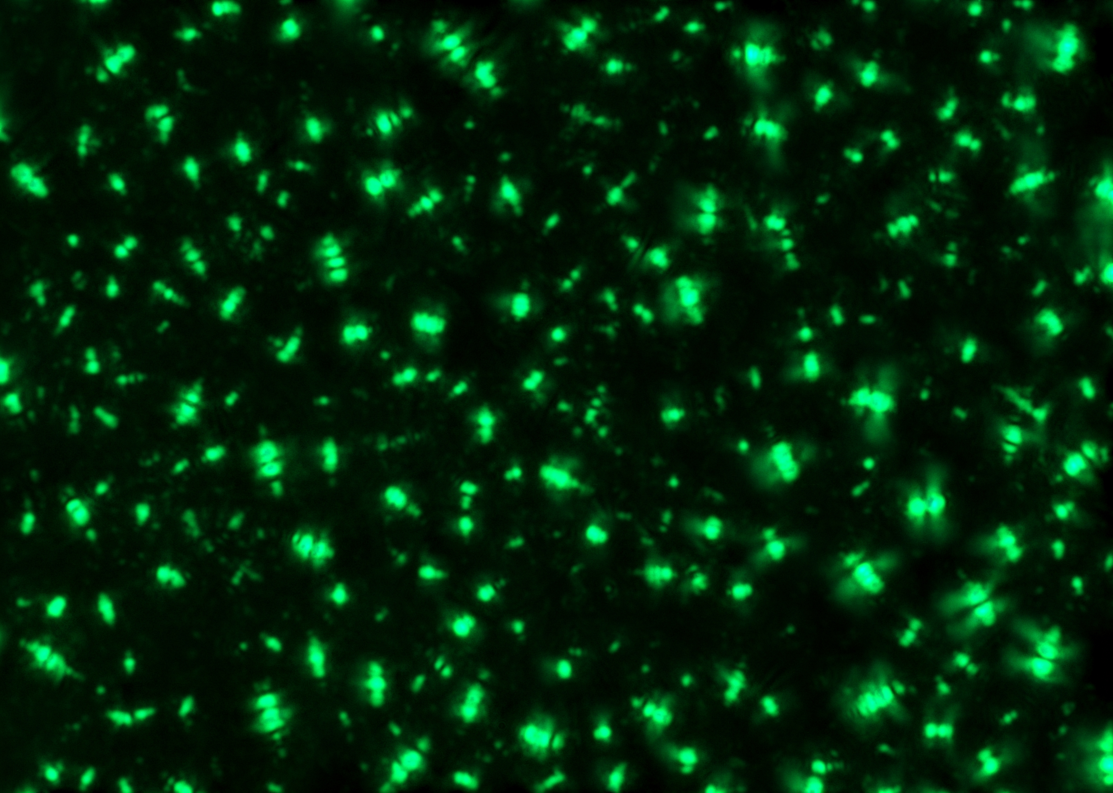
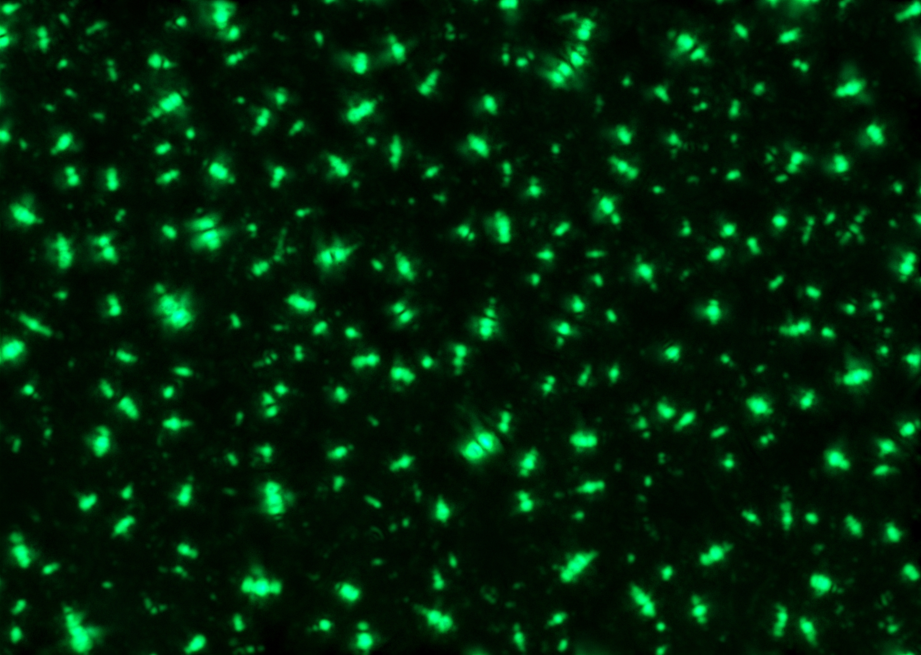

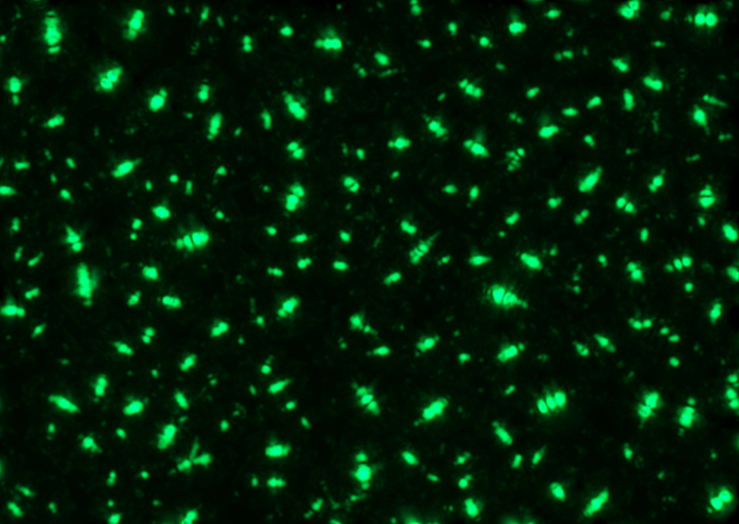
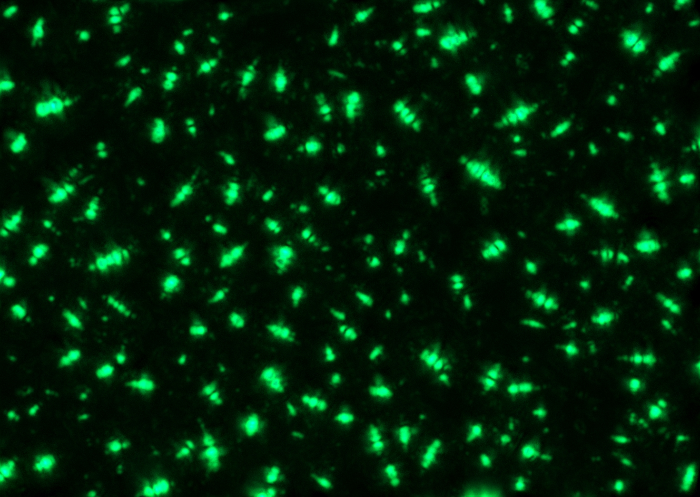


Second Step: Heating Time?
15 sec
30 sec
60 sec
120 sec

Slide 11
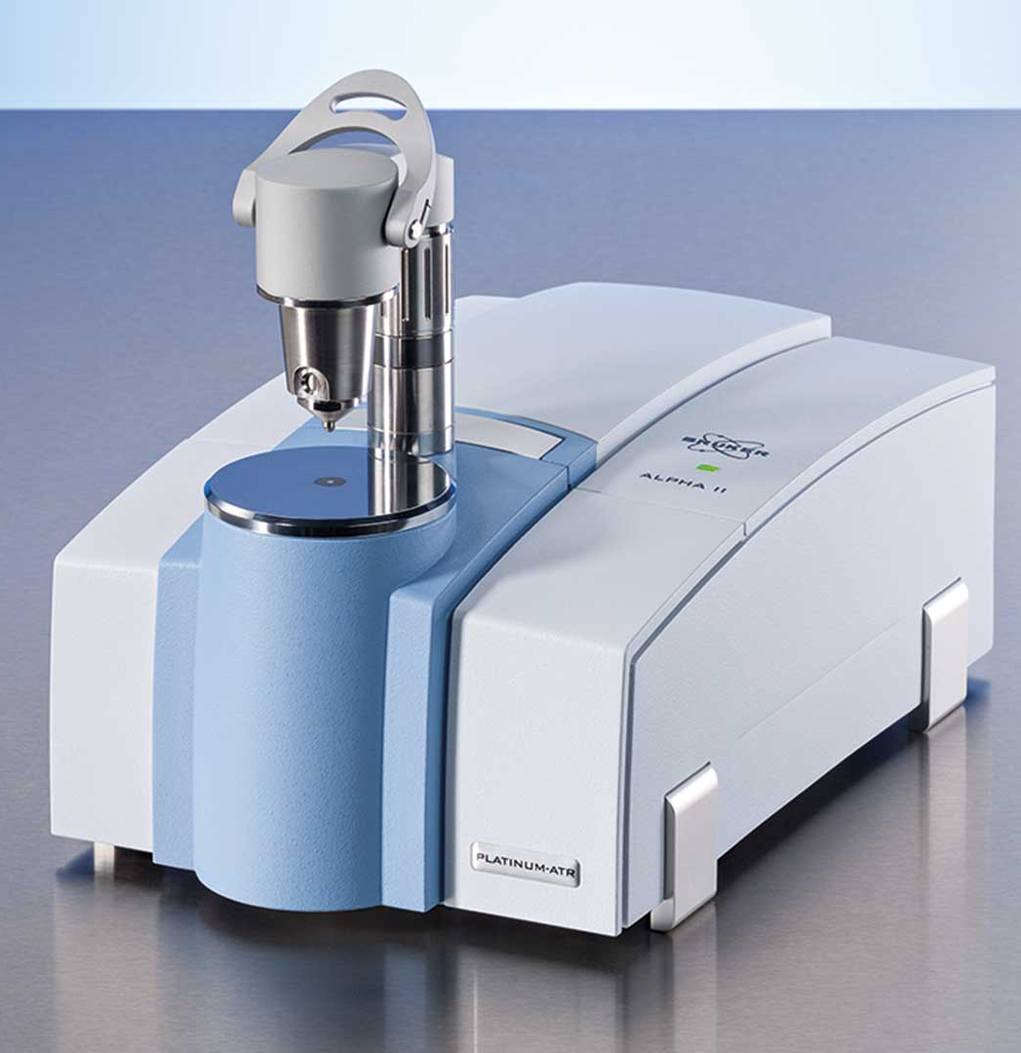
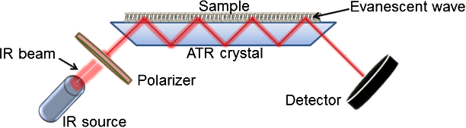
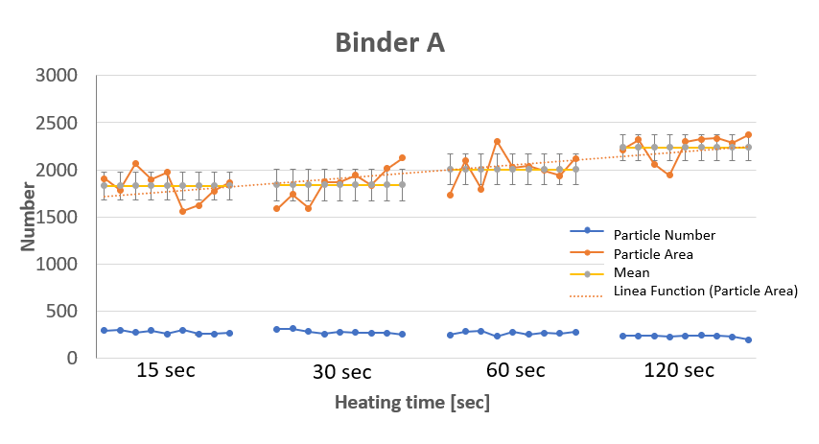
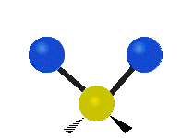
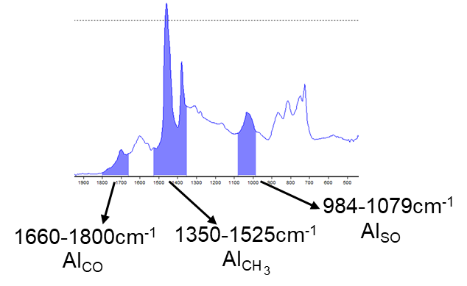

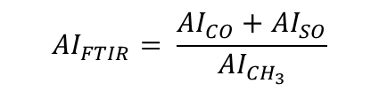
Impact of Heating Time and Microscope
https://www.bruker.com/de/products-and-solutions/infrared-and-raman/ft-ir-routine-spectrometer/alpha-ii-compact-ft-ir-spectrometer.html (23.08.2021)
Binder A
https://www.researchgate.net/figure/Schematic-representation-of-an-ATR-FTIR-system-The-infrared-beam-passes-through-the-ATR_fig1_275021699 (23.08.2021)
https://de.wikipedia.org/wiki/Deformationsschwingung (23.08.2021)
15 sec
30 sec
60 sec
120 sec

Slide 12


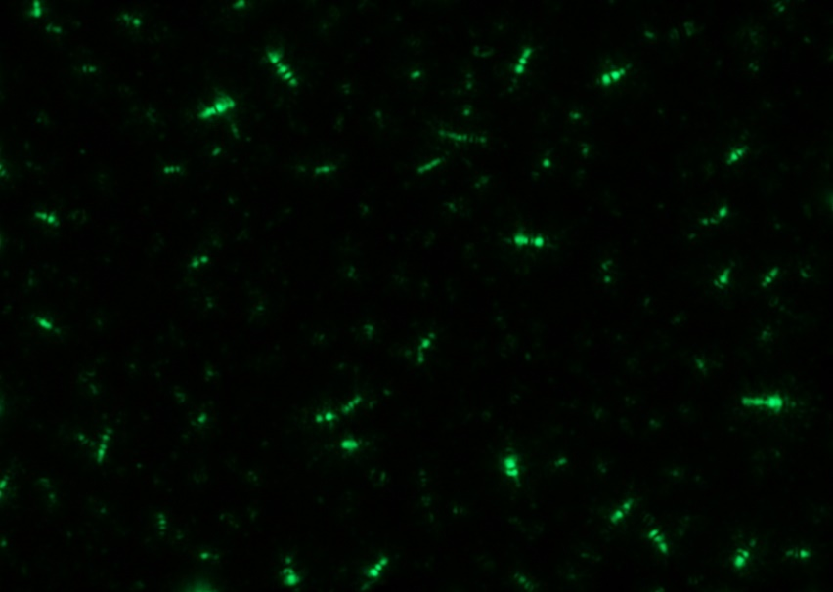
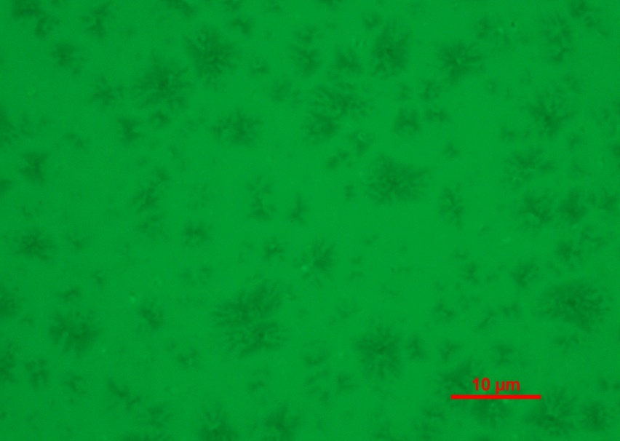
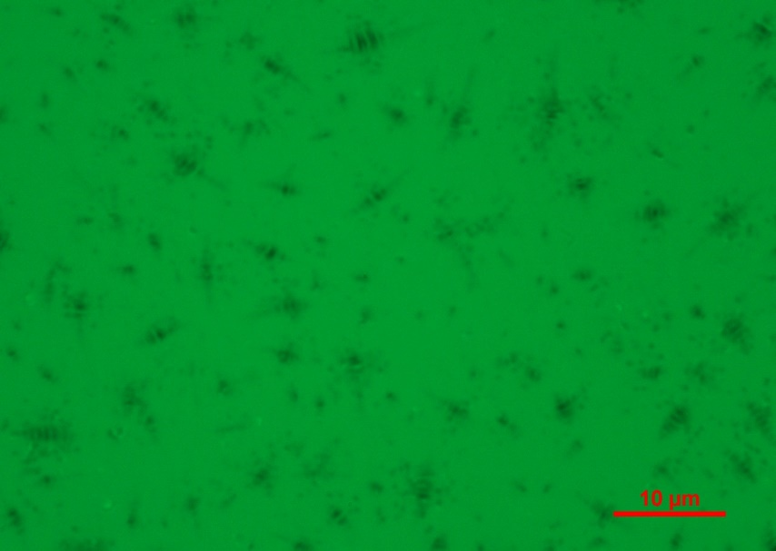
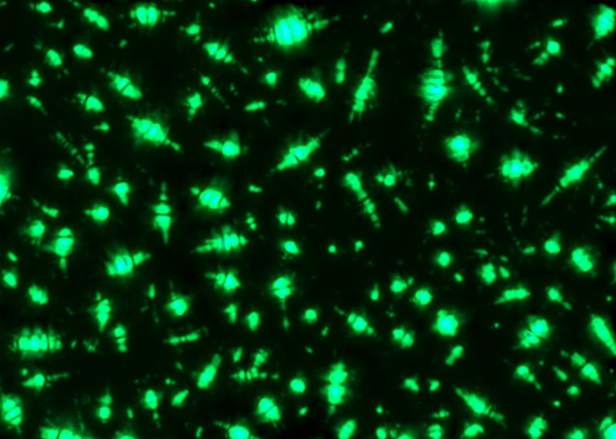
Comparing Different Crude Oil Sources
Binder A – 70/100 pen.
Binder B – 70/100 pen.
Binder C 70/100 pen.

Slide 13
Comparing Different Crude Oil Sources
Binder A
Binder B
Binder C

Slide 14
Comparing Different Crude Oil Sources
Binder A
Binder B
Binder C

Slide 15


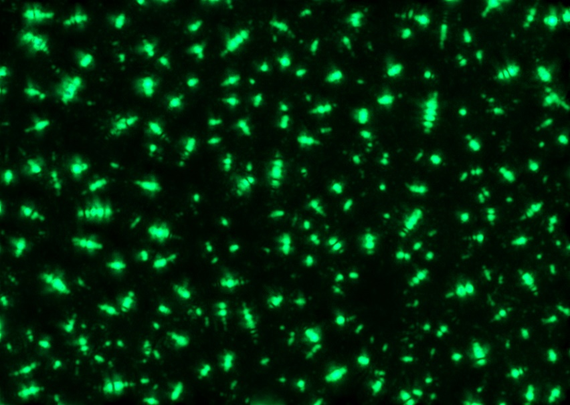
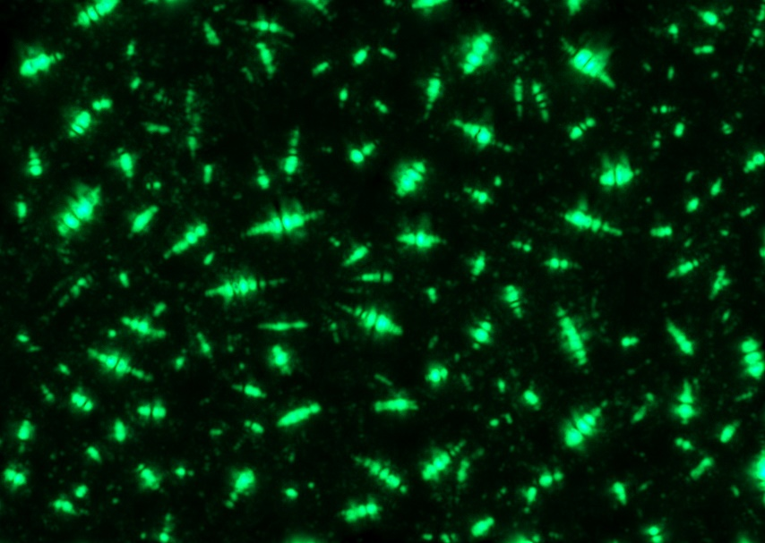
Comparing Different Ageing States
Binder A – 70/100 pen.
Binder A – RTFOT
Binder A – RTFOT+PAV

Slide 16
Comparing Different Ageing States
Unaged
RTFOT
RTFOT+PAV

Slide 17
Comparing Different Ageing States
Unaged
RTFOT
RTFOT+PAV

Slide 18


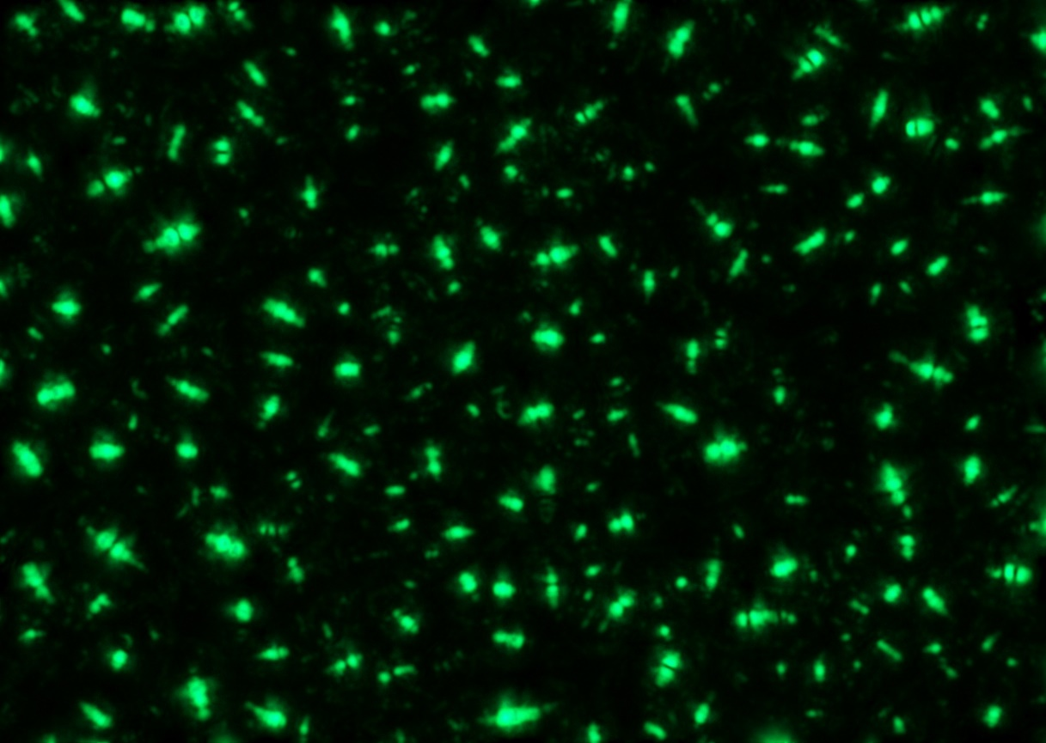
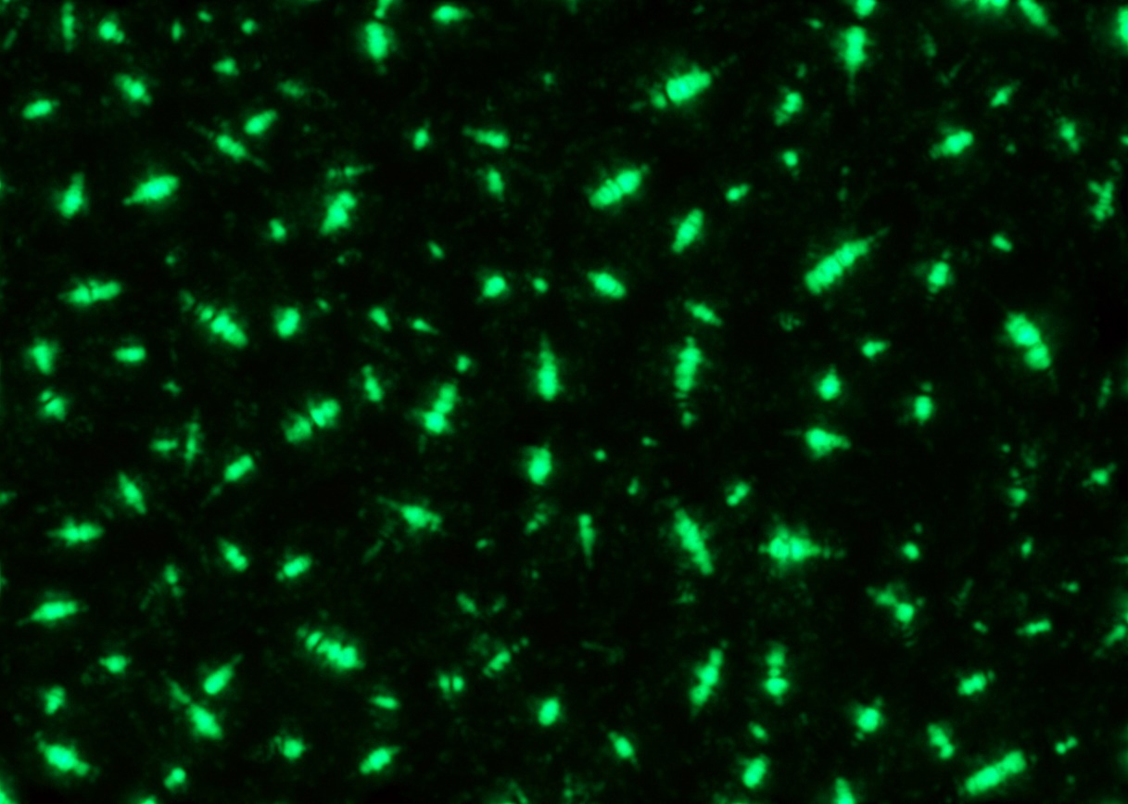
Comparing Different Specification Classes from the Same Crude Oil Source
50/70 pen.
160/220 pen.

Slide 19
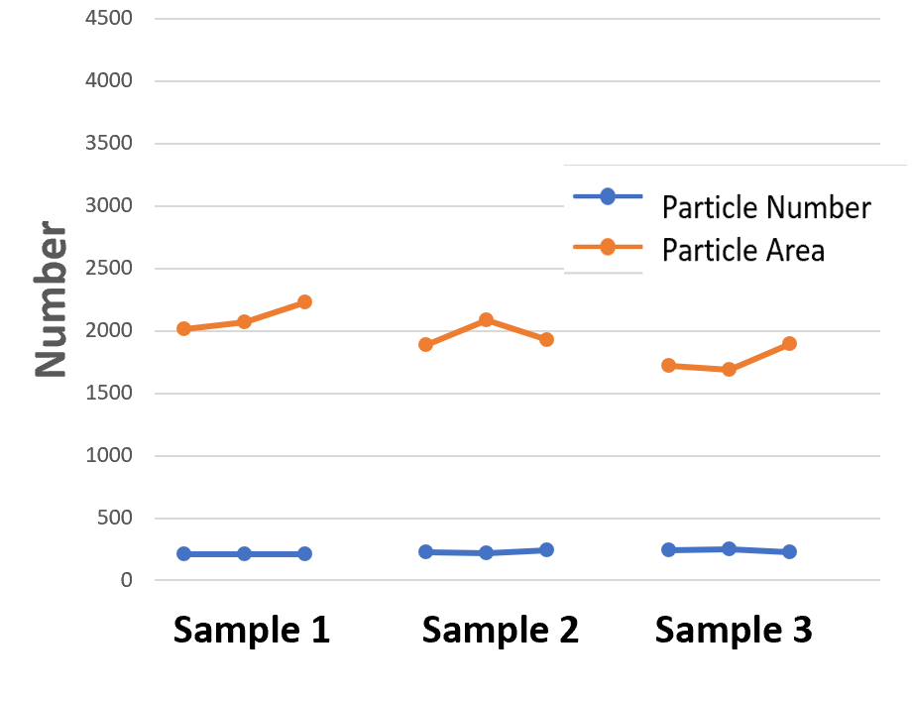
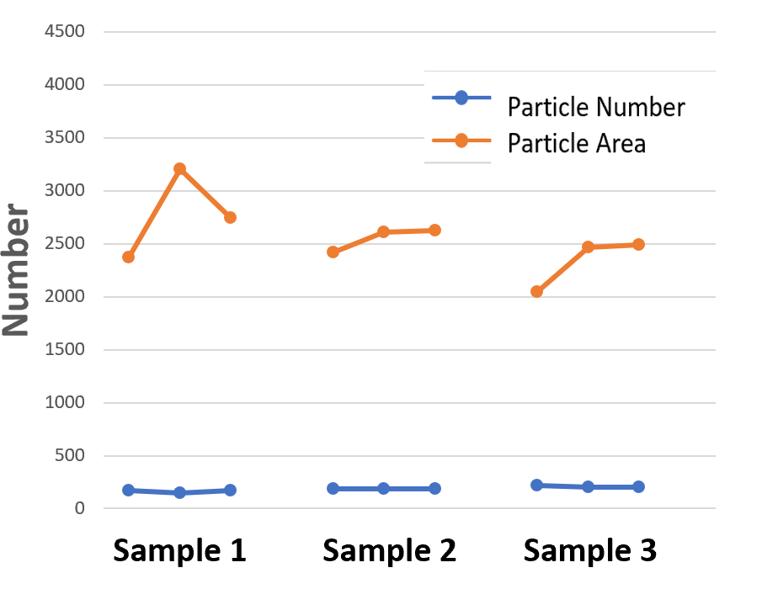
Comparing Different Specification Classes from the Same Crude Oil Source
50/70 pen.
160/220 pen.

Slide 20
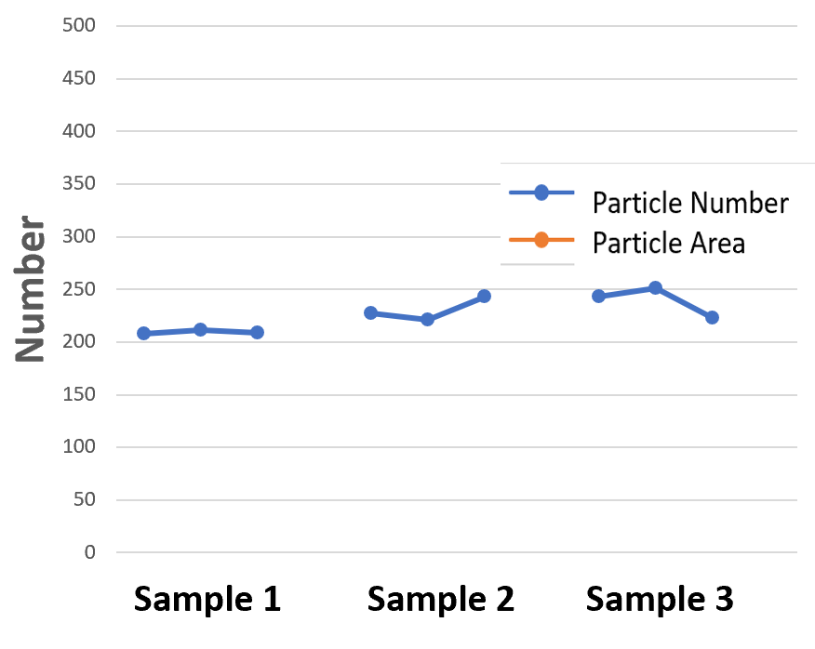
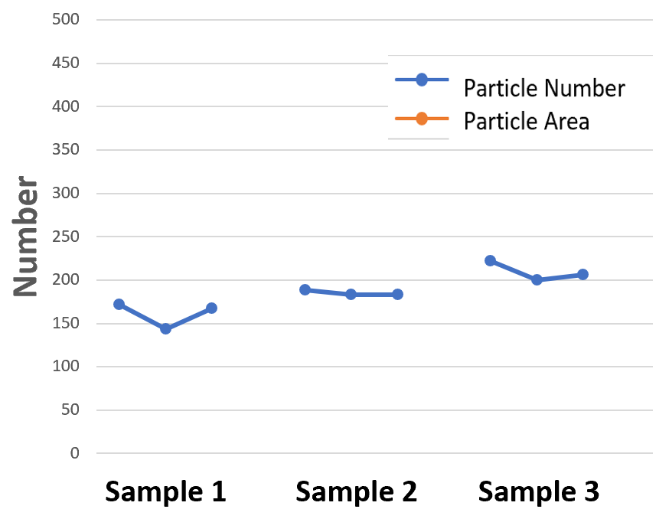
Comparing Different Specification Classes from the Same Crude Oil Source
50/70 pen.
160/220 pen.

Slide 21
Take Home Messages – What can we achieve with Microscopy so far?
Dark field microscopy can be used for particle analysis
Surface (brightfield) needs time to settle, while darkfield can be used immediately → 30 minutes recommended
Strict preparation routing
  Heavily depends on sample preparation → Thermal History!!!
  Small quantities age very rapid!
Different crude oil sources/refinery procedures can be distinguished
Different ageing states from the same bitumen are difficult
Different specification classes follow a small trend that can be distinguished

